Slide 1
Assessor Orientation
Office of Real Property Tax Services Educational Services

Slide 2
Assessor Orientation
Instructor / Session Information
(Optional)
Location Date/ Time
Name(s) / Title
address
phone
e-mail

Slide 3
Orientation Outline
Orientation Overview
Assessment Calendar
Real Property Defined
Data Collection & Maintenance
Sales Data
Complaint Form
Valuing Real Property
Exemptions Overview
Public Relations
Training and Certification
Additional References
Overview of Real Property Tax Offices

Slide 4
I. Orientation Overview

Slide 5
Orientation Overview
Orientation is designed to provide assessors and county directors with a general understanding of their responsibilities and the appropriate state and local government structure.
This material is provided to support County Director's in conducting Orientation training and as a resource to assist new assessors in their responsibilities.
The information is intended only to introduce the training that each local assessor must receive. It should not be cited as authority in any question of law.

Slide 6
II. Assessment Calendar

Slide 7
Assessment Calendar
Key *dates that affect the assessment process:
Valuation Date…………..…… July 1 preceding Year
Taxable Status Date………… March 1
Exemption Filing Deadline….. March 1
Tentative Roll Filed…………... May 1
Grievance Day……………….. 4th Tuesday in May
Final Roll Filed……………….. July 1
* Based on the standard assessment calendar

Slide 8
Assessment Calendar
Resources
Assessor’s Calendar | Handout that provides additional information on key dates that affect the assessment process
Fair Assessments | “Fair Assessments- A Guide for Property Owners” Explains the role of the assessor in the Assessment Process.
Real Property Tax Legislation | Links for a better understanding of Real Property Tax Law and Legislation.
Courses
Assessment Administration | To Lean more about the Assessment Process sign up for the Fundamentals of Assessment Administration course. Check the ORPTS Training Schedule for dates of availability.

Slide 9
III. Real Property Defined

Slide 10
Defining Real Property
Resources
Real Property Defined | Handout explaining how to Identify Real vs. Personal Property
Courses
Assessment Administration | To Learn more about the definition and identification of Real Property sign up for Assessment Administration. Check the ORPTS Training Schedule for dates of availability.

Slide 11
Equalization and Quantity Changes
Assessor’s Report Instruction for Cities and Towns
Reporting Operations Section
EQUALIZATION CHANGES - “CHANGE IN ASSESED VALUE CAUSED BY MARKET CHANGES”
REASSESSMENT ADJUST FOR EQUITY ECONOMIC OBSOLESCENCE
CHANGE IN ZONING CHANGE IN ECONOMIC STREAM
CHANGE IN LAND USE COURT-ORDERED REDUCTIONS
APPRECIATION SPLITS AND MERGES
DEPRECIATION REALLOCATION
PHYSICAL DETERIORATION UTILITY RETIREMENT IN PLACE

Slide 12
Equalization and Quantity Changes
QUANTITY CHANGES- “NONEQUALIZATION CHANGES”
INCREASE | DECREASE
CONSTRUCTION IN WHOLE OR IN PART IMPROVEMENTS RENOVATIONS | DEMOLITION FIRE
NEW EQUIPMENT (POLES, WIRES) | REMOVED EQUIPMENT
PLACEMENT OF A MOBILE HOME | REMOVAL OF A MOBILE HOME
LAND ANNEXED FROM AN ASSESSING UNIT | LAND DEEDED TO AN ASSESSING UNIT
OMITTED PROPERTY (RPTL 551) | DUPLICATE PARCEL
ACREAGE GAIN NOT AS A RESULT OF A SPLIT OR MERGE | ACREAGE LOSS NOT AS A RESULT OF A SPLIT OR MERGE
ROLL SECTION TRANSFER (From Roll Sections 5, 7 and/or 8 to Roll Sections 1, 3 and/or 6) | ROLL SECTION TRANSFER (From Roll Section 1, 3 and/or 6 to Roll Sections 5, 7 and/or 8)
OIL AND GAS RIGHTS (Increase due to production) | OIL AND GAS RIGHTS (Decrease due to production)

Slide 13
IV. Data Collection and Maintenance

Slide 14
Data Collection and Maintenance
Resources
Assessors’ Manual: Data Collection | Assessors’ Manuals are published by the Office of Real Property Tax Services and distributed to local assessors in order to help them perform their duties.
Real Property System (RPS) | Real Property System (RPS) software helps New York State real property local officials complete tasks related to assessing real property. The tasks include parcel maintenance, valuation querying and reporting
Courses
Fundamentals of Data Collection | To Learn more about Data Collection sign up for Fundamentals of Data Collection. Check the ORPTS Training Schedule for dates of availability.
Introduction to RPS V4 | To Learn more about RPS sign up for Introduction to RPS V4.

Slide 15
V. Sales Data

Slide 16
Sales Data
Resources
Sales Reporting | Information regarding RP-5217, Managing Sales Data, Usability Criteria, Sales Products, All Transfer Forms, SalesNet, and Governing Statutes.
Courses
Sales Data Management | To Learn more about Sales Data register for Sales Data Management within the ORPTS Training Portal.

Slide 17
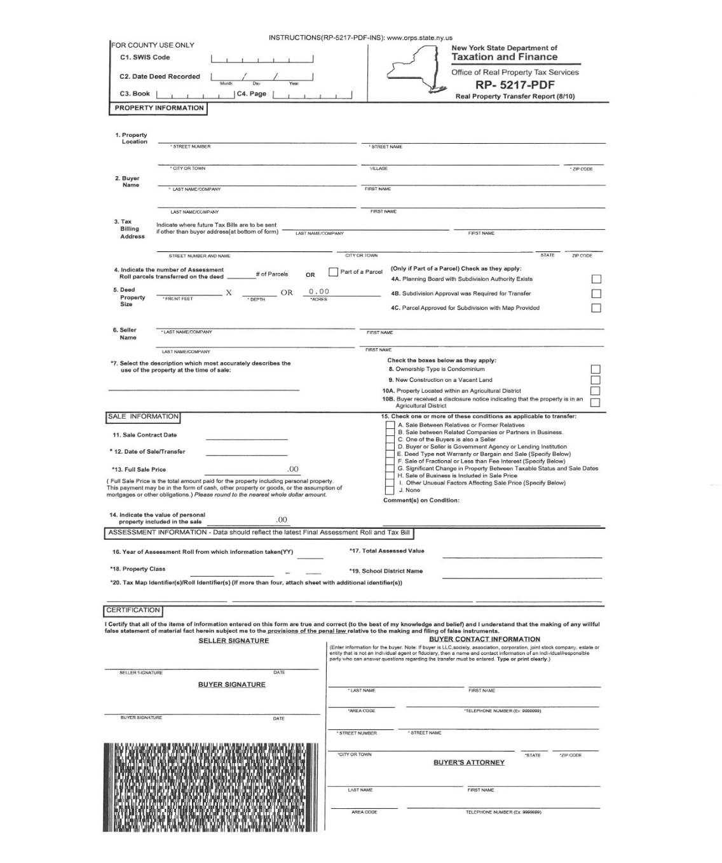
RP-5217
Real Property Transfer Report

Slide 18
VI. Complaint Process

Slide 19
Complaint Process
RP 524 – Complaint on Real Property Assessment
RP 524-Ins – Instruction for filing complaints
This form must be completely filled out so that parcel can be identified and to give the board a clear understanding of what is being requested
RPTL 730 – Small Claims Assessment Review
RPTL 730-Ins – Instructions for completing Small Claims Form

Slide 20
Complaint Form
RPTL 524 (3) requires complainants to file a written complaint on a prescribed form (RP-524)
Must include the tentative assessed value of the property as it appears on the assessment roll
the property owners estimate of market value (requested reduction from assessors value)
grounds for complaint
signed certification

Slide 21
VII. Valuing Real Property

Slide 22
Valuing Real Property
Resources
Value & Analysis Tools | Tools to assist with valuation principles
Valuation Standards | Valuation Standards provide the guidelines for valuing property in New York State for ad valorem real property taxation
Valuation Reference Manual Available in assessment community web portal | This volume of the Valuation Reference Manual (formerly known as Assessor’s Manual Vol. 7) is designed to provide users with a tool to calculate replacement costs for residential, farm, and commercial structures, an essential step completing the Cost Approach to valuation.
Courses
Cost, Market and Income Component | To learn more about Valuation sign up for courses equivalent to the Cost, Market and Income Component. These courses are not offered by ORPTS. See Educational Organizations Specializing in Appraisal Training.

Slide 23
Value Analysis Tools
Median Sales Trend
In order for a sale to be included in the above statistics it must be an arm’s length sale coded non-condominium. Further, the sale price must be greater than ten dollars and the number of days between the sale date and the contract date must be less than three hundred and sixty five or indeterminate.
Sales/Market Data
There are many uses for the data entered on the RP-5217 Real Property Transfer Report. Through this form, transfers of ownership of real property are changed on assessment rolls at the local level, and entered onto a sales database at the state level.
Valuation Standards
Valuation Standards provide the guidelines for valuing property in New York State for ad valorem real property taxation.

Slide 24
Value Analysis Tools
2011 Uniform Construction Index (UCI) Base Cost Tables
The UCI base cost tables is a tool to calculate replacement costs for industrial equipment and yard improvements, an essential step in completing the Cost Approach to valuation.
Valuation Reference Manual
This volume of the Valuation Reference Manual (formerly known as Assessor’s Manual Vol. 7) is designed to provide users with a tool to calculate replacement costs for residential, farm, and commercial structures, an essential step in completing the Cost Approach to valuation.
Cell Towers
This document provides information regarding the valuation of cell towers and associated real property.

Slide 25
Valuation Approaches
THE COST APPROACH
THE MARKET COMPARISON APPROACH
THE INCOME APPROACH

Slide 26
Data Items Used to Determine Value
LOCATION
SIZE
CONSTRUCTION MATERIALS
CONDITION
AGE

Slide 27
VIII. Exemptions Overview

Slide 28
Overview of Exemption Administration
Resources
Assessors Manual: Exemption Administration | Section 1 of Assessors Manual on Exemption Administration.
Exemption Publications | Listing of ORPTS Publications related to Exemptions.
STAR for Local Officials | The School Tax Relief (STAR exemption (Real Property Tax Law 425) provides a partial exemption from school taxes for most owner occupied primary residences.
Courses
Assessment Administration | To Lean more about the Assessment Process sign up for the Fundamentals of Assessment Administration course. Check the ORPTS Training Schedule for dates of availability.

Slide 29
IX. Public Relations

Slide 30
Overview of Public Relations
Resources
Public Relations Tools and Materials | A collection of tools and materials intended to assist assessors and county property tax directors with improving taxpayer understanding and perception of the assessment function.
Public Relations Recommendations | How to Improve the Public Perceptions of Your Efforts to Keep Assessment Rolls Up-To-Date. Recommendations from the Reassessment Public Relations Advisory Group
Courses
Assessment Administration | To Lean more about the Assessment Process sign up for the Fundamentals of Assessment Administration course. Check the ORPTS Training Schedule for dates of availability.

Slide 31
X. Training and Certification

Slide 32
Training & Certification Requirements
Resources
Educational Services Training Home | Contains links to training and qualifications information.
Qualifications and Certification Requirements | Minimum Qualifications and Basic Certification Training Requirements (See also Continuing Education Requirements).
Appointment and Certification Information | Sole Appointed Assessor appointment and certification information
Course Information
Training Schedule | Training schedule of all ORPTS sponsored courses. For Certification courses not sponsored by ORPTS see Educational Organizations Specializing in Appraisal Training.
Self Study Sessions | Self-led alternative to Classroom or Web-based training.
Web-based Training | Home page for ORPTS web based training program.

Slide 33
XI. Additional References

Slide 34
Additional References
Resources
Assessor’s Report Instructions Booklet | Assessor’s Report Instructions for Cities and Towns – Equalization & Tax Levy Distribution
A Self Review Guide for Assessing Units | Guidelines for Effective Assessment Administration in NYS.
PDC Reference Page - Guidelines for PDC | In a process known as pre-decisional collaboration, ORPTS works closely with assessors and counties to analyze market data to establish the LOA and measures of valuation uniformity.
Professional Organizations
NEW YORK STATE ASSOCIATION OF COUNTY DIRECTORS | A pamphlet explaining the role County Directors of Real Property Tax Services play in administering the real property tax in New York State.
Related Sites for Professional Organizations | NYS Association of Counties Association of Towns NYS Assessors’ Association International Association of Assessing Officers Appraisal Institute

Slide 35
Real Property Tax Law and Rules
Real Property Tax Law
New York Codes, Rules and Regulations – NYCRR
Adoptions
Emergency adoptions
Emergency readoptions
Five year rule review
Proposals

Slide 36
XII. Overview of Real Property Tax State and Local Offices

Slide 37
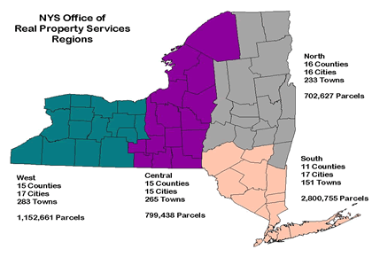
Overview ORPTS Regional offices
The Office of Real Property Tax Services (ORPTS) maintains its principal office in Albany and extends its operations through regional offices in Batavia, White Plains, Syracuse, and Albany.
The Division also maintains satellite offices in Ray Brook and Hauppauge.
See ORPTS Regional Offices for additional Information.
Regional offices provide a wide range of products and services.
See also ORPTS customer service teams.

Slide 38
Questions?

Slide 39
Summary
County Directors may print out a Certificate of Attendance to verify successful completion of the course.
Send by email to:
orpts.edservices@tax.ny.gov

