Slide 1


Income Tax Assistance Volunteer Training
TAX YEAR 2025
Notes:
Welcome to the Income Tax Assistance Volunteer Training for Tax Year 2025. I am (enter name), the (Title) for the (Division) at the New York State Department of Taxation and Finance. I am pleased to be presenting you this training. I would like to start by letting all of you know how valued you are to our Department. Your assistance to those taxpayers that need it most, through tax preparation and other financial literacy services, is essential to the communities you serve and to New York State as a whole. Our goal is to make sure you have the information you need to help others so let’s review our agenda.

Slide 2


Our Mission
To efficiently collect tax revenues in support of state services and programs, while acting with integrity and fairness in the administration of the tax laws of New York State.
Notes:
At the Tax Department, our mission is to efficiently collect tax revenues in support of state services and programs while acting with integrity and fairness in the administration of the tax laws of New York State.
The department is dedicated to providing fair tax administration to all taxpayers.

Slide 3
Compliance Continuum
A key department focus is the balance of efforts to promote voluntary compliance—the cornerstone of the State's system of taxation—with the duty to enforce New York's tax laws.
TAX DEPT
Publish forms, instructions and guidance
Assist and educate taxpayers
Capture return data and process payments
Resolve errors and issue bills
Propose tax legislation
Resolve protests
Audit
Collection
Litigation
Criminal enforcement
VOLUNTARY—LESS EXPENSIVE—MORE EFFICIENT
INVOLUNTARY—MORE EXPENSIVE—LESS EFFICIENT
Learn about tax obligations
File returns and make payments
Answer questions about filing errors
Review bills and pay or protest
Pay taxes found due after protest
Criminal enforcement defense
TAXPAYER
Review information
Undergo audit
Collection defense
Litigation defense
Notes:
A key department focus is the balance of efforts to promote voluntary compliance—the cornerstone of the State's system of taxation—with the duty to enforce New York's tax laws. More than 96 percent of the taxes collected are remitted voluntarily by taxpayers. The remaining 4 percent is a result of the department's enforcement programs—audit, collections, and criminal investigations.
So, while we will always have activities on the right side, the left side of the continuum is where we have tried to focus on improvement activities. This includes collection, litigation, and criminal enforcement.

Slide 4
Agenda
Partner Resources
Software Set-up
New York State Updates
Filing Requirements
New York Modifications
Pension Modifications
New York State Deductions
Personal Income Tax Credits
Taxpayer Resources

Slide 5

Online Training and Resources
Notes:
Access resources online training presentations and resources

Slide 6

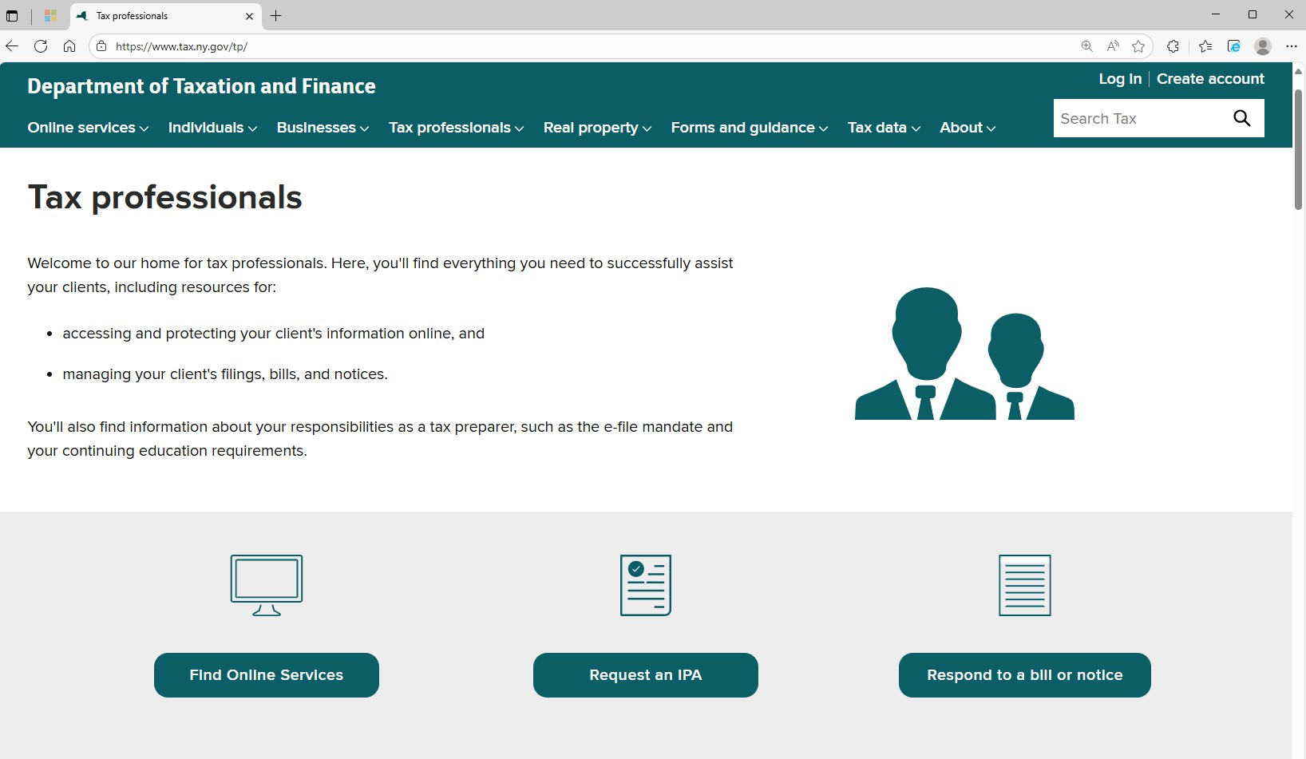
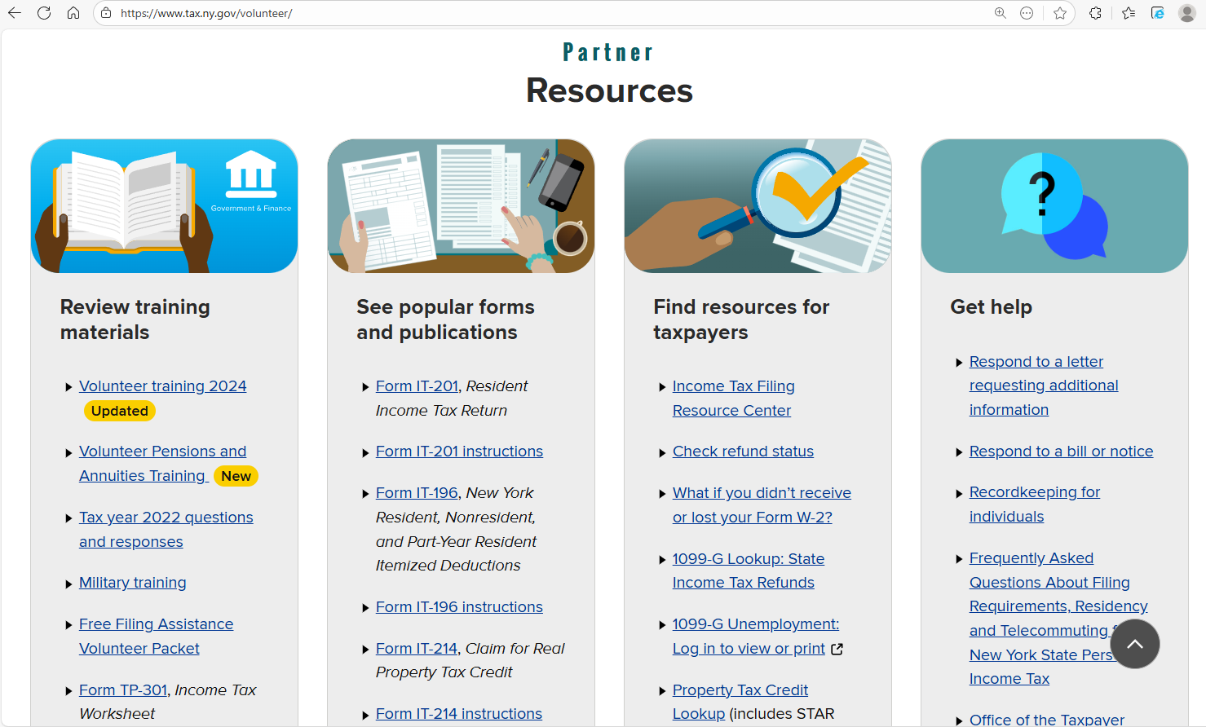

Volunteer Resource Center
Visit www.tax.ny.gov/volunteer
Notes:
From Volunteer Resource Center webpage Volunteer Income Tax Assistance (VITA) and Tax Counseling for the Elderly (TCE) partners can access New York State (NYS) tax training, tax forms and other resources to help train volunteers on preparing accurate NYS, New York City and Yonkers tax returns. Partners can request training support, order forms and view draft copies of notices their clients may have received. Partners can also email your questions to our Tax Partner email box: TaxPartners@tax.ny.gov

Slide 7
Training Materials
2025 Volunteer Training
Pension and Annuity Software Training
2025 Free Filing Assistance Volunteer Packet
Form TP-301, Income Tax Worksheet (2025)
Prior year’s training
Notes:
The Training Materials section includes all the training items that will help you throughout the season. It houses this training and the recorded version; a military personnel training which has specifics for those serving in the military; a link to the materials in the 2025 free file assistance volunteer packet, The TP-301 updated for 2025, the pension subtraction handout which helps answer questions on how taxation of pensions work and finally a link to a page which houses all of our older training presentations.

Slide 8
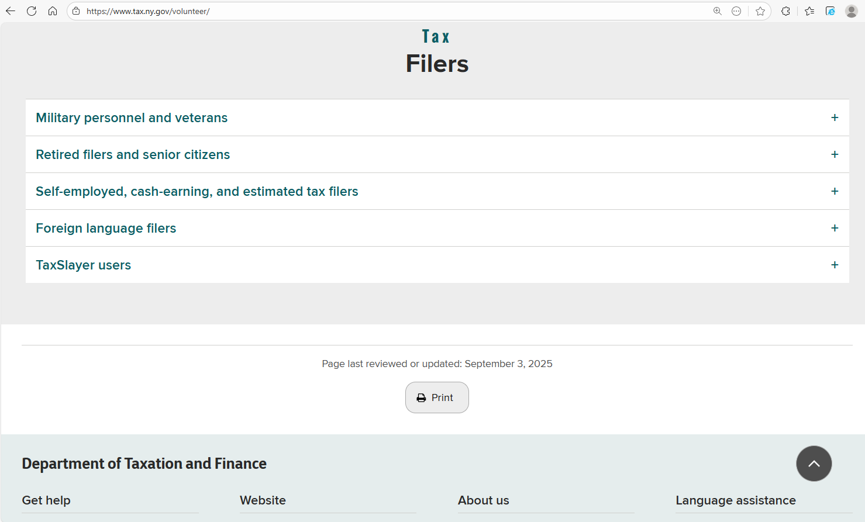
Volunteer Resource Center
Visit www.tax.ny.gov/volunteer
Notes:
At the bottom of the page, you will find information for:
Active military personnel and veterans
Retired person and senior citizens
The self-employed, cash-earners and estimated tax filers. I’ll touch on this section more in the next slide as this will impact the STEP partners
Foreign language filers; and,
Information and link to contact TaxSlayer Volunteer Support

Slide 9
Volunteer Packets and Forms
Request volunteer packets and forms:
Send requests to: taxpartners@tax.ny.gov
Include the following information:
Your name, email, and address (physical addresses only, no PO boxes)
Number of 2025 Free Filing Assistance Volunteer Packets (5 maximum)
Form type and quantity (TP-301 and NYC-210 only)

Slide 10
2025 Volunteer Packet
Volunteer Packets will include the following forms and instructions:
IT-201, Full-Year Resident Income Tax Return packet for New York State, New York City, Yonkers and MCTMT
Form IT-196, New York Resident, Nonresident, and Part-Year Resident Itemized Deductions
IT-225, New York State Modifications
IT-195, Allocation of Refund
IT-227, New York State Voluntary Contributions
IT-214, Claim for Real Property Tax Credit for Homeowners and Renters
Notes:
The Free Filing Assistance Packet has the main forms in it that are needed for filing. We include the IT 201 packet that has NYS, NYC and MCTMT in it, then the IT-196 for itemized deductions, the IT-225 for New York state modifications and the IT-195 which allows taxpayers to allocate any refund they having coming to them. I will discuss this later in the presentation.

Slide 11
2025 Volunteer Packet
Volunteer Packets will include the following forms and instructions:
Form IT-270, New York City Income Tax Elimination Credit
IT-268, Central Business District Toll Credit
NYC-210 and NYC-210-I, Claim for New York City School Tax Credit
DTF-215, The Earned Income Tax Credit - Recordkeeping Suggestions for Self-employed Persons
TP-301, Income Tax Worksheet
Note: additional supplies of some forms are available by mail during the filing season by emailing NYStax.SpecReq@tax.ny.gov.

Slide 12
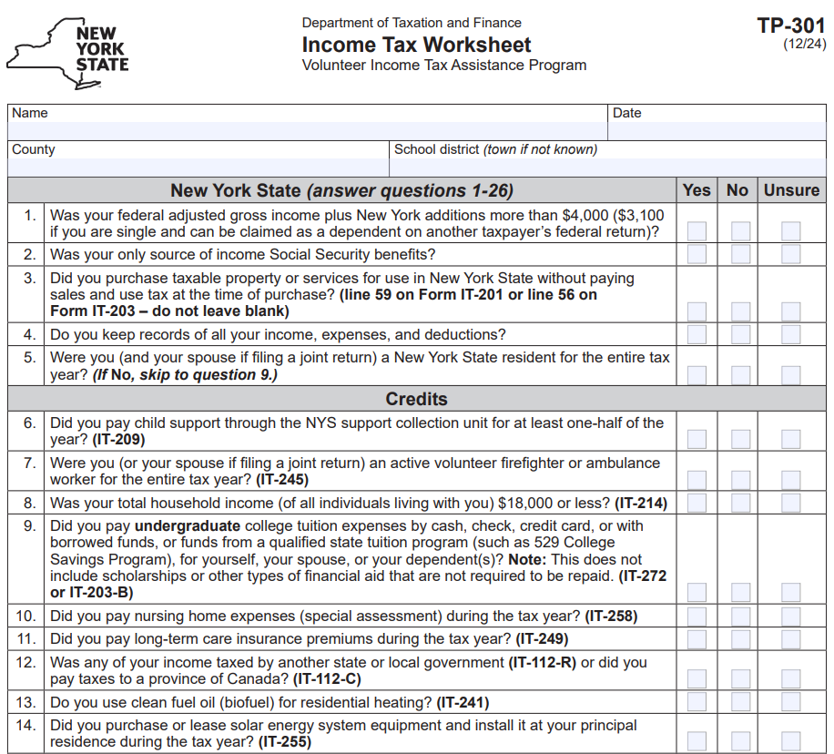
TP-301, Income Tax Worksheet
Includes all NY specific items that do not automatically carry forward from the federal return, including:
Additions such as state retirement contributions
Subtractions such as private and public employee pension exclusions
Credits that apply to NYS and NYC only
Notes:
Form TP-301, NYS Income Tax Worksheet - list all the items that are New York state specifics that would not automatically carry forward from the federal return:
Additions such as state retirement contributions
Subtractions such as Private and Public employee pension exclusions
Credits that apply to NYS and NYC only
Most partners use it as a training guide for volunteers and as a reference guide when preparing and quality reviewing returns. Some sites provide a copy to each taxpayer to complete along with the IRS intake sheet. It’s not required for you to give it to taxpayers; however, it’s a great practice to use it the preparing and reviewing stages to ensure you don’t miss anything on the NYS return.

Slide 13


Tax Professional Hotline
Available to tax professionals and volunteer preparers.
Limited or no wait time.
Experienced staff to answer more technical questions.
(518) 457-5451
Notes:
Available to tax professionals and volunteer preparers.

Slide 14

Software Set-up

Slide 15
E-file Mandate
All forms should be e-filed, either directly through software or by PDF attachment to the filing.
Volunteer preparers are not subject to e-file mandate.
New York State supports both linked and unlinked returns.
if the IRS does not accept a return, the state return can be submitted as an unlinked return
most software (including TaxSlayer and TaxWise) allow unlinked returns
Individual volunteer tax preparers should not sign tax returns
Note: tax returns must list the VITA/TCE site information
Notes:
New York State has a Personal income tax e-file mandate. We support both linked and unlinked returns. Even if the IRS will not accept a return, the state return can be filed as an unlinked return. Most software allows unlinked returns. All forms can be e-filed, either directly through software or by PDF attachment to the filing.

Slide 16
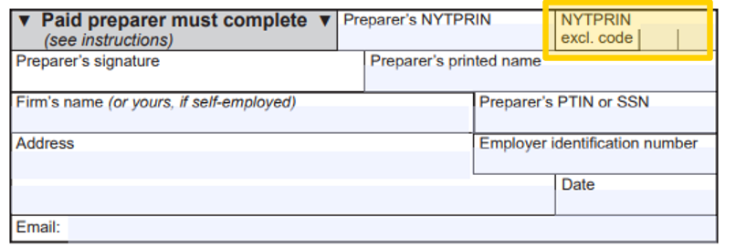
VITA/TCE Tax Preparer Code
Tax returns must include the site name and exclusion code 09, volunteer tax preparer
Notes:
You should make sure to use the 09 - volunteer tax preparer code in your program. You do not need to enter volunteers name in the software or on the tax returns.

Slide 17
Driver License Information
At the submission stage, taxpayers are required to provide their New York state driver license information, if they have it:
Driver license information protects taxpayers from fraud and identity theft.
Enter the required information from the driver license.
Note: Only the first three characters of the document number (Doc #) are required.
If the taxpayer won’t disclose their ID information:
You may check the box to indicate the taxpayer does not have an ID.
You must document you used due diligence to obtain the information, and the taxpayer refused.
Notes:
Drivers license ID information is used to protect taxpayers from fraud and identity theft. The document number for the primary taxpayer and spouse are required. Only the first three characters of the document number are required. If the taxpayer won’t disclose their ID information, you may check the box to indicate the taxpayer does not have an ID; and you must document you used due diligence to obtain the information, and the taxpayer refused.
Note: do not set up system to not ask for the driver license information – it is required by New York State.

Slide 18
Print All Worksheets
Give a copy of all worksheets to taxpayers:
For both the federal and New York State returns, worksheets must be completed to support the information on a tax return.
Taxpayers keep records and supporting documents for at least three years. It’s important that all worksheets be printed and kept with a copy of the return.
Taxpayers must maintain all documents that substantiate entries on a return. Worksheets are part of their supporting documentation.

Slide 19
Amended Returns and Attachments
We treat an amended return as the taxpayer is filing for the first time.
Submit all forms relevant to the information on the amended return, such as:
forms for any credits that are claimed or amended,
forms submitted as attachments to the original return that are still applicable (for example, IT-196, IT-227, IT-201-ATT, or IT-203-ATT), and
all wage and tax statements, such as Form IT-2.
Do not submit a copy of the original IT-201, IT-203, or IT-195.

Slide 20
Federal Changes
Taxpayers must file an amended New York State return within 90 days if the IRS made changes to the federal return.
Even if the item of omission is not taxable to New York State, it should be included on an amended return since it could result in reductions to itemized deductions and credits.
If New York State issues a bill for unreported federal changes, an amended return should not be filed. Follow the instructions on the notice.
Notes:
It’s important to mention to your clients that Taxpayers must file an amended New York State return to report any changes made to their federal return within 90 days of the federal change. Even if the item of omission is not taxable to New York State, it should be included on an amended return since it could result in reductions to itemized deductions and credits. If New York State issues a bill for unreported federal changes, an amended return should not be filed. Follow the instructions on the billing notice instead.

Slide 21
New York State and Local Sales Tax
New York State sales tax is owed if the taxpayer purchased an item or a service delivered to them in New York State without payment of sales and use tax. This includes:
Purchases through the internet, by catalog, or from shopping channels on the television.
Most tangible personal property is subject to tax.
Do not leave the line blank.
Do not set software to auto fill with zero amount.
Notes:
You must ask taxpayers if they have any sales tax owed. New York State sales tax is owed if the taxpayer purchased property or a service delivered to them in New York State without payment of sales and use tax. This includes purchases through the internet, by catalog, or from shopping channels on the television. Most tangible personal property is subject to tax. Do not leave the line blank. Do not set software to auto fill with zero amount.

Slide 22

New York State Updates
Notes:
Next, we’d like to highlight changes to New York State Income Tax, including changes to the:
Servicemembers Civil Relief Act of 2023,
Personal Income Tax Rates; and,
Metropolitan Commuter Transportation Mobility Tax (MCTMT).

Slide 23


Tax Due Date
Taxes are due: April 15, 2026

Slide 24
Inflation Refund Checks
The 2025-2026 New York State Budget provided for one-time inflation refund payments to eligible New Yorkers
Over 8 million inflation refund checks have been delivered to New York taxpayers
Eligibility based on tax year 2023:
filed Form IT-201, New York State Resident Income Tax Return;
reported income within qualifying thresholds; and
were not claimed as a dependent on another taxpayer’s return
Inflation refund checks were being mailed to eligible New Yorkers through the end of November
Visit www.tax.ny.gov (search: inflation)

Slide 25
Inflation Refund Checks
Check amounts are not taxable for New York State, New York City, or Yonkers resident income tax purposes.
Instructions for the following forms will be updated for taxpayers to subtract the check amount to the extent it was included in federal adjusted gross income:
Form IT-201-I: line 25
Form IT-203-I: line 24
Yonkers worksheet: line I
Visit www.tax.ny.gov (search: inflation)

Slide 26

Metropolitan Commuter Transportation Mobility Tax Calculation
The Metropolitan Commuter Transportation District (MCTD) is now divided into two zones:
Zone 1:
Zone 2:
includes the counties of New York (Manhattan), Bronx, Kings (Brooklyn), Queens, and Richmond (Staten Island).
includes the counties of Rockland, Nassau, Suffolk, Orange, Putnam, Dutchess, and Westchester.
Notes:
Calculating Metropolitan Commuter Transportation Mobility Tax (MCTMT) rate –
For tax years beginning on or after January 1, 2023, the MCTD is divided into two zones.
Zone 1 (includes the five boroughs of NYC)
Zone 2 (counties around NYC)

Slide 27
Self-employed Individuals Subject to the MCTMT
For tax years beginning on or after January 1, 2026, the MCTMT rates on net earnings from self-employment for individuals engaging in the business within MCTD are:
.60% (.0060) of the net earnings attributable to the MCTD within Zone 1, if such earnings exceed $150,000 for the tax year, and
.34% (.0034) of the net earnings attributable to the MCTD within Zone 2, if such earnings exceed $150,000 for the tax year.
The $150,000 thresholds are computed on an individual basis for each zone, even if you file a joint income tax return.
Visit www.tax.ny.gov (search: mctmt)
Notes:
For self-employed individuals, the budget provided relief by raising the exemption threshold from $50,000 to $150,000.
For tax years beginning on or after January 1, 2026, the MCTMT rates on net earnings from self-employment for individuals engaging in the business within MCTD are:
.60% (.0060) of the net earnings attributable to the MCTD within Zone 1, if such earnings exceed $150,000 for the tax year, and
.34% (.0034) of the net earnings attributable to the MCTD within Zone 2, if such earnings exceed $150,000 for the tax year.
Note: The $150,000 thresholds are computed on an individual basis for each zone, even if you file a joint income tax return.

Slide 28
Federal Legislation H.R. 1 (Public Law 119-21)
New federal deductions: H.R. 1 provides new temporary deductions for individuals, including tipped income, overtime pay, seniors (aged 65+), and auto loan interest.
Federal adjusted gross income (FAGI): is the starting point for computing New York State tax income tax.
New York tax treatment: As the new federal deductions under H.R. 1 are taken after the computation of FAGI, they will not flow through to New York unless the state specifically acts to adopt the changes.
Notes:
Federal provisions from House Resolution 1 include new temporary deductions for individuals, including deductions for tipped income, overtime pay, seniors (aged 65+), and auto loan interest.
When computing New York State tax income tax, the starting point is federal adjusted gross income.
As the new federal deductions under H.R. 1are taken after the computation of FAGI, they will not flow through to New York unless the state specifically acts to adopt the changes.
See New York State forms and instructions for additional information on how House Resolution 1 will impact NYS.
NOTE: THIS IS THE CURRENT TAX TREATMENT, AND THAT COULD CHANGE. The state budget process starts in January.
Reminder: The legislature passes tax legislation. The Tax Department is the administrator of the tax law.

Slide 29

Filing Requirements

Slide 30
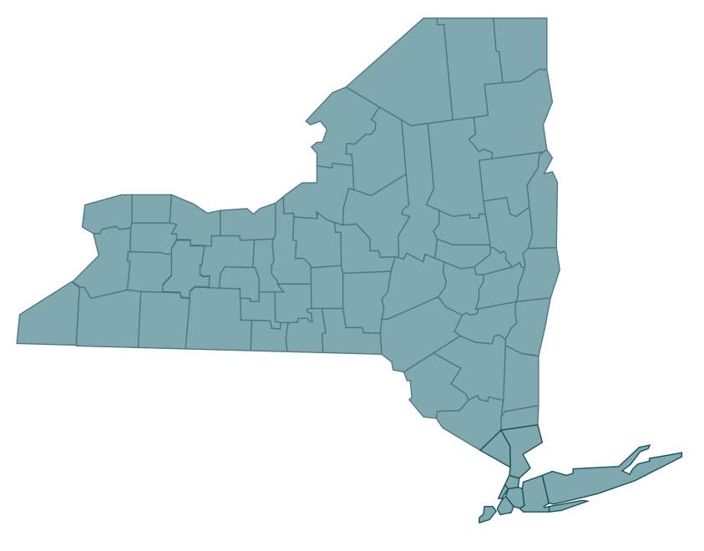
Determine New York State Filing Status
New York State filing requirements are based on the taxpayer’s resident status as one of the following:
Resident,
Nonresident, or
Part-year resident.
Notes:
When filing a New York state return the first thing you must determine is residency. You need to know if the taxpayer Is a resident, non-resident, or part-year resident.

Slide 31
Filing Requirements
Full-year New York State residents file Form IT-201, Resident Income Tax Return.
Taxpayers who are a nonresident of New York and have income from New York State sources file Form IT-203, Nonresident and Part-Year Resident Income Tax Return.
Taxpayers are considered a part-year resident if they meet the definition of resident and nonresident for only part of the year.
Part-year residents file Form IT-203, Nonresident and Part-Year Resident Income Tax Return.
Visit www.tax.ny.gov (search: definitions)
Notes:
If the taxpayer is a resident for New York State income tax purposes and is required to file an income tax return, they will need to file Form IT-201, Resident Income Tax Return.
If the taxpayer is a part-year resident or nonresident for New York State income tax purposes and is required to file an income tax return, they will need to file Form IT-203, Nonresident and Part-Year Resident Income Tax Return.

Slide 32
New York State Resident Filing Requirements
Taxpayers must file a New York State resident income tax return if they meet any of the following conditions:
they’re required to file a federal return;
they’re not required to file a federal return but their federal adjusted gross income plus New York additions is more than $4,000 ($3,100 or more if the taxpayer is single and can be claimed as a dependent on another taxpayer’s federal tax return);
they want to claim a refund of any New York State, New York City, or Yonkers income taxes withheld from their pay, or from UI benefit payments; or,
they want to claim New York refundable or carryover credits.
Notes:
Taxpayers must file a New York State resident return if:
they’re required to file a federal return;
($3,100 or more if the taxpayer is single and can be claimed as a dependent on another taxpayer’s federal tax return);
they want to claim a refund from any New York State, New York City, or Yonkers income taxes withheld from their pay; or
they want to claim New York refundable or carryover credits.

Slide 33
New York State Residency
Taxpayers are a New York State resident for income tax purposes if:
their domicile is New York State (see Exception); or
they maintain a permanent place of abode in New York State for substantially all of the taxable year; and spend more than 184 days in New York State during the taxable year, whether or not they are domiciled in New York State for any portion of the taxable year.
Exception: If the taxpayer’s domicile is New York but they meet all three of the conditions in either Group A or Group B, they are not a New York State resident. See the Tax Department’s website for more information.
Visit www.tax.ny.gov (search: definitions)
Notes:
To be considered a resident of New York State for tax purposes, an individual must fall into one of two categories.
Domiciliary: the taxpayer's domicile is New York State. Meaning their permanent home is located in New York.
Statutory Resident: the taxpayer's domicile is not of New York State, but:
the taxpayer maintains a permanent place of abode in New York State; and
the taxpayer spends more than 184 days in New York State.

Slide 34
Servicemembers Relief Act (Public Law 117-333)
New York State conforms to the Servicemembers Civil Relief Act (SCRA).
Under SCRA, a service member (and their spouse) may each elect, for purposes of taxation, any of the following (regardless of the date they were married):
the residence or domicile of the servicemember,
the residence or domicile of the spouse, or
the permanent duty station of the servicemember.
Important: to make this election, enter the applicable special condition code on the IT-201 or IT-203 return.
Visit www.tax.ny.gov (search: military)
Notes:
We mentioned the Servicemembers Relief Act last year, but we want to remind tax professionals of important provisions that impact servicemembers and their families.
2023 amendments allow servicemembers, and their spouses, greater flexibility to choose their state of domicile for tax purposes.
Under SCRA, servicemembers and their spouse can elect any of the following:
For more information on the Servicemembers relief act and how to report on the IT-201 and 203, visit our website Search military.
SCRA is not automatic.
For more information, visit our website and search “military”

Slide 35
Permanent Place of Abode
In general, a permanent place of abode is a residence (a building or structure where a person can live) that:
a taxpayer permanently maintains, whether owned or not; and
is suitable for year-round use.
Notes:
What is a permanent place of abode? It’s a residence (a building or structure where a person can live) that you permanently maintain, whether you own it or not, and is suitable for year-round use. A permanent place of abode usually includes a residence that your spouse owns or leases.

Slide 36
Nonresidents: New York Source Income
Nonresidents of New York State are subject to New York State tax on income derived from New York State sources.
New York source income includes, but is not limited to:
certain real or tangible personal property located in New York State;
services performed in New York State;
a business, trade, profession, or occupation carried on in New York State whether or not as an employee;
a New York S corporation in which the taxpayer is a shareholder.
For a full list of items considered New York source income, review the instructions for Form IT-203.
Notes:
Taxpayers may have to file a New York State return if they're a nonresident of New York and they have income from New York State sources.
See the instructions for Form IT-203 for a list of items considered New York sourced income.
Examples include:
services performed in New York State;
business, trade, profession, or occupation carried on in New York State

Slide 37

Nonresident and Part-Year Resident Income Allocation
Nonresidents and Part-year residents are required to file Form IT-203-B with Form IT-203, if the taxpayer:
marked “yes” in item H, indicating they or their spouse maintained living quarters in NYS in 2025 (return currently rejects in this scenario if IT-203-B is not attached); or
earned salary or wages both inside and out of NYS during 2025 (workdays in and out of New York need to be entered), or
is claiming the college tuition itemized deduction.
Form IT-203-B, Nonresident and Part-Year Resident Income Allocation

Slide 38
Telecommuting Rules
For nonresidents whose primary office is in New York State, days telecommuting are considered days worked in the state unless the employer has established a bona fide employer office at the telecommuting location.
For more information, see TSB-M-06(5)I, New York Tax Treatment of Nonresidents and Part-Year Residents Application of the Convenience of the Employer Test to Telecommuters and Others.
Visit www.tax.ny.gov (search: nonresident-faqs)
Notes:
For nonresidents and part-year residents whose primary office is in New York State, any work day spent telecommuting outside of New York are considered days worked in the state unless the employer has established a bona fide employer office at their telecommuting location.
There are a number of factors that determine whether your employer has established a bona fide employer office at your telecommuting location. In general, unless your employer specifically acted to establish a bona fide employer office at your telecommuting location, you will continue to owe New York State income tax on income earned while telecommuting.

Slide 39
New York City or Yonkers Residents
Taxpayers must report New York City resident income tax or Yonkers resident income tax surcharge on their state return if they:
were a New York City or Yonkers resident for the tax year, and
are required to file a New York State return.
New York City includes the Bronx, Brooklyn, Manhattan, Queens, and Staten Island.
Taxpayers who changed their New York City or Yonkers resident status during the year must complete Form IT-360.1, Change of City Resident Status and include with Form IT-201 or IT-203.
Form IT-360.1, Change of City Resident Status

Slide 40
New York Resident Credit
Taxpayers who were a full-year or part-year resident of New York State, and had income sourced to and taxed by another state, a local government within another state, or the District of Columbia, may claim a credit against their New York State tax.
This credit is allowable only for the portion of the tax that applies to income sourced to and taxed by the other taxing authority while you were a New York State resident.
Form IT-112-R, New York State Resident Credit

Slide 41
Summary of NYS Income Tax Return
Adjustments to income
Federal Adjusted Gross Income
New York additions and subtractions
New York Adjusted Gross Income (NYAGI)
Standard or New York Itemized Deductions
NY Taxable Income
Credits
Federal Adjusted Gross Income (FAGI)
Notes:
Once you know if a taxpayer is a resident or not and that they need to file here is the general flow of the New York State tax return. The New York Return is based off of the federal return with adjustments and modifications. The flow starts with the same income items from the Federal Return that you put in Federal Adjusted Gross Income, but we have adjustments to that income to give you the federal adjusted gross income. From there we have New York specific additions and subtractions to arrive at New York Adjusted Gross Income. We then deduct a New York standard deduction or New York itemized deduction to arrive at NY taxable income. Taxable income is used to compute the tax which is further reduced by tax credits.
We will now go through each section highlighting where we are unique.

Slide 42

New York Modifications
Notes:
Next we will discuss addition and subtraction modifications, first let’s explain why we have these modifications.

Slide 43
New York State Modifications
New York adjusted gross income (NYAGI) is federal adjusted gross income after certain New York additions and New York subtractions (modifications).
New York State taxes certain items of income not taxed by the federal government. Taxpayers must add these New York additions to FAGI.
Similarly, New York State does not tax certain items of income taxed by the federal government. Taxpayers must subtract these New York subtractions from FAGI.
Form IT-225, New York State Modifications
Notes:
New York State taxes certain items of income not taxed by the federal government. Taxpayers must add these New York additions to FAGI.
Similarly, New York State does not tax certain items of income taxed by the federal government. Taxpayers must subtract these New York subtractions from FAGI.
New York adjusted gross income (NYAGI) is federal adjusted gross income after certain New York additions and New York subtractions (modifications).
New York State Addition and Subtraction modifications are generally reported on Form IT-225, New York State Modifications, unless specifically noted.
For these additions and subtractions some items have their own line items on the return, but other items are included on the IT-225. The software will place them appropriately.

Slide 44
Common New York State Additions
Public employee 414(h) retirement contributions
Interest income on state and local bonds
New York City flexible benefits program (IRC 125)
New York 529 college savings program distributions
Notes:
Some common new York state additions include:
Interest income on state and local bonds
Net gain from casualty and theft loss
Public employee 414(h) retirement contributions
New York City Flexible Benefits Program (IRC 125) amounts deducted or deferred from salary
New York’s 529 college savings program
Let’s go into these one at a time.

Slide 45
Public Employee 414(h) Retirement Contributions
Taxpayers who are a member of a public employee retirement system must report 414(h) retirement contributions as an addition modification to their FAGI on the New York State return.
Public employee retirement systems include:
New York State and Local Retirement System
New York City Retirement System
New York City Police Pension Fund
New York City Teachers Retirement System
414(h) retirement contributions are reported to the employee in box 14 on Form W-2.
Notes:
Regarding the 414H contributions and the IRC 125 flexible benefit programs:
Taxpayers must report 414(h) retirement contributions as an addition modification to their Federal Adjusted Gross Income (FAGI) on the New York State return. These contributions are related to the New York State and Local Retirement System; New York City Retirement System; New York City Police Pension Fund, or New York City Teachers Retirement System.
414(h) retirement contributions are reported to the employee in box 14 on Form W-2. This addition modification is reported on:
Line 21 of Form IT-201 (Residents), and
Line 21 of Form IT-203 (Nonresidents and Part-year Residents)

Slide 46
Interest Income on State and Local Bonds and Obligations
Interest income is generally taxed by NYS and NYC in the same manner as the federal government.
However, there are exceptions for certain bonds and obligations issued by the United States government, its possessions, and agencies.
The interest income on these bonds and obligations may be taxable for New York tax purposes but not for federal purposes or vice versa.
You must add interest income that is subject to New York income tax but exempt from federal income tax to federal AGI when computing New York AGI.
Notes:
For Interest income on State and local bonds
If the interest is from other than New York State or it’s local governments, an addition modification must be made.
For Net Gains from Casualty and Theft Loss
When there is a net gain on the New York itemized deduction for a casualty or theft, an addition modification must be made.

Slide 47
New York City Flexible Benefits Program (IRC 125)
If federal Form W-2 (box 14) shows an amount that was deducted or deferred under a flexible benefits program established by New York City or certain other New York City public employers on your or a decedent’s behalf, then include this amount on Form IT-225, line 1 using code A-101.
These amounts will be listed on the W-2 as IRC 125, similar to the 414(h) contributions.
See Form IT-225 instructions for a list of certain other New York City public employers.
Notes:
Taxpayers who participate in a New York City flexible benefits program (IRC 125), must report the amount deducted or deferred from their salary as an addition modification.
This modification is for flexible benefits programs established by New York City or certain other New York City public employers.
IRC 125 benefit plan amounts are reported to the employee in box 14 on Form W-2. This addition modification is reported on:
Line 23 of Form IT-201 (Residents), and
Line 22 of Form IT-203 (Nonresidents and Part-year Residents)
Form IT-225 instructions includes a list of certain other New York City public employers.

Slide 48
New York 529 College Savings Plan Distributions
New York State's college savings program (or 529 Plan) is a way to save money for college education.
Taxpayers can subtract some or all their yearly contributions from their NYAGI (see the New York subtractions).
However, if these contributions are withdrawn and not used for a qualified purpose, the distribution may be considered nonqualified and may need to be added back to NYAGI for the year the funds are distributed.
This is not a direct addback of the distribution; the line 22 worksheet must be completed to determine the amount.
Notes:
New York State's college savings program (or 529 Plan) is a way to save money for college education.
Taxpayers can subtract some or all their yearly contributions from their NYAGI (see the New York subtractions).
However, if these contributions are withdrawn and not used for a qualified purpose, the distribution may be considered nonqualified and may need to be added back to NYAGI for the year the funds are distributed.
This is not a direct addback of the distribution; the line 22 worksheet must be completed to determine the amount.

Slide 49
Common New York State Subtractions
refunds, credits, or offsets of state and local income taxes
interest on U.S. government bonds
New York 529 college savings program
student loans discharged or forgiven under any federally authorized program
pension modifications
Notes:
Now let’s talk about subtractions. Some of the common New York State subtractions you may have seen in the past:
refunds, credits, or offsets of state and local income taxes
interest on U.S. government bonds
New York 529 college savings program
$20,000 pension/annuity exclusion for taxpayers 59½ or older
pensions of New York State, local, or federal government employees
deduction for student loans discharged due to death or disability

Slide 50
Taxable Refunds, Credits, and Offsets
If an amount is entered for taxable refunds, credits, or offsets of state and local income taxes on the taxpayer’s federal return, report that amount on line 4 of the New York State return.
This income is not taxed by New York State, and should be subtracted on Form IT-201, line 25, or Form IT-203, line 24.
The amounts reported on line 4 must be the same as line 25 on Form IT-201 or line 24 on Form IT-203.

Slide 51
Interest Income on U.S. Government Bonds
Interest income on bonds or other obligations of the U.S. government is not taxed by New York.
If the taxpayer had interest income from U.S. government bonds or other U.S. government obligations, they may be eligible for subtraction on Form IT-201, line 28, or Form IT-203, line 27.
For more information, see TSB-M-95(4)I, New York Tax Treatment of Interest Income on Federal, State, and Municipal Bonds and Obligations.

Slide 52
NY 529 College Savings Program Deduction/Earnings Distribution
For contributions to or a withdrawal from one or more tuition savings accounts established under New York's 529 college savings program:
Contributions: as an account owner, the taxpayer may be eligible to subtract up to $5,000 ($10,000 for married taxpayers filing a joint return). Complete the line 30 worksheet in the IT-201 instructions.
Withdrawals: as an account owner, if the taxpayer made a withdrawal and part of the withdrawal was included in their federal adjusted gross income, then enter that amount on line 2 of the line 30 worksheet in the IT-201 instructions.
For IT-203 filers, see IT-225 instructions and enter that amount on Form IT-225, Section B, using code S-104.
See IT-225 instructions for nonqualified withdrawals.

Slide 53
Student Loans Discharged or Forgiven
For student loans discharged or forgiven under any federally authorized program:
If the taxpayer has any student loan discharged or forgiven by the Secretary of Education allowed under any federally authorized program, then include the amount of the discharged or forgiven student loan to the extent it was included in federal adjusted gross income.
Note: Do not include any amount as a subtraction modification if it was not included in federal adjusted gross income.
See the IT-225 Form instructions for the deduction for student loans discharged due to death or disability.

Slide 54
Subtraction Modifications
Other Common NYS Subtractions
military combat pay
military pay (Form IT-203 filers only)
disability income exclusion
pension and annuity income modifications

Slide 55

Pension Modifications

Slide 56
Pension and Annuity Income
Pension income is not taxable in New York State when it is paid by:
1
1
2
3
New York State or a local government
The federal government
Certain public authorities

Slide 57
Pension and Annuity Income Exclusion
For pension income that is taxable to New York:
If a taxpayer is over the age of 59 ½ or turns 59 ½ during the tax year, they may qualify for a pension and annuity exclusion of up to $20,000.
If a taxpayer became age 59 ½ during the tax year, the exclusion is allowed only for the amount of pension income received on or after they became 59 ½.
In order to subtract the pension and annuity income, it must be reported as income on the New York State return.

Slide 58
Pension and Annuity Income Exclusion
For pension income that is taxable to New York:
Married taxpayers who both receive pension income are each entitled to a maximum exclusion of $20,000.
Note: taxpayers cannot claim any unused portion of the spouse’s exclusion.
Taxpayers who receive their own pension income and a deceased spouse’s pension income, are entitled to a maximum exclusion of $20,000 each year.

Slide 59

Supplemental Retirement Plans for Public Employees
Deferred compensation plans are not public pensions and do not qualify for the public pension exclusion.
Taxpayers can exclude distributions up to $20,000 from a deferred compensation plan, provided they were at least 59 ½ at the time of the distribution.
Visit www.tax.ny.gov (search: seniors)

Slide 60

Pension and Annuity Income Example 1
Married taxpayers filing jointly:
Spouse 1 (age 59 ½) received $30,000 in pension income from New York State
Spouse 2 (age 60) received $10,000 in taxable pension income
+
Total pension subtraction allowed = $40,000

Slide 61
Pension and Annuity Income Example 2
Married taxpayers filing jointly:
Spouse 1 (age 55) received $35,000 in pension income from the federal government
Spouse 2 (age 56) received $15,000 in taxable pension and annuity income
+
Total pension subtraction allowed = $35,000

Slide 62
Pension and Annuity Income Example 3
Married taxpayers filing jointly:
Spouse 1 (age 63) received $30,000 in pension income from the state of New Jersey
Spouse 2 (age 58) received $10,000 in taxable pension and annuity income
+
Total pension subtraction allowed = $20,000

Slide 63
Pension and Annuity Income Example 4
Taxpayer filing as Head of Household or Single:
Taxpayer (age 62)
received $50,000 in pension income from New York State
withdrawal from deferred compensation of $30,000
Total pension subtraction allowed = $70,000

Slide 64
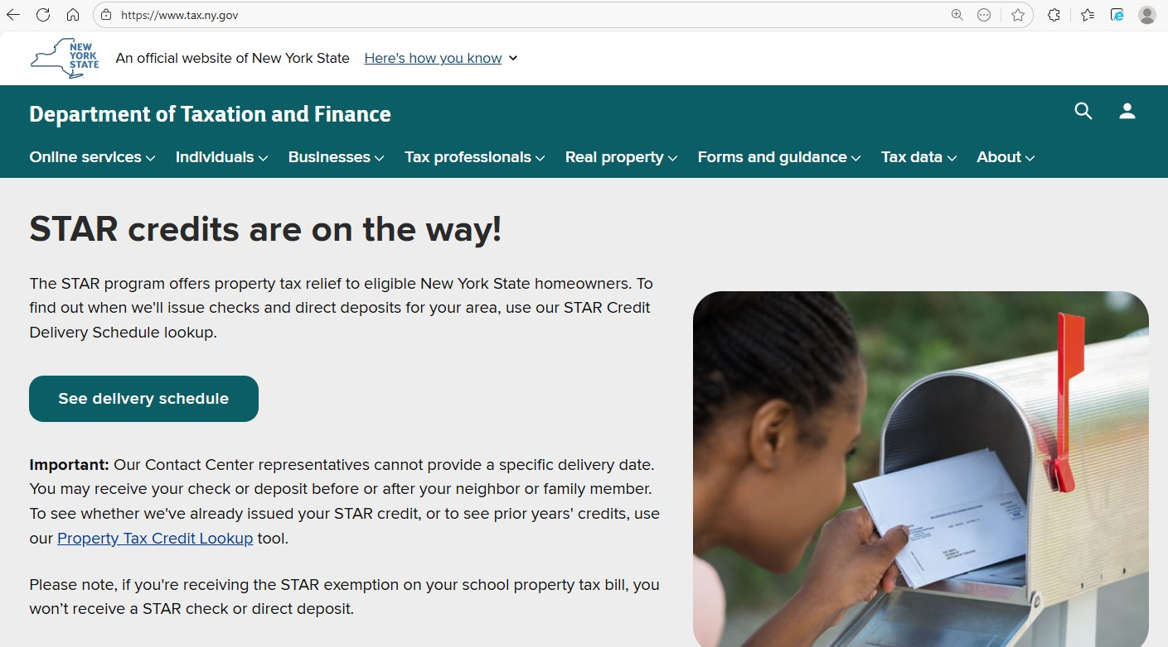
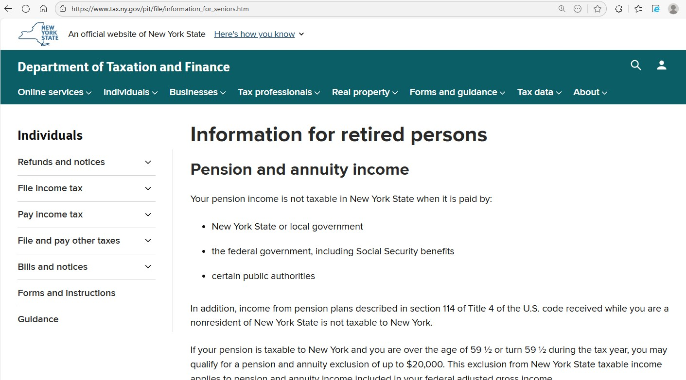
Resources for Seniors and Retired Persons
Visit www.tax.ny.gov (search: seniors)

Slide 65

New York State Deductions
Notes:
Once all the modifications to income are done, you have your New York adjusted gross income and we can now cover deductions

Slide 66
Standard and Itemized Deduction
The standard deduction is a specific dollar amount that reduces the amount of taxable income.
Some taxpayers choose to itemize their deductions if their total allowable itemized deductions is greater than their standard deduction.
Note: Taxpayers who are married and filing separate returns must both take the standard deduction unless both spouses choose to itemize their deductions.
Notes:
Some taxpayers choose to itemize their deductions if their total allowable itemized deductions is greater than their standard deduction.
Note: Taxpayers who are married and filing separate returns must both take the standard deduction unless both spouses choose to itemize their deductions.

Slide 67
Standard Deduction Table and Dependent Exemptions
The standard deduction amount is based on the filing status below:
Filing Status | Standard Deduction Amount
Single (and can be claimed as a dependent on another taxpayer's federal return) | $3,100
Single (and cannot be claimed as a dependent on another taxpayer's federal return) | $8,000
Married filing joint return | $16,050
Married filing separate return | $8,000
Head of Household (with qualifying person) | $11,200
Qualifying surviving spouse | $16,050
The value of each New York State dependent exemption is $1,000.

Slide 68
New York Itemized Deductions
Taxpayers may itemize their deductions for New York State income tax purposes whether or not they itemized their deductions on their federal income tax return.
In general, New York itemized deductions are computed using the federal rules as they existed prior to the changes made to the Internal Revenue Code (IRC) by the Tax Cuts and Jobs Act (Public Law 115-97).
New York State itemized deductions are reported on Form IT-196, New York Resident, Nonresident, and Part-Year Resident Itemized Deductions.
Notes:
Itemized deductions are handled on Form IT-196, New York Resident, Nonresident, and Part-Year Resident Itemized Deductions:
This form Walks you through the computation of New York itemized deductions. And the software guides you though them as well, so we won’t go through these items in the training. For additional guidance, visit the www.tax.ny.gov (search: deductions).

Slide 69
New York Itemized Deductions (cont.)
Taxpayers may claim itemized deductions if they:
had large, uninsured medical or dental expenses;
paid state and local taxes, including real estate and real property taxes;
paid mortgage interest;
had large, unreimbursed expenses as an employee;
had large, uninsured casualty (fire, flood, wind) or theft losses;
made large contributions to qualified charities; or
had large, unreimbursed miscellaneous expenses.

Slide 70
Required Documentation
Taxpayers should only claim the deductions they can provide required documentation for.
For a list of required documentation to support deductions claimed, see our webpage Checklists for acceptable proof of itemized deductions.
Visit www.tax.ny.gov (search: checklists)

Slide 71

Personal Income Tax Credits

Slide 72
Earned Income Credit (EIC)
EIC is a refundable tax credit that helps working people with low to moderate income.
The credit amount varies by family size and earnings and phases out at higher income levels.
Taxpayers must claim the federal earned income credit.
The credit is generally equal to 30% of the allowable federal earned income credit, reduced by the amount of any household credit.
Taxpayers and qualifying children must each have a valid social security number (SSN) by the due date of the tax return.
Full-year or part-year New York City residents can claim the NYC EIC credit.
Form IT-215, Claim for Earned Income Credit
Notes:
Now on to the various credits. I want to start with the earned income credit because this is probably the largest credit that taxpayers can qualify for. Read slide:
EIC is a refundable tax credit for working taxpayers. This credit puts money directly into the pockets of working taxpayers, can be a financial lifeline for those struggling to make ends meet.
The investment income threshold increased so that Investment income can not be greater than $11,950

Slide 73
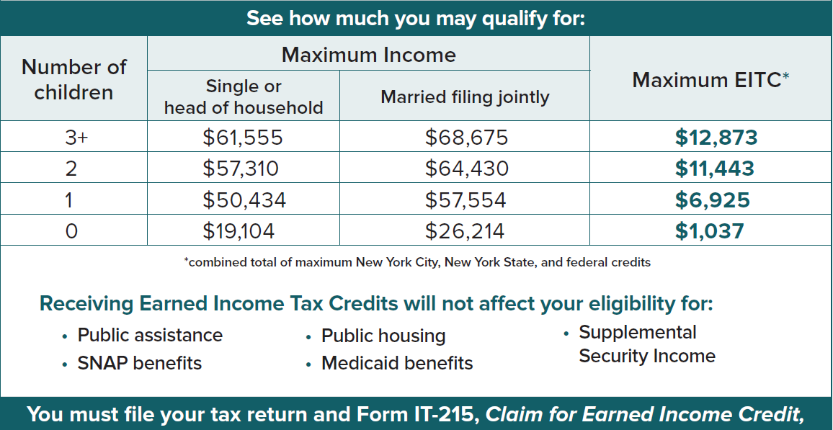
EIC Credit Amounts
Visit www.tax.ny.gov (search: eic)

Slide 74
Noncustodial Parent Earned Income Credit
This credit is for taxpayers that have qualifying dependents that don't reside with them and meet all of the qualifying conditions:
did not claim the New York State earned income credit (EIC),
were a full-year New York State resident,
were at least 18 years of age,
are a parent of a minor child (or children) with whom they do not reside and are under the age of 18,
have an order in effect for at least one-half of the tax year requiring child support payments be paid through a New York State Support Collection Unit (SCU); and,
have paid an amount in child support during the tax year.
Notes:
Next is the Non custodial parent earned income credit. If a taxpayer does not qualify to claim the EIC, they may qualify for the Noncustodial Parent Earned Income Credit. On the previous slide, we mentioned that to be a qualifying child, the child have lived with the taxpayer for more than half the year. Noncustodial parents are the parent of a child (or children) who did not reside with them during the tax year, but they had to pay child support and meet other requirements.
did not claim the New York State earned income credit (EIC);
were a full-year New York State resident;
were at least 18 years of age;
are a parent of a minor child (or children) with whom they do not reside and are under the age of 18;
must have an order in effect for at least one-half of the tax year requiring child support payments be paid through a New York State Support Collection Unit (SCU); and
have paid an amount in child support during the tax year 2025
And similar to EIC, taxpayers and any qualifying children must have a valid SSN by the due date of the return.

Slide 75
Noncustodial Parent Earned Income Credit (cont.)
Taxpayers may claim the greater of:
20% of the federal EIC that could have claimed if the noncustodial child met the qualifying child definition. Compute it as if the taxpayer had one qualifying child without the benefit of the joint return phase-out amount (even if you had a married filing joint return); or
2.5 times the federal EIC that the taxpayer could have claimed if you met the eligibility requirements, computed as if you had no qualifying children.
Note: Taxpayers and qualifying children must each have a valid social security number (SSN) by the due date of the tax return.
Form IT-209, Claim for Noncustodial Parent New York Earned Income Credit

Slide 76
Empire State Child Credit
The Empire State child credit may be available to full-year NYS residents who have a qualifying child and meet certain income limitations.
For tax year 2025 New York State has decoupled from the federal child tax credit and the credit computation has been simplified.
To qualify, a valid social security number (SSN) or individual taxpayer identification number (ITIN) must be provided for the taxpayer and for each child listed on Form IT-213.
For additional information, see the IT-213 instructions.
IT-213, Claim for Empire State Child Credit

Slide 77
Empire State Child Tax Credit
For tax year 2025, the credit is now:
$1,000 for each qualifying child under the age of four
$330 for each qualifying child aged four through sixteen

Slide 78
Empire State Child Tax Credit (Article 22)
For tax years 2026 and 2027, taxpayers may claim:
$1,000 per qualifying child under the age of four
$550 per qualifying child aged four through 16
Form IT-213, Claim For Empire State Child Tax Credit

Slide 79
Empire State Child Tax Credit
The credit amount will be reduced by $16.50 for every $1,000 when federal adjusted gross income exceeds the income threshold for the filing status below:
married filing joint return: $110,000;
single, head of household, or qualifying surviving spouse: $75,000; or
married filing a separate return: $55,000.
Notes:
The credit is phased out when FAGI exceeds applicable thresholds for the specific filing threshold shown here.

Slide 80
Child and Dependent Care Credit
This credit is calculated based on the amount of the taxpayer’s New York State adjusted gross income, the number of qualifying persons, and the amount of qualified expenses paid.
Qualified expenses include amounts paid for household services and care of the qualifying person(s) while the taxpayer worked or looked for work.
The credit allowed is:
fully refundable for full-year residents,
partially refundable for part-year residents, and
nonrefundable for non-residents.
Form IT-216, Claim for Child and Dependent Care Credit
Notes:
Next is the child and dependent care credit, is a tax credit that may help you pay for the care of qualifying children and other dependents (which we all know can be very expensive)
The child and dependent care credit can be claimed if qualified to claim the federal child and dependent credit (whether it was claimed it or not). And this is a refundable credit for NYS residents.
Note: the child and dependent care expenses must be work related: meaning that they allow taxpayers to work or look for work.
How much is the credit?
The credit is computed based on the amount of your New York State adjusted gross income, the number of qualifying persons, and the amount of qualified expenses paid.
Note: Each person listed on the return must provide a valid Social Security number (SSN) or individual taxpayer identification number (ITIN).

Slide 81
Child and Dependent Care Credit (cont.)
Qualified expense limits based on the number of qualifying persons:
$3,000 for one,
$6,000 for two,
$7,500 for three,
$8,500 for four, and
$9,000 for five or more qualified persons

Slide 82
Child And Dependent Care Credit (cont.)
Child and dependent care expenses include, but are not limited to:
education: programs for children below kindergarten level
dependent care centers: place that provides care for more than 6 persons and complies with state regulations
transportation: transportation for the care of a qualifying person by a care provider (ex: bus, subway, taxi)
fees and deposits: fees paid to an agency to get care services

Slide 83
New York City Child and Dependent Care Credit
Refundable for full-year New York City residents who paid child-care expenses for at least one child who was under age four on December 31.
Taxpayers must:
have federal adjusted gross income of $30,000 or less, and
be eligible to claim the New York State child and dependent care credit.
The credit can be as much as 75% of the New York State child and dependent care credit, depending on the amount of federal adjusted gross income (FAGI).
Form IT-216, Claim for Child and Dependent Care Credit
Notes:
There is also a NYC Child and Dependent Care Credit that is refundable for full-year NYC residents who paid child-care expenses for at least one child who was under age four on December 31.
Taxpayers must:
have federal adjusted gross income of $30,000 or less, and
be eligible to claim the New York State child and dependent care credit.
And this credit can be as much as 75% of the New York State credit.

Slide 84
College Tuition Credit or Itemized Deduction
The college tuition credit or itemized deduction is allowed for qualified college tuition expenses paid for an eligible student.
College tuition credit is limited to $400 per eligible student and to full-year NYS residents only.
If the college tuition credit is more than the tax for the tax year, the excess credit will be refunded without interest.
College tuition itemized deduction is for taxpayers who itemized their deductions on the NYS return, the maximum deduction is $10,000 for each eligible student.
Note: Taxpayers may claim either the credit or the deduction, but not both.
Form IT-272, Claim for College Tuition Credit or Itemized Deduction
Notes:
The claim for college tuition credit.
Only qualified tuition expenses paid for undergraduate enrollment or attendance at an institution of higher education qualify for the credit. Up to $10,000 of tuition expenses per eligible student can be used to calculate the credit. Taxpayers can claim a 4% refundable credit or use the tuition expense amount as an added itemized deduction. For tuition expense under $5,000, the credit is the lesser of $200 or the tuition expense.

Slide 85
Qualified Tuition Expenses
Qualified college tuition expenses include only tuition paid for the undergraduate enrollment or attendance of the student at an institution of higher education.
Qualified college tuition expenses do not include:
tuition paid through scholarships or other financial aid that need not be repaid;
amounts paid for room and board, and other similar personal or living expenses;
amounts paid for books, supplies, equipment, and nonacademic activities, even if required by the school; or
expenses reimbursed to you by your employer.
Notes:
Expenses may be paid by cash, check, credit card, or with borrowed funds. The eligible student doesn’t need to be enrolled in a degree program or to attend full time for the expenses to qualify. If the student is claimed as a dependent, these payments are treated as paid by the taxpayer.
Let’s review the college tuition credit or deduction. The qualified expenses for this credit and the itemized deduction are listed on the on the IT-272. However, a taxpayer can not take both the credit and the deduction. There is a worksheet included to help determine which is more beneficial. Do not claim the following as qualified expenses:
graduate-level tuition expenses
tuition expenses that were paid by scholarships, grants and/or an employer
expenses for:
room/board, insurance, medical expenses, and transportation;
course related books, supplies, or equipment; and
fees paid as a condition of enrollment, attendance, or non-academic activities

Slide 86
Volunteer Firefighter and Ambulance Worker Credit
Taxpayers are eligible for this refundable credit if they:
were an active volunteer firefighter or volunteer ambulance worker, and
were a resident of New York State.
Note: Taxpayers cannot claim this credit if you receive a real property tax exemption that relates to your volunteer service. However, if the property has multiple owners, the owner(s) whose volunteer service was not the basis of the exemption may be eligible to claim the credit.
Credit amount: $200 ($400 for married filing joint taxpayers where both spouses are eligible).
Form IT-245, Claim for Volunteer Firefighters' and Ambulance Workers' Credit
Notes:
The claim for volunteer firefighter and Ambulance worker credit is a $200 refundable credit or $400 if married filing jointly and both spouses qualify. The taxpayer must be a full-year resident and active volunteer firefighters or ambulance workers for the entire year for which the credit is claimed. Use IT-201-ATT - Code 354 on line 12. If a taxpayer receives a real property tax exemption that relates to their volunteer service, they cannot claim the volunteer firefighters’ and ambulance workers’ credit.

Slide 87
Nursing Home Assessment Credit
This refundable credit is available if taxpayers paid the nursing home assessment imposed on a New York State nursing home.
This credit is equal to the 6% base-rate portion of the assessment that you directly paid during the year.
The amount of this assessment is on the billing statement or other statements provided to a resident by the nursing home.
It is not the amount of total care expenses paid during the year.
Form IT-258, Claim for Nursing Home Assessment Credit
Notes:
The refundable nursing home credit is available for the amount of assessment imposed on a residential health care facility.
The assessment must be separately stated and must be paid directly by the individual taxpayer claiming the credit. The credit equals the assessment amount (not expenses) separately stated and accounted for on the billing statement. Use IT-201-ATT - Code 258 on line 12 or IT-203-ATT - Code 258 on line 12.

Slide 88
Long-Term Care Insurance Credit
This credit is for premiums paid for qualified long-term care insurance policies.
The credit is equal to 20% of the premiums paid during the tax year for the purchase of or for continuing coverage under a qualifying long-term care insurance policy.
Credit is only available to taxpayers with a NYAGI less than $250,000.
The credit amount cannot exceed $1,500 per return.
Form IT-249, Claim for Long-Term Care Insurance Credit
Notes:
The claim for long term care insurance credit is for premiums paid for qualified long-term care insurance policies. The credit is equal to 20% of the premiums paid during the tax year for the purchase of or for continuing coverage under a qualifying long-term care insurance policy.
Remember, health and life insurance premiums do not qualify for the credit. The credit is only available to taxpayers with NYAGI of less than $250,000 and is capped at $1,500 per return for taxable years beginning on or after January 1, 2020

Slide 89
Real Property Tax Credit
For tax years beginning on or after January 1, 2025, eligibility for the credit is based on federal adjusted gross income (FAGI) instead of household gross income.
The household concept for determining qualifying taxes and splitting the credit has been eliminated.
The credit brackets have been condensed, and the credit amount is now a flat amount based on FAGI.
Form IT-214, Claim for Real Property Tax Credit
Notes:
For tax years beginning on or after January 1, 2025, a new credit is available to eligible full-year or part-year New York City residents that may reduce or eliminate New York City personal income tax liability.
The credit is available for full-year or part-year New York City residents who:
claim one or more dependents,
have a FAGI no more than $5,000 above the applicable income threshold,
do not claim a New York City or New York State Pass-through entity tax (PTET) credit, and
have investment income of $10,000 or less.
The credit shall be applied against any remaining New York City liability after accounting for all other tax credits and may not reduce New York City tax to less than zero.
The form for this credit is the IT-270, New York City Income Tax Elimination Credit

Slide 90
New York City Income Tax Elimination Credit
For tax years beginning on or after January 1, 2025, a new credit is available to eligible taxpayers that may reduce or eliminate their New York City resident income tax liability.
An eligible taxpayer is a New York City resident, who claims at least one or more dependents, with a FAGI no more than $5,000 above the applicable income threshold.
The taxpayer cannot claim either the New York City or New York State Pass-through entity tax (PTET) credit and cannot have more than $10,000 in investment income.
Form IT-270, New York City Income Tax Elimination Credit
Notes:
For tax years beginning on or after January 1, 2025, a new credit is available to eligible full-year or part-year New York City residents that may reduce or eliminate New York City personal income tax liability.
The credit is available for full-year or part-year New York City residents who:
claim one or more dependents,
have a FAGI no more than $5,000 above the applicable income threshold,
do not claim a New York City or New York State Pass-through entity tax (PTET) credit, and
have investment income of $10,000 or less.
The credit shall be applied against any remaining New York City liability after accounting for all other tax credits and may not reduce New York City tax to less than zero.
The form for this credit is the IT-270, New York City Income Tax Elimination Credit

Slide 91
New York City Income Tax Elimination Credit
Income Threshold Table
Married filing joint return or Qualifying surviving spouse |  | Married filing separate return, Single or Head of household
Number of dependents | Income Threshold | Number of dependents | Income Threshold
1 | $36,789 | 1 | $31,503
2 | $46,350 | 2 | $36,824
3 | $54,545 | 3 | $46,512
4 | $61,071 | 4 | $53,711
5 | $68,403 | 5 | $59,928
6 | $75,204 | 6 | $65,712
7 or more | $91,902 | 7 | $74,565
 |  | 8 or more | $88,361
Notes:
The applicable threshold varies by the number of dependents claimed shown here.
The threshold goes from a low of $36,789 ($31,503 singles) with one dependent to a high of $91,902 ($88,361 singles) with 7 or more dependents (8 or more for singles).
Note: the credit shall be applied against any remaining New York City liability after accounting for all other tax credits and may not reduce New York City tax to less than zero.

Slide 92
Central Business District Toll Credit
Taxpayers are eligible for this credit if:
their primary residence during the year was in New York City’s Central Business District (also known as the Congestion Relief Zone);
they have a New York adjusted gross income of less than $60,000 for the year; and
they paid Central Business District tolls (Congestion Relief Zone tolls) during the year (excluding any tolls used as a trade or business expense).
Form IT-268, Central Business Toll Credit

Slide 93
Geothermal Energy System Credit
The limitation on the credit amount increased to $10,000 for qualified systems placed in service on or after July 1, 2025.
For tax years beginning on or after January 1, 2026, taxpayers may elect to receive the excess credits amount as a refund as follows:
married filing jointly or qualifying surviving spouses: FAGI of $180,000 or less, or
single, married filing separately, or heads of household: FAGI of $90,000 or less.
Form IT-267, Geothermal Energy System Credit
Notes:
The limitation on the credit amount increased to $10,000 for qualified systems placed in service on or after July 1, 2025.
For tax years beginning on or after January 1, 2026, taxpayers who meet certain income requirements may elect to receive any unused credit amount as a refund.
The form for this credit is the Form IT-267, Geothermal Energy System Credit
Background:
The credit is for:
purchased geothermal energy system equipment, or
entered into a written agreement for the lease of geothermal energy system equipment,
Note: The geothermal energy system must use solar thermal energy stored in the ground or bodies of water to produce heat for residential use, commonly known as a ground source heat pump.

Slide 94

Green Energy Credits
Clean Heating Fuel Credit:
This refundable credit applies to purchases of bio heating fuel for residential purposes.
Bioheating fuel must contain at least 6% biodiesel per gallon. Bioheating fuel that is comprised of renewable hydrocarbon diesel blended with conventional home heating oil may also qualify.
Note: The percentage of biodiesel included in the bioheating fuel is shown in the number or numbers preceded by the letter B in the bioheating fuel designation.
Form CT/IT-241, Clean Heating Fuel Credit
Notes:
The clean heating fuel credit has been extended through tax year 2028
Applies to purchases of bio heating fuel for residential purchases before January 1, 2029.
The forms for this credit are the CT/IT-241
Background: The credit is available to taxpayers for the purchase of bioheating fuel used for space heating or hot water production for residential purposes within New York State.

Slide 95
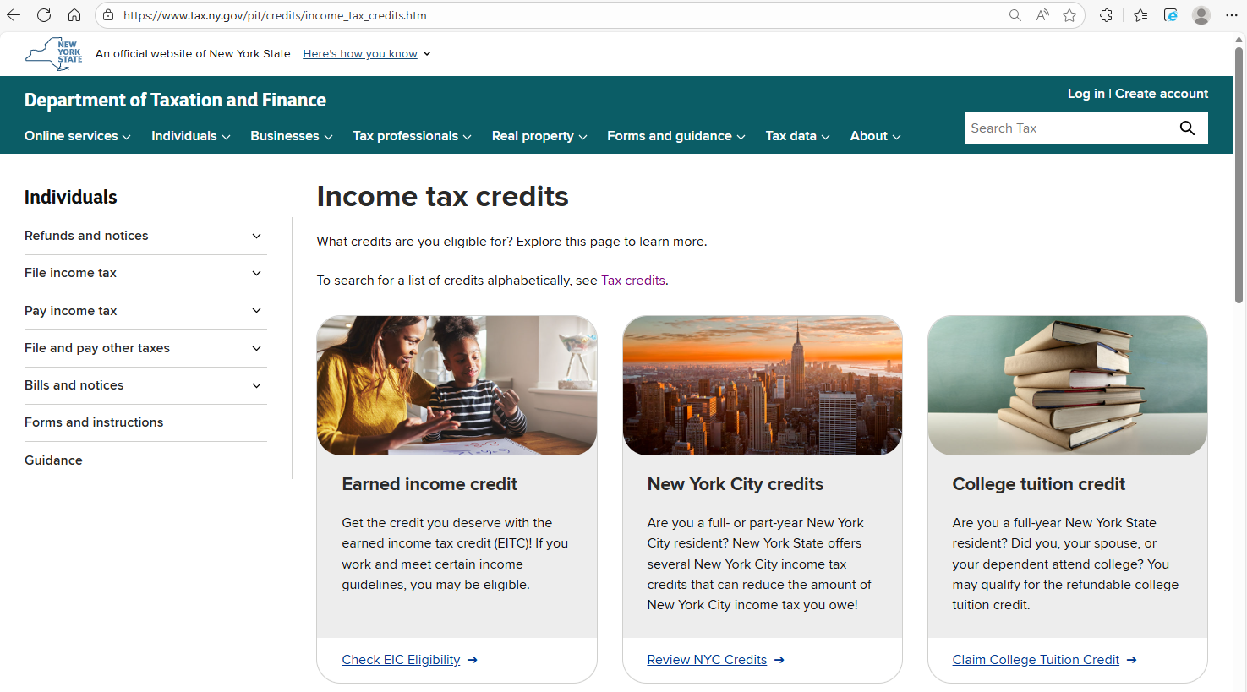
Income Tax Credits
Visit www.tax.ny.gov (search: credits)

Slide 96

Taxpayer Resources

Slide 97
Tax Department Website
Visit www.tax.ny.gov

Slide 98








Contact Us
To find assistance, scroll to the bottom of our website and select Contact Us under Get Help.
Customer Service
Telephone Assistance
Provide
Feedback
Follow us on social and subscribe to our emails to receive tax tips, news and the latest guidance.
Connect with Us

Slide 99

Language Assistance
To increase taxpayer access to tax information, we:
Translate many important forms and documents in at least the 12 most commonly spoken languages in New York State.
Offer free interpretation services by calling 518-453-8137.
Visit www.tax.ny.gov (search: language)

Slide 100

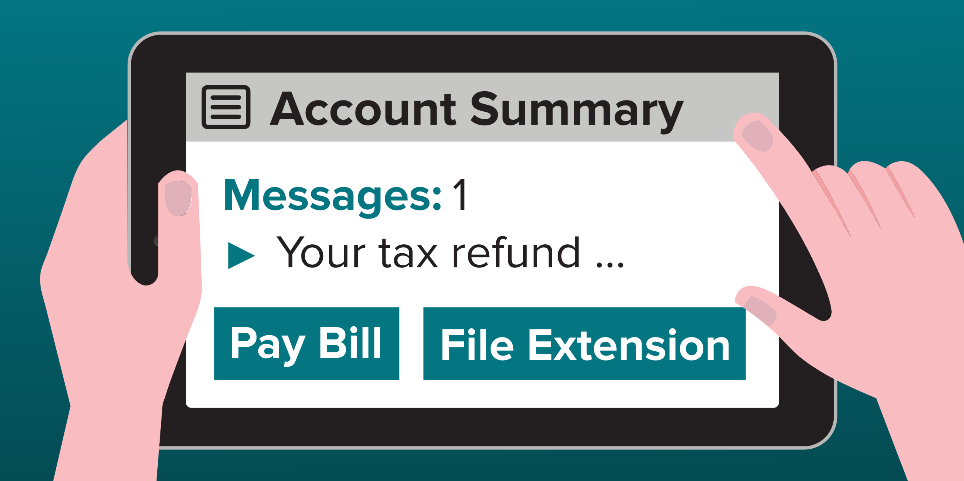
Individual Online Services Account
Free and secure way to manage tax information – anywhere, anytime.
With an individual account, taxpayers can:
pay a bill
file an income tax extension
respond to a department notice
sign up for refund notifications
review your filing history
and more

Slide 101


Wage and Withholding Transcripts
Current tax year information:
If a taxpayer misplaced or lost their Form W-2, they can request a state wage and tax transcript beginning on April 19th.
Prior tax year information:
Taxpayers can request a transcript by calling 518-457-5181.

Slide 102
Form 1099-G Information
Form 1099-G, Certain Government Payments
The 1099-G amount reflects the amount of state and local taxes a taxpayer overpaid through withholding or estimated tax payments.
Taxpayers may view and print Form 1099-G, Statement for Recipients of State Income Tax Refunds, directly from the Tax Department’s website.
If taxpayer received unemployment compensation in 2025, including any income taxes withheld.
Taxpayers may view and print Form 1095-G from the New York State Department of Labor’s website.
Form 1099-G, unemployment compensation.

Slide 103


Requests for Additional Information
Form DTF-948 or DTF-948-O, Request for Information (RFI), is used to request additional information or documentation.
It’s important to respond by the date printed on the letter.
Easiest, fastest way to respond is through the Respond to Department Notice application in Online Services.

Slide 104

Protest Rights
Certain notices (additional tax due, refund denial) have protest rights
Taxpayers must respond within 90 days and request either
Free conciliation conference
Tax Appeals hearing
Respond within
90 days
Visit www.tax.ny.gov (search: protest)

Slide 105
Installment Payment Agreements
If a taxpayer is unable to pay a tax bill in full, they can:
request an installment payment agreement (IPA), and
make monthly payments towards the unpaid tax balance.
Easiest and fastest
way to request an IPA
through Online Services
Balance of $20,000 or less
with 36 or fewer monthly payments
Visit www.tax.ny.gov (search: ipa)

Slide 106
Voluntary Disclosure and Compliance Program
If a taxpayer owe back taxes and haven't filed related returns:
telling the department what taxes they owe;
paying those taxes; and
entering an agreement to pay all future taxes.
Avoid monetary penalties and possible criminal charges
It’s easy to apply
answer a few questions, and submit your application electronically
Visit www.tax.ny.gov (search: vold)
Notes:
RS: NEW SLIDE

Slide 107

Protect Personal Information
Scammers will use scare tactics to get individuals to share personal and financial information with them.
Scammers may:
demand immediate payment for a tax debt;
make threats over the phone, possibly with police action or deportation; or
demand payment in a specific way, such as through prepaid debit cards, gift cards, or in person.

Slide 108
Protect Personal Information
The Tax Department and the IRS will never:
request personal information over the phone, or by text or email
threaten taxpayers for failure to pay a tax debt;
refuse a request to call us back using a number found on our website; or
demand taxpayers pay taxes without the option to question or appeal the amount owed.

Slide 109

Report Fraud or Identity Theft
Report a scam
For more information, visit www.tax.ny.gov (search: fraud) for more information on common scams and how to report them to the Tax Department.
Report identity theft
complete Form DTF-275, Identify Theft Declaration
mail or fax to the Tax Department

Slide 110
Taxpayer Rights Advocate
Provides free and independent New York State tax issue assistance.
Ensures that the taxpayer’s New York State tax issue is reviewed in a timely manner.
Helps the taxpayer understand important notices and deadlines.
Explains taxpayer rights and responsibilities under the New York State Tax Law.
Helps resolve long-standing tax issues.

Slide 111
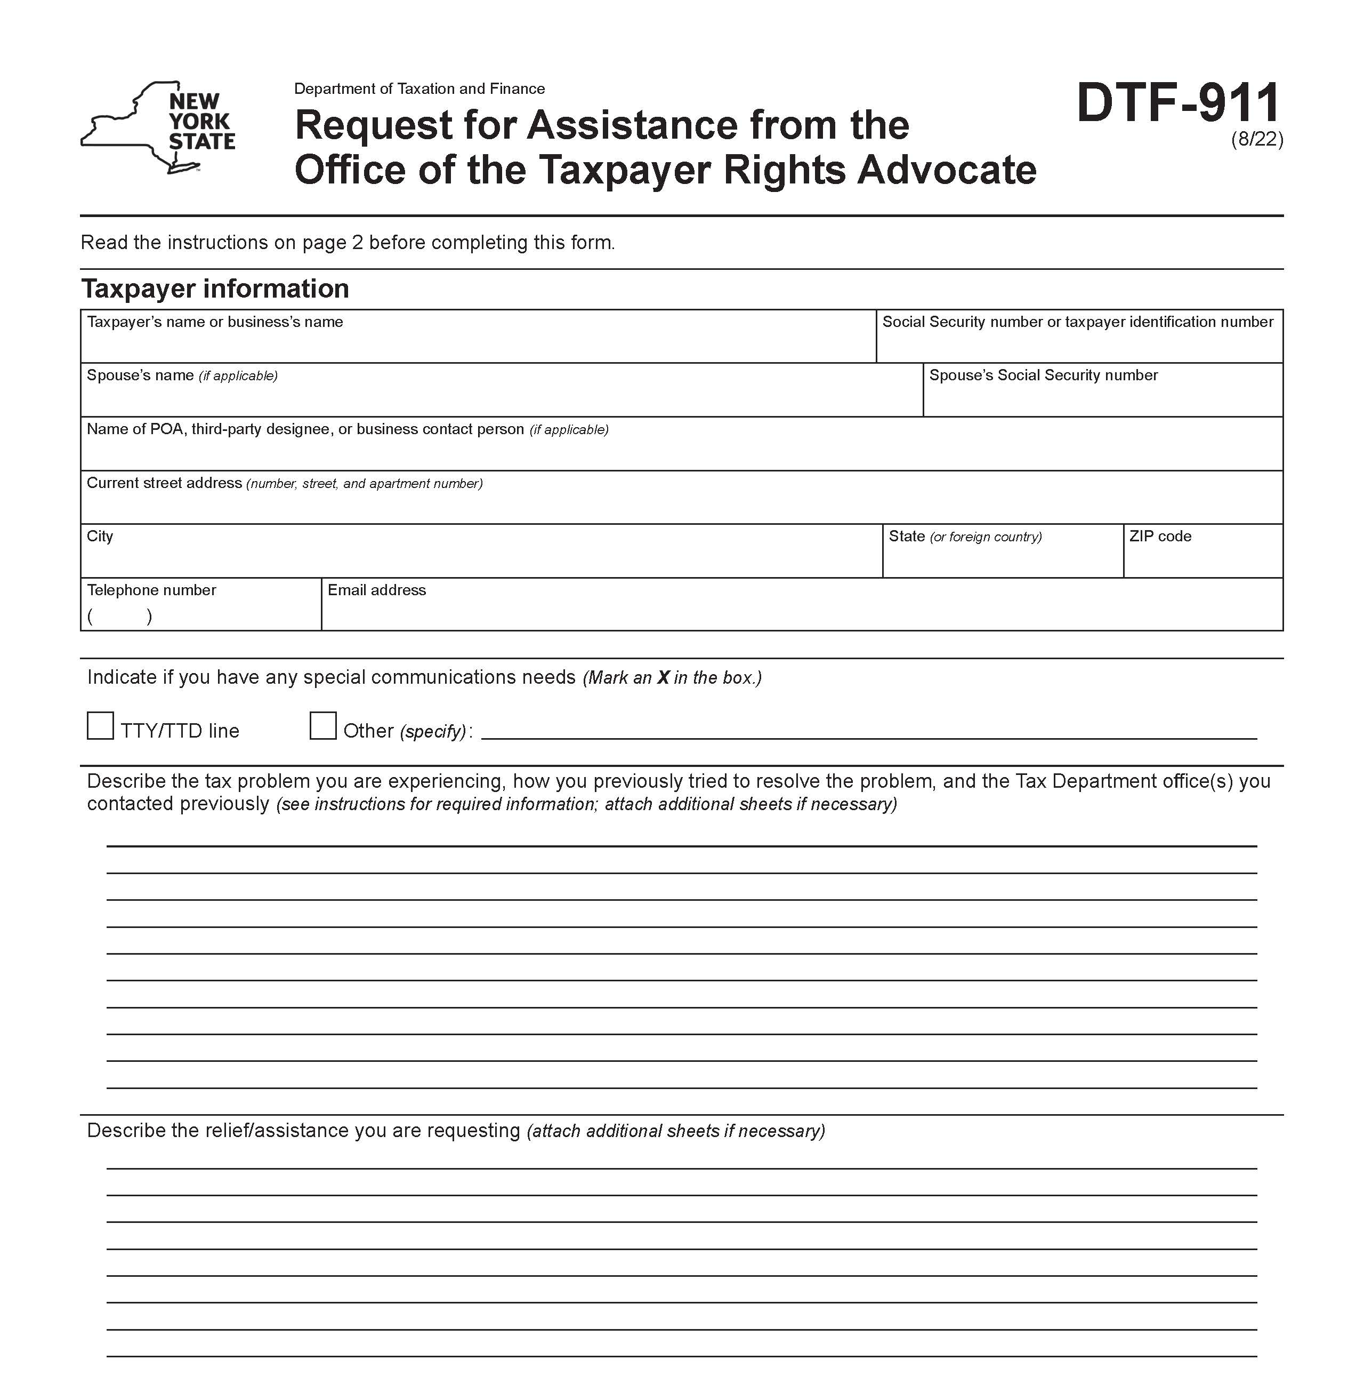
Get Help From the Advocate
The Office of the Taxpayer Rights Advocate (OTRA) works with taxpayers and the Tax Department to find tax issue resolution.
For assistance:
complete Form DTF-911
fax or mail to department
Call: 518-530-4357
You will be assigned an advocate.
Visit www.tax.ny.gov (search: advocate)

Slide 112


Subscription Services
Subscribe to tax tips, news, and updates
Visit www.tax.ny.gov (search: subscribe)
Notes:
Can't get enough of Tax? Subscribe to receive emails with tax tips, news, and the latest guidance. From our website search subscribe.

Slide 113
Subscription Services
Tax Type Information
Adult-use cannabis
Alcoholic beverages tax and beverage container deposits
Cigarette, tobacco, and vapor products taxes
Congestion surcharge
Corporation tax
Employer Compensation Expense Program
Medical cannabis and opioid taxes
Metropolitan commuter transportation mobility tax (MCTMT)
Miscellaneous tax
Personal income tax
Real estate transfer tax and mortgage recording tax
Sales tax
Sales tax exempt organizations
Wireless communications surcharges
Withholding tax
Partnerships
Pass-through entity tax (PTET)
Highway use tax (HUT)
IFTA
Estate tax
Subscribe to receive emails with:
tax tips
tax guidance, such as new publications or regulation changes
filing updates and reminders, and
press releases.
Notes:
Subscription emails are the place we send them out first, so please make sure you sign up! You can receive emails with tax tips, the latest guidance, filing updates and reminders, and press releases. You can tailor your email subscriptions to the tax information you need. If you haven’t checked your subscriptions lately, you should review them to make sure you have everything checked off that you want information on.

