Slide 1


Site Coordinators
Training
TAX YEAR 2025
Notes:
On behalf of Team Tax, we would like to thank you for your unwavering commitment to serving the community with compassion, integrity, and excellence. The Site Coordinators Training highlight the resources and tax changes for this year as well as reminders to assist with site set-up and preparing accurate New York State returns.

Slide 2


Our Mission
To efficiently collect tax revenues in support of state services and programs, while acting with integrity and fairness in the administration of the tax laws of New York State.
Notes:
At the Tax Department, our mission is to efficiently collect tax revenues in support of state services and programs while acting with integrity and fairness in the administration of the tax laws of New York State.
The department is dedicated to providing fair tax administration to all taxpayers.

Slide 3
Compliance Continuum
A key department focus is the balance of efforts to promote voluntary compliance—the cornerstone of the State's system of taxation—with the duty to enforce New York's tax laws.
TAX DEPT
Publish forms, instructions and guidance
Assist and educate taxpayers
Capture return data and process payments
Resolve errors and issue bills
Propose tax legislation
Resolve protests
Audit
Collection
Litigation
Criminal enforcement
VOLUNTARY—LESS EXPENSIVE—MORE EFFICIENT
INVOLUNTARY—MORE EXPENSIVE—LESS EFFICIENT
Learn about tax obligations
File returns and make payments
Answer questions about filing errors
Review bills and pay or protest
Pay taxes found due after protest
Criminal enforcement defense
TAXPAYER
Review information
Undergo audit
Collection defense
Litigation defense
Notes:
A key department focus is the balance of efforts to promote voluntary compliance—the cornerstone of the State's system of taxation—with the duty to enforce New York's tax laws. More than 96 percent of the taxes collected are remitted voluntarily by taxpayers. The remaining 4 percent is a result of the department's enforcement programs—audit, collections, and criminal investigations.
So, while we will always have activities on the right side, the left side of the continuum is where we have tried to focus on improvement activities. This includes collection, litigation, and criminal enforcement.

Slide 4


Department Focus
The focus of the NYS Department of Taxation and Finance includes:
One Voice Initiative
Taxpayer Modernization
Notes:
One Voice Initiative: is the department’s effort to provide clear and consistent information from across the agency. Whether you speak to a call center representative, an auditor, our processing resolution centers, you should receive the same information.
Tax Modernization: This multi-year project is on track to improve the technology we use to make the department, and our system of tax administration, more efficient. Withholding tax changes went live in March 2025. New case management system to improve our ability to engage with the public on protest related cases. And our recent Online Services (OLS) changes that was launched on December 8, 2025.

Slide 5

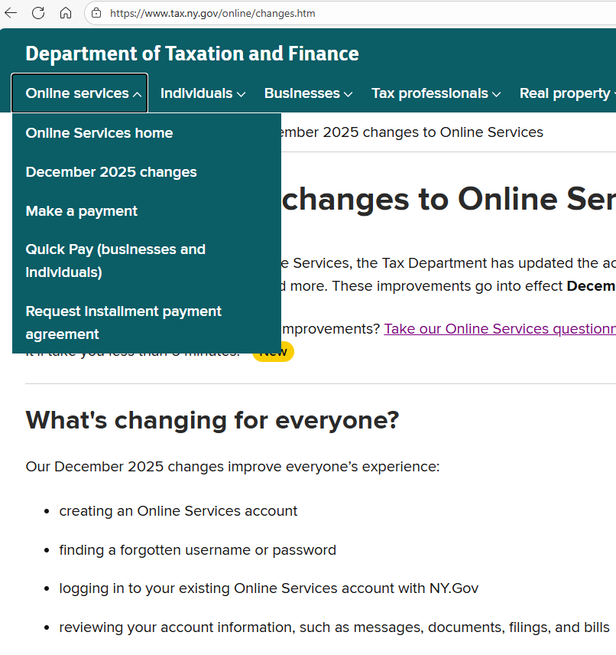

Online Services Changes
Changes will improve everyone’s experience:
creating an Online Services account
finding a forgotten username or password
logging into Online Services accounts with NY.gov
reviewing account information, such as messages, documents, filings, and bills
navigating within an account
Visit www.tax.ny.gov (search: online-changes)
Notes:
Effective December 2025, the Tax Department will inactivate the Online Services accounts of individuals who have not used their accounts within the past three years.
Taxpayers can reactivate their account at any time to access their tax information and use the services available in their accounts.
Taxpayers can view certain documents, including letter and bills, on the new Documents Summary page, if sent within the past three years.

Slide 6

Inflation Refund Checks

Slide 7
Inflation Refund Checks
The 2025-2026 New York State Budget provided for one-time inflation refund payments to eligible New Yorkers
Over 8 million inflation refund checks have been delivered to New York taxpayers
Eligibility based on tax year 2023:
filed Form IT-201, New York State Resident Income Tax Return;
reported income within qualifying thresholds; and
were not claimed as a dependent on another taxpayer’s return
Inflation refund checks were being mailed to eligible New Yorkers through the end of November
Visit www.tax.ny.gov (search: inflation)

Slide 8
Inflation Refund Checks
Check amounts are not taxable for New York State, New York City, or Yonkers resident income tax purposes.
Instructions for the following forms will be updated for taxpayers to subtract the check amount to the extent it was included in federal adjusted gross income:
Form IT-201-I: line 25
Form IT-203-I: line 24
Yonkers worksheet: line I
Visit www.tax.ny.gov (search: inflation)

Slide 9

School Tax Relief (STAR) Program

Slide 10

Homeowner Benefit Portal
Use the portal to:
register for STAR
enroll in STAR Credit Direct Deposit
check the status of property tax registrations
switch to the STAR credit
view, edit, or close their registrations
verify information
take action to resolve issues
Visit www.tax.ny.gov (search: homeowner)

Slide 11
Star Simplification
Effective for the 2026 STAR benefit period:
Income and age eligibility rules for the STAR exemption and credit programs have been simplified.
Going forward, it will be easier for homeowners to qualify for STAR.

Slide 12

STAR Resources
Information available online:
types of STAR
STAR credit delivery schedule
look up property tax credits
how to report STAR (if itemizing deductions)
STAR letters
upcoming changes
Visit www.tax.ny.gov (search: star)

Slide 13

Resources and UPDATEs

Slide 14

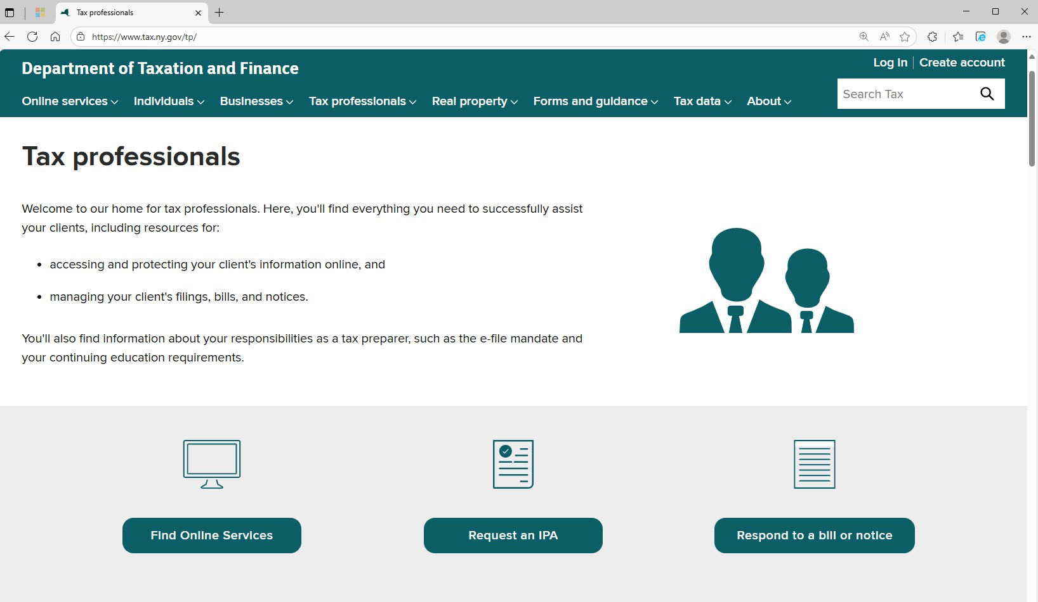
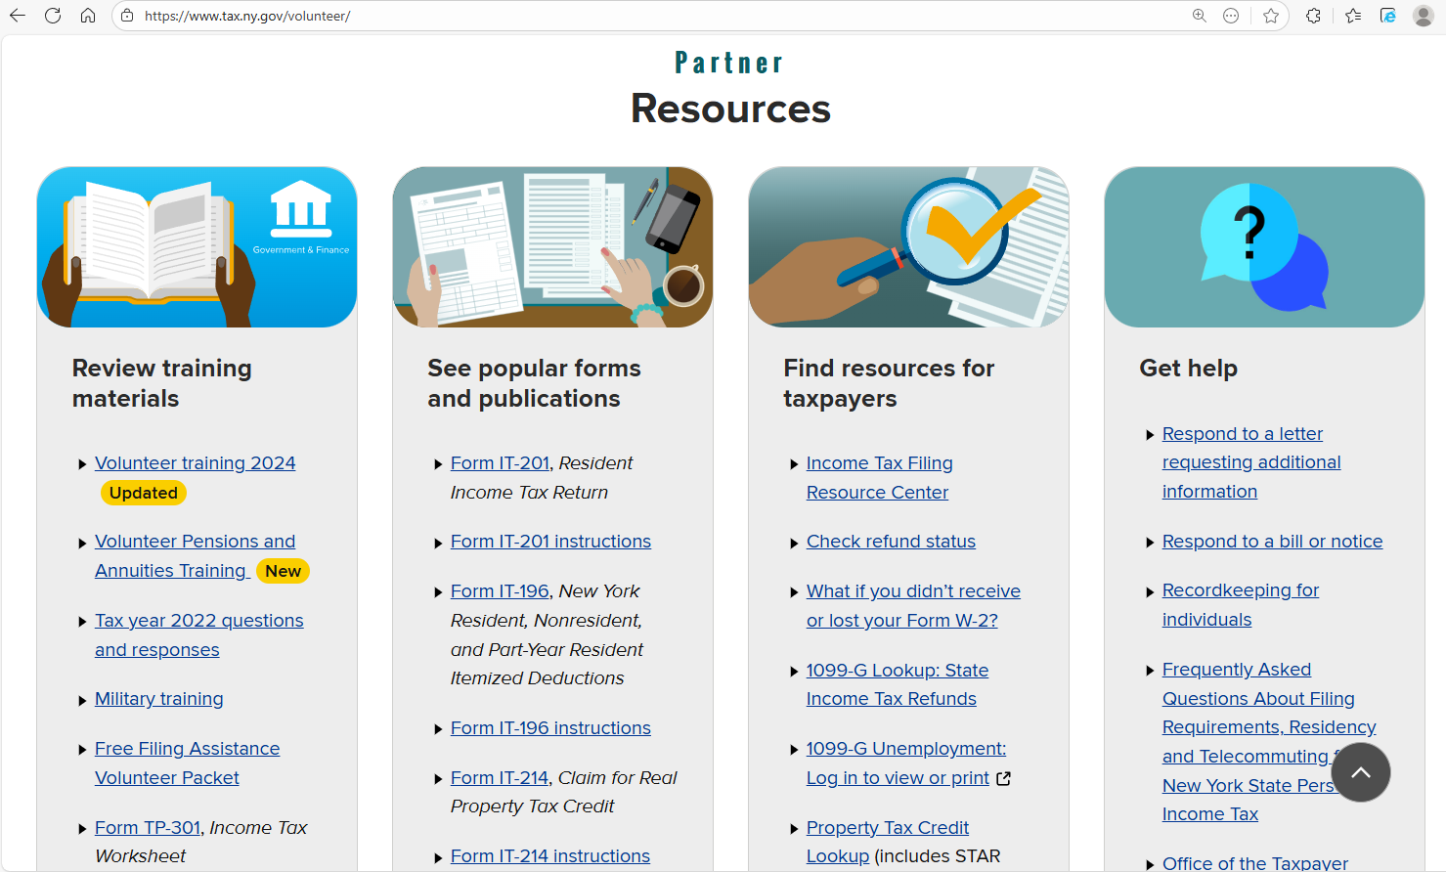
Volunteer Resource Center
Visit www.tax.ny.gov/volunteer
Notes:
From Volunteer Resource Center webpage Volunteer Income Tax Assistance (VITA) and Tax Counseling for the Elderly (TCE) partners can access New York State (NYS) tax training, tax forms and other resources to help train volunteers on preparing accurate NYS, New York City and Yonkers tax returns. Partners can request training support, order forms and view draft copies of notices their clients may have received. Partners can also email your questions to our Tax Partner email box: TaxPartners@tax.ny.gov

Slide 15
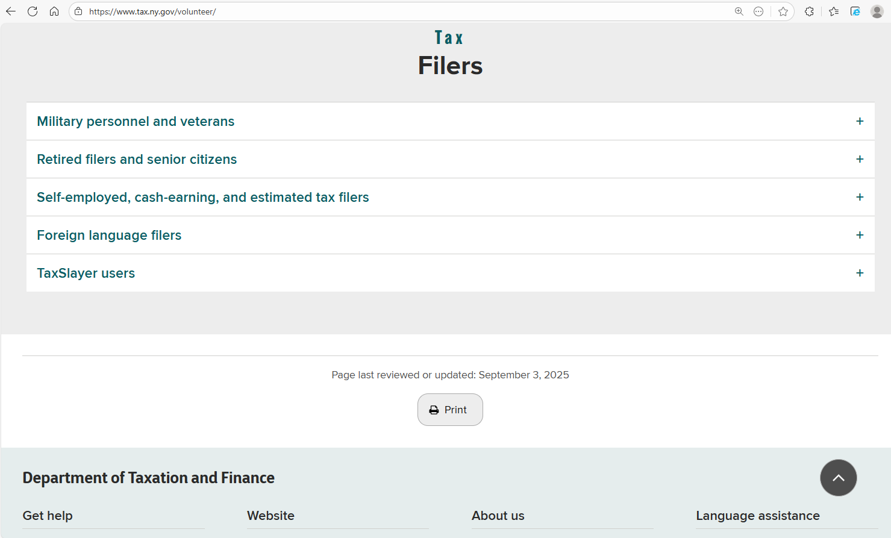
Volunteer Resource Center
Visit www.tax.ny.gov/volunteer

Slide 16
Volunteer Packets and Forms
Request volunteer packets and forms:
Send requests to: taxpartners@tax.ny.gov
Include the following information:
Your name, email, and address (physical addresses only, no PO boxes)
Number of 2025 Free Filing Assistance Volunteer Packets (5 maximum)
Form type and quantity (TP-301 and NYC-210 only)

Slide 17
2025 Volunteer Packet
Volunteer Packets will include the following forms and instructions:
IT-201, Full-Year Resident Income Tax Return packet for New York State, New York City, Yonkers and MCTMT
Form IT-196, New York Resident, Nonresident, and Part-Year Resident Itemized Deductions
IT-225, New York State Modifications
IT-195, Allocation of Refund
IT-227, New York State Voluntary Contributions
IT-214, Claim for Real Property Tax Credit for Homeowners and Renters

Slide 18
2025 Volunteer Packet
Volunteer Packets will include the following forms and instructions:
Form IT-270, New York City Income Tax Elimination Credit
IT-268, Central Business District Toll Credit
NYC-210 and NYC-210-I, Claim for New York City School Tax Credit
DTF-215, The Earned Income Tax Credit - Recordkeeping Suggestions for Self-employed Persons
TP-301, Income Tax Worksheet
Note: additional supplies of some forms are available by mail during the filing season by emailing NYStax.SpecReq@tax.ny.gov.

Slide 19
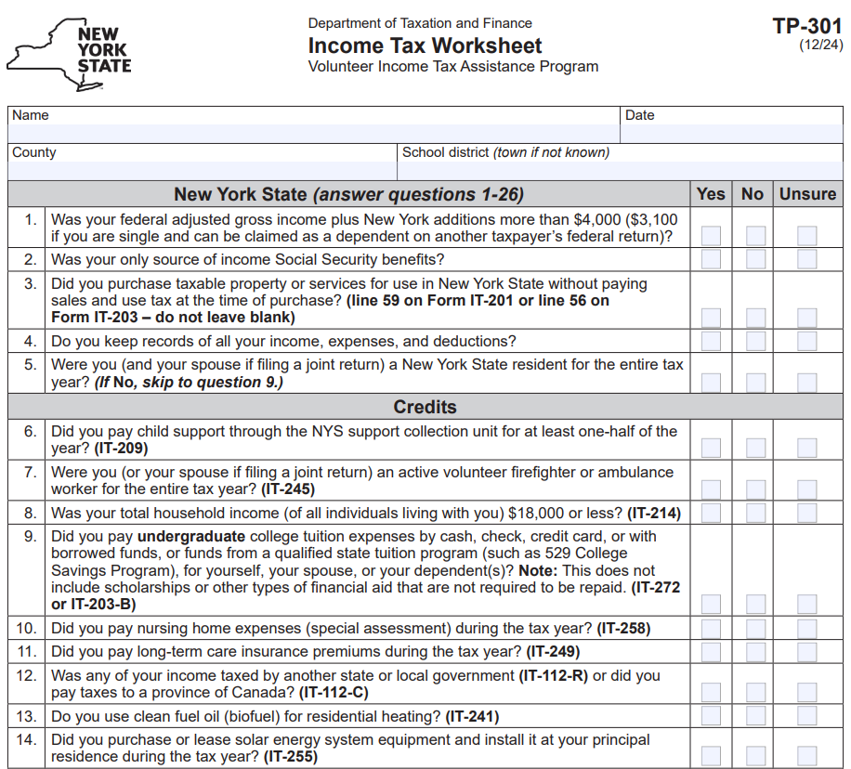
NYS Income Tax Worksheet: Form TP-301
List all the items that are New York state specifics that would not automatically carry forward from the federal return:
Additions such as state retirement contributions
Subtractions such as Private and Public employee pension exclusions
Credits that apply to NYS and NYC only
Notes:
Form TP-301, NYS Income Tax Worksheet - list all the items that are New York state specifics that would not automatically carry forward from the federal return:
Additions such as state retirement contributions
Subtractions such as Private and Public employee pension exclusions
Credits that apply to NYS and NYC only
Most partners use it as a training guide for volunteers and as a reference guide when preparing and quality reviewing returns. Some sites provide a copy to each taxpayer to complete along with the IRS intake sheet. It’s not required for you to give it to taxpayers; however, it’s a great practice to use it the preparing and reviewing stages to ensure you don’t miss anything on the NYS return.

Slide 20


Tax Professional Hotline
Available to tax professionals and volunteer preparers.
Limited or no wait time.
Experienced staff to answer more technical questions.
(518) 457-5451
Notes:
Available to tax professionals and volunteer preparers.

Slide 21


Tax Due Date
Taxes are due: April 15, 2026

Slide 22

Software Set-up and Reminders

Slide 23
E-file Mandate
All forms should be e-filed, either directly through software or by PDF attachment to the filing.
Volunteer preparers are not subject to e-file mandate.
New York State supports both linked and unlinked returns.
IRS will not accept a return, the state return can be filed as an unlinked return
most software (including TaxSlayer and TaxWise) allows unlinked returns
Volunteer preparers should not sign tax returns
Note: return must list the VITA/TCE site information
Notes:
New York State has a Personal income tax e-file mandate. We support both linked and unlinked returns. Even if the IRS will not accept a return, the state return can be filed as an unlinked return. Most software allows unlinked returns. All forms can be e-filed, either directly through software or by PDF attachment to the filing.

Slide 24
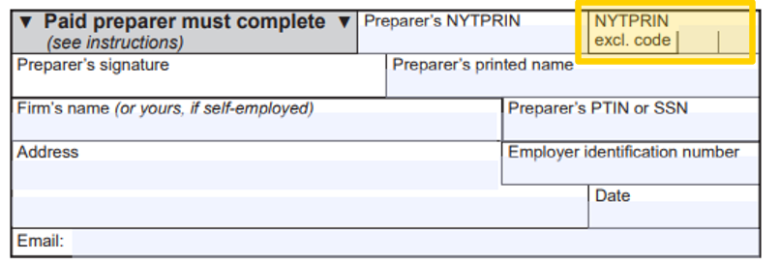
VITA/TCE Tax Preparer Code
Tax returns should include the site name and exclusion code 09 (volunteer tax preparer)
Note: you must set up the software with code 09 - volunteer tax preparer code.
Notes:
You should make sure to use the 09 - volunteer tax preparer code in your program. You do not need to enter volunteers name in the software or on the tax returns.

Slide 25
Driver License Information
At the submission stage taxpayers are required to provide their New York state driver license information, if they have it:
ID information is used to protect taxpayers from fraud and identity theft.
Only the first three characters of the document number (Doc #) are required.
If the taxpayer won’t disclose their ID information:
You may check the box to indicate the taxpayer does not have an ID.
You must document you used due diligence to obtain the information, and the taxpayer refused.
Notes:
Drivers license ID information is used to protect taxpayers from fraud and identity theft. The document number for the primary taxpayer and spouse are required. Only the first three characters of the document number are required. If the taxpayer won’t disclose their ID information, you may check the box to indicate the taxpayer does not have an ID; and you must document you used due diligence to obtain the information, and the taxpayer refused.
Note: do not set up system to not ask for the driver license information – it is required by New York State.

Slide 26
Amended Returns and Attachments
We treat an amended return as the taxpayer is filing for the first time.
Submit all forms relevant to the information on the amended return, such as:
forms for any credits that are claimed or amended,
forms submitted as attachments to the original return that are still applicable (for example, IT-196, IT-227, IT-201-ATT, or IT-203-ATT), and
all wage and tax statements, such as Form IT-2.
Do not submit a copy of the original IT-201, IT-203, or IT-195.

Slide 27
New York State and Local Sales Tax
New York State sales tax is owed if the taxpayer purchased property or a service delivered to them in New York State without payment of sales and use tax:
This includes purchases through the internet, by catalog, or from shopping channels on the television.
Most tangible personal property is subject to tax.
Do not leave the line blank.
Do not set software to auto fill with zero amount.
Notes:
You must ask taxpayers if they have any sales tax owed. New York State sales tax is owed if the taxpayer purchased property or a service delivered to them in New York State without payment of sales and use tax. This includes purchases through the internet, by catalog, or from shopping channels on the television. Most tangible personal property is subject to tax. Do not leave the line blank. Do not set software to auto fill with zero amount.

Slide 28
Print All Worksheets
Give copy of worksheets to taxpayers:
For both the federal and New York State returns, worksheets must be completed to support the information on a return.
A copy of the return should be printed and maintained for at least three years. It’s important that all worksheets be printed and kept with a copy of the return.
Taxpayers must maintain all documents that substantiate entries on a return. Worksheets are part of their supporting documentation.

Slide 29

Federal Legislation

Slide 30
Federal Legislation H.R. 1 (Public Law 119-21)
New federal deductions: H.R. 1 provides new temporary deductions for individuals, including tipped income, overtime pay, seniors (aged 65+), and auto loan interest.
Federal adjusted gross income (FAGI): is the starting point for computing New York State tax income tax.
New York tax treatment: As the new federal deductions under H.R. 1 are taken after the computation of FAGI, they will not flow through to New York unless the state specifically acts to adopt the changes.
Notes:
Federal provisions from House Resolution 1 include new temporary deductions for individuals, including deductions for tipped income, overtime pay, seniors (aged 65+), and auto loan interest.
When computing New York State tax income tax, the starting point is federal adjusted gross income.
As the new federal deductions under H.R. 1are taken after the computation of FAGI, they will not flow through to New York unless the state specifically acts to adopt the changes.
See New York State forms and instructions for additional information on how House Resolution 1 will impact NYS.
NOTE: THIS IS THE CURRENT TAX TREATMENT, AND THAT COULD CHANGE. The state budget process starts in January.
Reminder: The legislature passes tax legislation. The Tax Department is the administrator of the tax law.

Slide 31

Income Tax Changes
Notes:
Next, we’d like to highlight changes to New York State Income Tax, including changes to the:
Servicemembers Civil Relief Act of 2023,
Personal Income Tax Rates; and,
Metropolitan Commuter Transportation Mobility Tax (MCTMT).

Slide 32
Servicemembers Relief Act (Public Law 117-333)
New York State conforms to the Servicemembers Civil Relief Act (SCRA).
Under SCRA, a service member (and their spouse) may each elect, for purposes of taxation, any of the following (regardless of the date they were married):
the residence or domicile of the servicemember,
the residence or domicile of the spouse, or
the permanent duty station of the servicemember.
Important: to make this election, enter the applicable special condition code on the IT-201 or IT-203 return.
Visit www.tax.ny.gov (search: military)
Notes:
We mentioned the Servicemembers Relief Act last year, but we want to remind tax professionals of important provisions that impact servicemembers and their families.
2023 amendments allow servicemembers, and their spouses, greater flexibility to choose their state of domicile for tax purposes.
Under SCRA, servicemembers and their spouse can elect any of the following:
For more information on the Servicemembers relief act and how to report on the IT-201 and 203, visit our website Search military.
SCRA is not automatic.
For more information, visit our website and search “military”

Slide 33
Personal Income Tax Rates
For tax years beginning on or after January 1, 2026, tax rates are reduced for several income brackets. Most rate reductions will be phased in over two years and fully implemented by 2027.
The temporary top tax rates, previously scheduled to expire after tax year 2027, are extended through tax year 2032.
The tax table benefit recapture provisions are also amended to conform with these rate reductions.
Visit www.tax.ny.gov (search: tables)

Slide 34

Metropolitan Commuter Transportation Mobility Tax Calculation
The Metropolitan Commuter Transportation District (MCTD) is now divided into two zones:
Zone 1:
Zone 2:
includes the counties of New York (Manhattan), Bronx, Kings (Brooklyn), Queens, and Richmond (Staten Island).
includes the counties of Rockland, Nassau, Suffolk, Orange, Putnam, Dutchess, and Westchester.
Notes:
Calculating Metropolitan Commuter Transportation Mobility Tax (MCTMT) rate –
For tax years beginning on or after January 1, 2023, the MCTD is divided into two zones.
Zone 1 (includes the five boroughs of NYC)
Zone 2 (counties around NYC)

Slide 35
Self-employed Individuals Subject to the MCTMT (Article 23)
For tax years beginning on or after January 1, 2026, the MCTMT rates on net earnings from self-employment for individuals engaging in the business within MCTD are:
.60% (.0060) of the net earnings attributable to the MCTD within Zone 1, if such earnings exceed $150,000 for the tax year, and
.34% (.0034) of the net earnings attributable to the MCTD within Zone 2, if such earnings exceed $150,000 for the tax year.
The $150,000 thresholds are computed on an individual basis for each zone, even if you file a joint income tax return.
Visit www.tax.ny.gov (search: mctmt)
Notes:
For self-employed individuals, the budget provided relief by raising the exemption threshold from $50,000 to $150,000.
For tax years beginning on or after January 1, 2026, the MCTMT rates on net earnings from self-employment for individuals engaging in the business within MCTD are:
.60% (.0060) of the net earnings attributable to the MCTD within Zone 1, if such earnings exceed $150,000 for the tax year, and
.34% (.0034) of the net earnings attributable to the MCTD within Zone 2, if such earnings exceed $150,000 for the tax year.
Note: The $150,000 thresholds are computed on an individual basis for each zone, even if you file a joint income tax return.

Slide 36

Tax Credit Updates

Slide 37

Empire State Child Tax Credit (Article 22)
For tax year 2025, the credit is now:
$1,000 for each qualifying child under the age of four
$330 for each qualifying child aged four through sixteen
Form IT-213, Claim For Empire State Child Tax Credit

Slide 38
Empire State Child Tax Credit (Article 22)
For tax years 2026 and 2027, taxpayers may claim:
$1,000 per qualifying child under the age of four
$550 per qualifying child aged four through 16
Form IT-213, Claim For Empire State Child Tax Credit

Slide 39
Empire State Child Tax Credit (Article 22)
The credit amount will be reduced by $16.50 for every $1,000 when federal adjusted gross income exceeds the income threshold for the filing status below:
married filing joint return: $110,000;
single, head of household, or qualifying surviving spouse: $75,000; or
married filing a separate return: $55,000.
Form IT-213, Claim For Empire State Child Tax Credit
Notes:
The credit is phased out when FAGI exceeds applicable thresholds for the specific filing threshold shown here.

Slide 40
Real Property Tax Credit (Article 22)
For tax years beginning on or after January 1, 2025, eligibility for the credit is based on federal adjusted gross income (FAGI) instead of household gross income.
The household concept for determining qualifying taxes and splitting the credit has been eliminated.
The credit brackets have been condensed, and the credit amount is now a flat amount based on FAGI.
Form IT-214, Claim for Real Property Tax Credit
Notes:
For tax years beginning on or after January 1, 2025, a new credit is available to eligible full-year or part-year New York City residents that may reduce or eliminate New York City personal income tax liability.
The credit is available for full-year or part-year New York City residents who:
claim one or more dependents,
have a FAGI no more than $5,000 above the applicable income threshold,
do not claim a New York City or New York State Pass-through entity tax (PTET) credit, and
have investment income of $10,000 or less.
The credit shall be applied against any remaining New York City liability after accounting for all other tax credits and may not reduce New York City tax to less than zero.
The form for this credit is the IT-270, New York City Income Tax Elimination Credit

Slide 41
New York City Income Tax Elimination Credit (Article 30)
For tax years beginning on or after January 1, 2025, a new credit is available to eligible taxpayers that may reduce or eliminate their New York City resident income tax liability.
An eligible taxpayer is a New York City resident, who claims at least one or more dependents, with a FAGI no more than $5,000 above the applicable income threshold.
The taxpayer cannot claim either the New York City or New York State Pass-through entity tax (PTET) credit and cannot have more than $10,000 in investment income.
Form IT-270, New York City Income Tax Elimination Credit
Notes:
For tax years beginning on or after January 1, 2025, a new credit is available to eligible full-year or part-year New York City residents that may reduce or eliminate New York City personal income tax liability.
The credit is available for full-year or part-year New York City residents who:
claim one or more dependents,
have a FAGI no more than $5,000 above the applicable income threshold,
do not claim a New York City or New York State Pass-through entity tax (PTET) credit, and
have investment income of $10,000 or less.
The credit shall be applied against any remaining New York City liability after accounting for all other tax credits and may not reduce New York City tax to less than zero.
The form for this credit is the IT-270, New York City Income Tax Elimination Credit

Slide 42
New York City Income Tax Elimination Credit (Article 30)
Income Threshold Table
Married filing joint return or Qualifying surviving spouse |  | Married filing separate return, Single or Head of household
Number of dependents | Income Threshold | Number of dependents | Income Threshold
1 | $36,789 | 1 | $31,503
2 | $46,350 | 2 | $36,824
3 | $54,545 | 3 | $46,512
4 | $61,071 | 4 | $53,711
5 | $68,403 | 5 | $59,928
6 | $75,204 | 6 | $65,712
7 or more | $91,902 | 7 | $74,565
 |  | 8 or more | $88,361
Notes:
The applicable threshold varies by the number of dependents claimed shown here.
The threshold goes from a low of $36,789 ($31,503 singles) with one dependent to a high of $91,902 ($88,361 singles) with 7 or more dependents (8 or more for singles).
Note: the credit shall be applied against any remaining New York City liability after accounting for all other tax credits and may not reduce New York City tax to less than zero.

Slide 43
Central Business District Toll Credit (Article 22)
Taxpayers are eligible for this credit if:
their primary residence during the year was in New York City’s Central Business District (also known as the Congestion Relief Zone);
they have a New York adjusted gross income of less than $60,000 for the year; and
they paid Central Business District tolls (Congestion Relief Zone tolls) during the year (excluding any tolls used as a trade or business expense).
Form IT-268, Central Business Toll Credit

Slide 44
Geothermal Energy System Credit (Article 22)
The limitation on the credit amount increased to $10,000 for qualified systems placed in service on or after July 1, 2025.
For tax years beginning on or after January 1, 2026, taxpayers may elect to receive the excess credits amount as a refund as follows:
married filing jointly or qualifying surviving spouses: FAGI of $180,000 or less, or
single, married filing separately, or heads of household: FAGI of $90,000 or less.
Form IT-267, Geothermal Energy System Credit
Notes:
The limitation on the credit amount increased to $10,000 for qualified systems placed in service on or after July 1, 2025.
For tax years beginning on or after January 1, 2026, taxpayers who meet certain income requirements may elect to receive any unused credit amount as a refund.
The form for this credit is the Form IT-267, Geothermal Energy System Credit
Background:
The credit is for:
purchased geothermal energy system equipment, or
entered into a written agreement for the lease of geothermal energy system equipment,
Note: The geothermal energy system must use solar thermal energy stored in the ground or bodies of water to produce heat for residential use, commonly known as a ground source heat pump.

Slide 45

Green Energy Credits (Articles 22, 9-A, and 9)
Clean Heating Fuel Credit:
This refundable credit has been extended through tax years beginning before January 1 , 2029.
Applies to purchases of bio heating fuel for residential purchases.
Form CT/IT-637, Alternative Fuels and Electric Vehicle Recharging Property Credit
Notes:
The clean heating fuel credit has been extended through tax year 2028
Applies to purchases of bio heating fuel for residential purchases before January 1, 2029.
The forms for this credit are the CT/IT-637, Alternative Fuels and Electric Vehicle Recharging Property Credit
Background: The credit is available to taxpayers for the purchase of bioheating fuel used for space heating or hot water production for residential purposes within New York State.

Slide 46

Pension and Annuity Income

Slide 47
Pension and Annuity Income
Pension income is not taxable in New York State when it is paid by:
1
1
2
3
New York State or a local government
The federal government, including Social Security benefits
Certain public authorities

Slide 48
Pension and Annuity Income Exclusion
For pension income that is taxable to New York:
If a taxpayer is over the age of 59 ½ or turns 59 ½ during the tax year, they may qualify for a pension and annuity exclusion of up to $20,000.
If a taxpayer became age 59 ½ during the tax year, the exclusion is allowed only for the amount of pension income received on or after they became 59 ½.
In order to subtract the pension and annuity income, it must be reported as income on the New York State return.

Slide 49
Pension and Annuity Income Exclusion
For pension income that is taxable to New York:
Married taxpayers who both receive pension income are each entitled to a maximum exclusion of $20,000.
Note: taxpayers cannot claim any unused portion of the spouse’s exclusion.
Taxpayers who receive their own pension income and a deceased spouse’s pension income, are entitled to a maximum exclusion of $20,000 each year.

Slide 50

Supplemental Retirement Plans for Public Employees
Deferred compensation plans are not public pensions and do not qualify for the public pension exclusion.
Taxpayers can exclude distributions up to $20,000 from a deferred compensation plan, provided they were at least 59 ½ at the time of the distribution.
Visit www.tax.ny.gov (search: seniors)

Slide 51

Pension and Annuity Income Example 1
Married taxpayers filing jointly:
Spouse 1 (age 59 ½) received $30,000 in pension income from New York State
Spouse 2 (age 60) received $10,000 in taxable pension income
+
Total pension subtraction allowed = $40,000

Slide 52
Pension and Annuity Income Example 2
Married taxpayers filing jointly:
Spouse 1 (age 55) received $35,000 in pension income from the federal government
Spouse 2 (age 56) received $15,000 in taxable pension and annuity income
+
Total pension subtraction allowed = $35,000

Slide 53
Pension and Annuity Income Example 3
Married taxpayers filing jointly:
Spouse 1 (age 63) received $30,000 in pension income from the state of New Jersey
Spouse 2 (age 58) received $10,000 in taxable pension and annuity income
+
Total pension subtraction allowed = $20,000

Slide 54
Pension and Annuity Income Example 4
Taxpayer filing as Head of Household or Single:
Taxpayer (age 62)
received $50,000 in pension income from New York State
withdrawal from deferred compensation of $30,000
Total pension subtraction allowed = $70,000

Slide 55
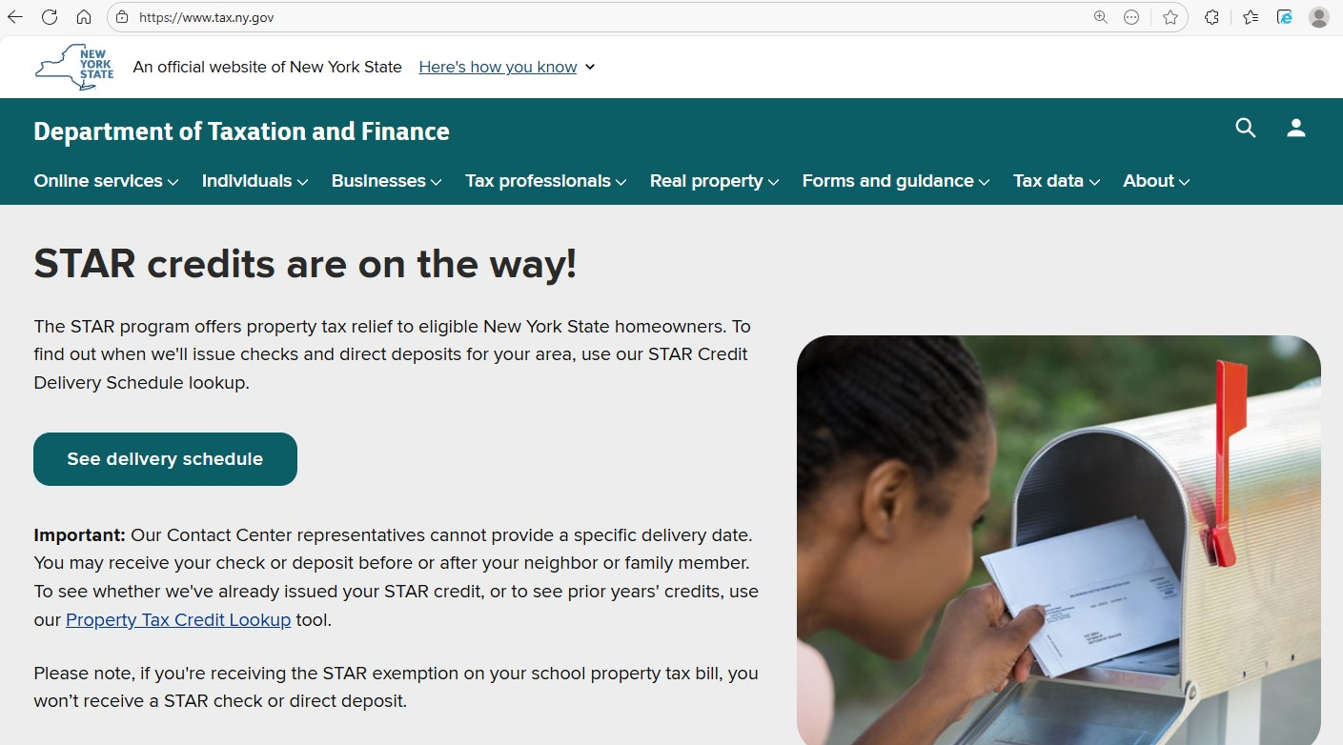
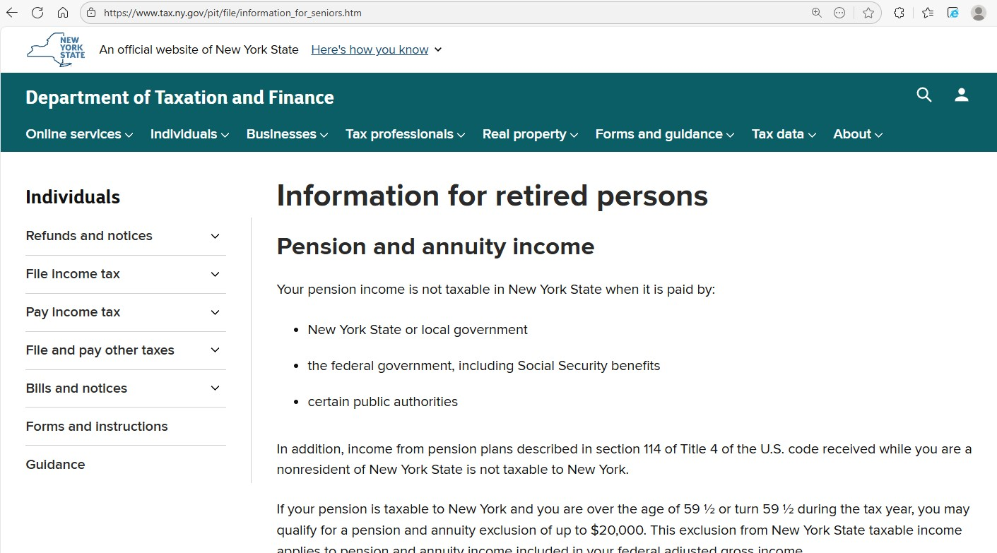
Resources for Seniors and Retired Persons
Visit www.tax.ny.gov (search: seniors)

Slide 56

Filing Reminders

Slide 57
New York City or Yonkers Residents
Taxpayers must report New York City resident income tax or Yonkers resident income tax surcharge on their state return if they:
were a New York City or Yonkers resident for the tax year, and
are required to file a New York State return.
New York City includes the Bronx, Brooklyn, Manhattan, Queens, and Staten Island.
Taxpayers who changed their New York City or Yonkers resident status during the year must complete Form IT-360.1, Change of City Resident Status and include with Form IT-201 or IT-203.
Form IT-360.1, Change of City Resident Status

Slide 58
Nonresident and Part-Year Resident Income Allocation
Nonresidents and Part-year residents are required to file Form IT-203-B with Form IT-203, if the taxpayer:
marked “yes” in item H, indicating they or their spouse maintained living quarters in NYS in 2025 (return currently rejects in this scenario if IT-203-B is not attached); or
earned salary or wages both inside and out of NYS during 2025 (workdays in and out of New York need to be entered), or
is claiming the college tuition itemized deduction.
Form IT-203-B, Nonresident and Part-Year Resident Income Allocation

Slide 59
New York Resident Credit
If the taxpayer paid tax to both a state and one or more local governments within that state on the same or different amounts of income, use only one Form IT-112-R.
If the taxpayer paid tax to both a state and one or more local governments within that state on different amounts of income, include in column B the larger amount of income subject to tax by either the state or one or more local governments with that state.
Using multiple IT-112-R forms and separating the taxes paid to a state and local government(s) within that state provides the taxpayer with a higher resident credit than they are entitled to claim.
Notes:
This change was communicated to the software vendors. But just something to watch out for.

Slide 60


Wage and Withholding Transcripts
Current tax year information:
If a taxpayer misplaced or lost their Form W-2, they can request a state wage and tax transcript beginning on April 19th.
Prior tax year information:
Taxpayers can request a transcript by calling 518-457-5181.

Slide 61

Taxpayer Resources

Slide 62
Tax Department Website
Visit www.tax.ny.gov

Slide 63








Contact Us
To find assistance, scroll to the bottom of our website and select Contact Us under Get Help.
Customer Service
Telephone Assistance
Provide
Feedback
Follow us on social and subscribe to our emails to receive tax tips, news and the latest guidance.
Connect with Us

Slide 64

Language Assistance
To increase taxpayer access to tax information, we:
Translate many important forms and documents in at least the 12 most commonly spoken languages in New York State.
Offer free interpretation services by calling 518-453-8137.
Visit www.tax.ny.gov (search: language)

Slide 65

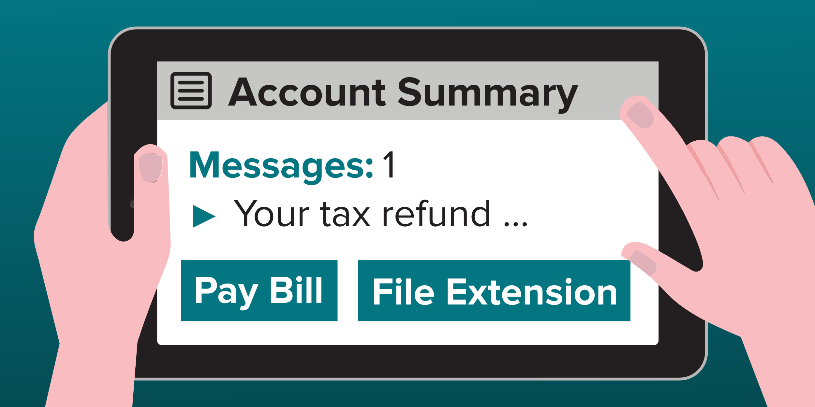
Individual Online Services Account
Free and secure way to manage tax information – anywhere, anytime.
With an individual account, taxpayers can:
pay a bill
file an income tax extension
respond to a department notice
sign up for refund notifications
review your filing history
and more

Slide 66


Requests for Additional Information
Form DTF-948 or DTF-948-O, Request for Information (RFI), is used to request additional information or documentation.
It’s important to respond by the date printed on the letter.
Easiest, fastest way to respond is through the Respond to Department Notice application in Online Services.

Slide 67

Protest Rights
Certain notices (additional tax due, refund denial) have protest rights
Taxpayers must respond within 90 days and request either
Free conciliation conference
Tax Appeals hearing
Respond within
90 days
Visit www.tax.ny.gov (search: protest)

Slide 68
Installment Payment Agreements
If a taxpayer is unable to pay a tax bill in full, they can:
request an installment payment agreement (IPA), and
make monthly payments towards the unpaid tax balance.
Easiest and fastest
way to request an IPA
through Online Services
Balance of $20,000 or less
with 36 or fewer monthly payments
Visit www.tax.ny.gov (search: ipa)

Slide 69
Voluntary Disclosure and Compliance Program
If a taxpayer owe back taxes and haven't filed related returns:
telling the department what taxes they owe;
paying those taxes; and
entering an agreement to pay all future taxes.
Avoid monetary penalties and possible criminal charges
It’s easy to apply
answer a few questions, and submit your application electronically
Visit www.tax.ny.gov (search: vold)
Notes:
RS: NEW SLIDE

Slide 70

Protect Personal Information
Scammers will use scare tactics to get individuals to share personal and financial information with them.
Scammers may:
demand immediate payment for a tax debt;
make threats over the phone, possibly with police action or deportation; or
demand payment in a specific way, such as through prepaid debit cards, gift cards, or in person.

Slide 71
Protect Personal Information
The Tax Department and the IRS will never:
request personal information over the phone, or by text or email
threaten taxpayers for failure to pay a tax debt;
refuse a request to call us back using a number found on our website; or
demand taxpayers pay taxes without the option to question or appeal the amount owed.

Slide 72

Report Fraud or Identity Theft
Report a scam
For more information, visit www.tax.ny.gov (search: fraud) for more information on common scams and how to report them to the Tax Department.
Report identity theft
complete Form DTF-275, Identify Theft Declaration
mail or fax to the Tax Department

Slide 73
Taxpayer Rights Advocate
Provides free and independent New York State tax issue assistance.
Ensures that the taxpayer’s New York State tax issue is reviewed in a timely manner.
Helps the taxpayer understand important notices and deadlines.
Explains taxpayer rights and responsibilities under the New York State Tax Law.
Helps resolve long-standing tax issues.

Slide 74
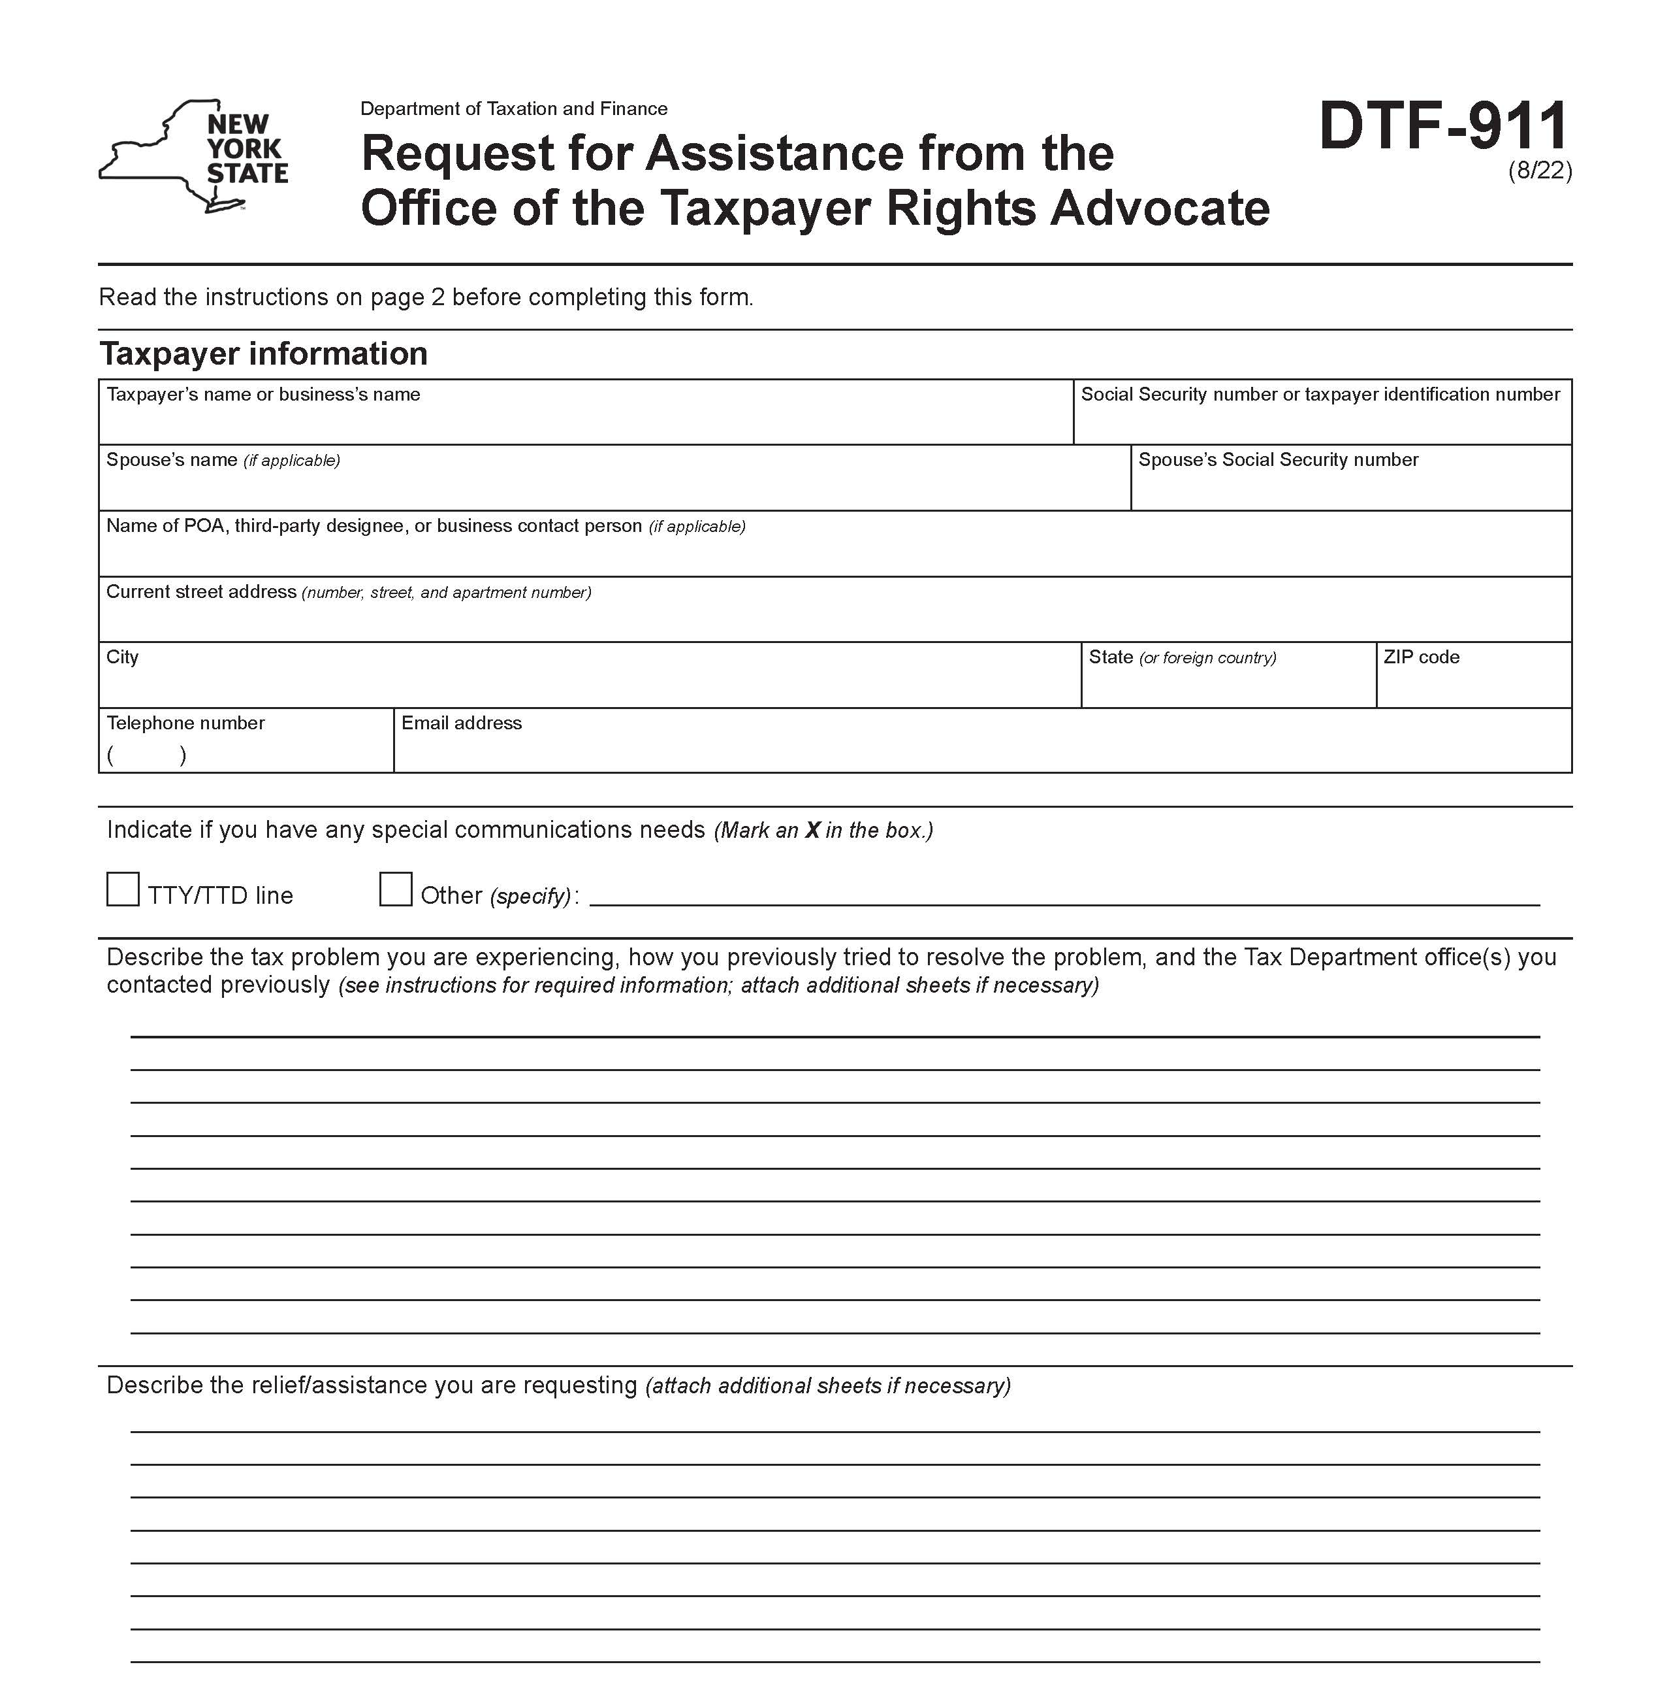
Get Help From the Advocate
The Office of the Taxpayer Rights Advocate (OTRA) works with taxpayers and the Tax Department to find tax issue resolution.
For assistance:
complete Form DTF-911
fax or mail to department
Call: 518-530-4357
You will be assigned an advocate.
Visit www.tax.ny.gov (search: advocate)

Slide 75
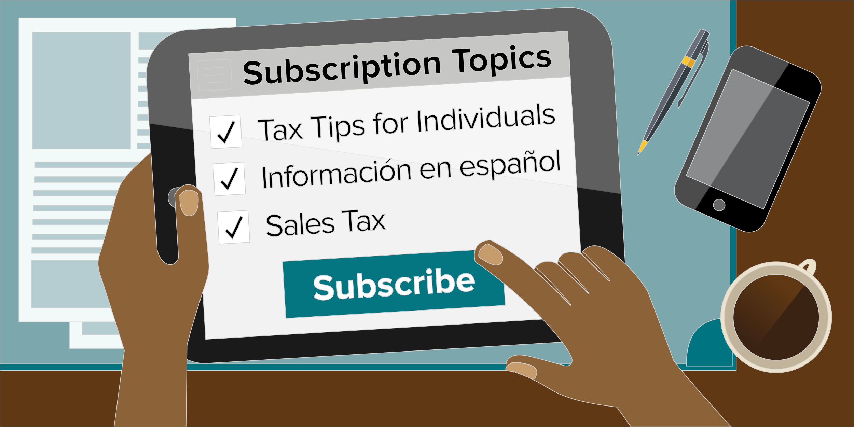

Subscription Services
Subscribe to tax tips, news, and updates
Visit www.tax.ny.gov (search: subscribe)
Notes:
Can't get enough of Tax? Subscribe to receive emails with tax tips, news, and the latest guidance. From our website search subscribe.

Slide 76
Subscription Services
Tax Type Information
Adult-use cannabis
Alcoholic beverages tax and beverage container deposits
Cigarette, tobacco, and vapor products taxes
Congestion surcharge
Corporation tax
Employer Compensation Expense Program
Medical cannabis and opioid taxes
Metropolitan commuter transportation mobility tax (MCTMT)
Miscellaneous tax
Personal income tax
Real estate transfer tax and mortgage recording tax
Sales tax
Sales tax exempt organizations
Wireless communications surcharges
Withholding tax
Partnerships
Pass-through entity tax (PTET)
Highway use tax (HUT)
IFTA
Estate tax
Subscribe to receive emails with:
tax tips
tax guidance, such as new publications or regulation changes
filing updates and reminders, and
press releases.
Notes:
Subscription emails are the place we send them out first, so please make sure you sign up! You can receive emails with tax tips, the latest guidance, filing updates and reminders, and press releases. You can tailor your email subscriptions to the tax information you need. If you haven’t checked your subscriptions lately, you should review them to make sure you have everything checked off that you want information on.

