Slide 1
Volunteer Pensions and Annuities Training
Tax Year 2024
Notes:
Welcome to the Income Tax Assistance Volunteer Training for Tax Year 2024. I am (enter name), the (Title) for the (Division) at the New York State Department of Taxation and Finance. I am pleased to be presenting you this training. I would like to start by letting all of you know how valued you are to our Department. Your assistance to those taxpayers that need it most, through tax preparation and other financial literacy services, is essential to the communities you serve and to New York State as a whole. Our goal is to make sure you have the information you need to help others so let’s review our agenda.

Slide 2
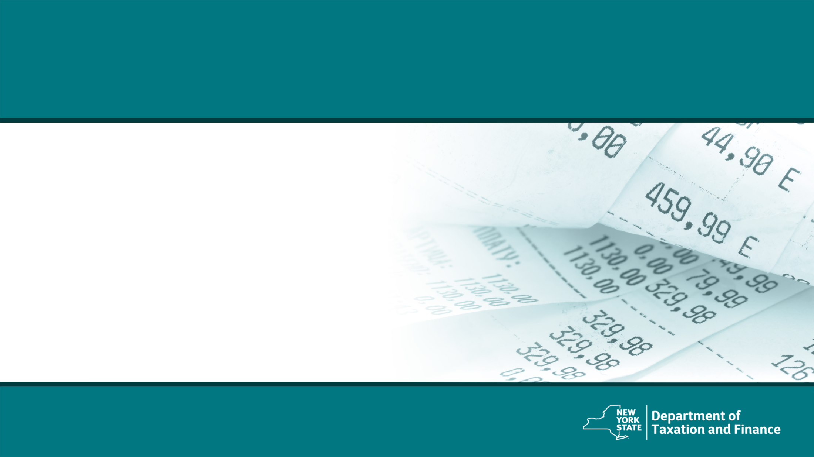
Federal Income and Adjustments
Notes:
Let’s start with income and adjustments.

Slide 3
Federal Income and Adjustments
The computation of New York State, New York City, and Yonkers income tax is based on the information reported on the federal income tax return, including income and federal adjustments to income.
Federal adjusted gross income (FAGI) is gross income minus adjustments to income.
Gross income includes wages, dividends, capital gains, business income, retirement distributions, as well as other income.
Notes:
The computation of New York State, New York City, and Yonkers income tax is based on the information reported on the federal income tax return, including income and federal adjustments to income.
Federal adjusted gross income (FAGI) is gross income minus adjustments to income.
Gross income includes wages, dividends, capital gains, business income, retirement distributions, as well as other income.

Slide 4
Addition and Subtraction Modifications
Notes:
Next we will discuss addition and subtraction modifications, first let’s explain why we have these modifications.

Slide 5
New York State Modifications
New York State taxes certain items of income not taxed by the federal government. Taxpayers must add these New York additions to FAGI.
Similarly, New York State does not tax certain items of income taxed by the federal government. Taxpayers must subtract these New York subtractions from FAGI.
New York adjusted gross income (NYAGI) is federal adjusted gross income after certain New York additions and New York subtractions (modifications).
Notes:
New York State taxes certain items of income not taxed by the federal government. Taxpayers must add these New York additions to FAGI.
Similarly, New York State does not tax certain items of income taxed by the federal government. Taxpayers must subtract these New York subtractions from FAGI.
New York adjusted gross income (NYAGI) is federal adjusted gross income after certain New York additions and New York subtractions (modifications).
For these additions and subtractions some items have their own line items on the return, but other items are included on the IT-225. The software will place them appropriately.

Slide 6
Form IT-225
New York State Addition and Subtraction modifications are generally reported on Form IT-225, New York State Modifications, unless specifically noted.
Notes:
New York State Addition and Subtraction modifications are generally reported on Form IT-225, unless specifically noted.
For these additions and subtractions some items have their own line items on the return, but other items are included on the IT-225. The software will place them appropriately.

Slide 7
Common New York State Additions
Public employee 414(h) retirement contributions
Interest income on state and local bonds
Net gain from casualty and theft loss
New York City flexible benefits program (IRC 125)
New York’s 529 college savings program distributions
Notes:
Some common new York state additions include:
Interest income on state and local bonds
Net gain from casualty and theft loss
Public employee 414(h) retirement contributions
New York City Flexible Benefits Program (IRC 125) amounts deducted or deferred from salary
New York’s 529 college savings program
Let’s go into these one at a time.

Slide 8
414(h) Retirement Contributions
Taxpayers who are a member of a public employee retirement system must report 414(h) retirement contributions as an addition modification to their FAGI on the New York State return.
Public employee retirement systems include:
New York State and Local Retirement System
New York City Retirement System
New York City Police Pension Fund
New York City Teachers Retirement System
Notes:
Regarding the 414H contributions and the IRC 125 flexible benefit programs:
Taxpayers must report 414(h) retirement contributions as an addition modification to their Federal Adjusted Gross Income (FAGI) on the New York State return. These contributions are related to the New York State and Local Retirement System; New York City Retirement System; New York City Police Pension Fund, or New York City Teachers Retirement System.

Slide 9
414(h) Retirement Contributions
414(h) retirement contributions are reported to the employee in box 14 on Form W-2.
This addition modification is reported on:
Line 21 of Form IT-201 (Residents), and
Line 21 of Form IT-203 (Nonresidents and Part-year Residents)
Notes:
Reported to the employee in box 14 on Form W-2.
414(h) pension contributions are added on line 21 of Form IT-201, Resident Income Tax Return and on line 21 of Form IT-203, Nonresident and Part-year Resident Income Tax Return.
(Line numbers verified – 2023 2022)

Slide 10
Pensions and Annuities Examples
Notes:
Some taxpayers incorrectly exclude pension income or take an excessive pension subtraction.

Slide 11
Pensions and Annuities
Two New York State subtractions for pension income:
Pensions of New York State, local governments within New York State, and the federal government – 100% subtraction
Pension and annuity income exclusion – up to $20,000 subtraction
taxpayer must be over the age of 59 ½
if the taxpayer turned 59 ½ during the tax year, the exclusion is only allowed for income received on or after they became 59 ½
Notes:
Some taxpayers incorrectly exclude pension income or take an excessive pension subtraction so this is an important area.
There are two New York State subtractions for pension income:
100% of pensions of New York State and local governments and the federal government can be excluded, or
the $20,000 pension and annuity income exclusion.
Be aware that deferred compensation or supplemental pension income is not fully excludable government pension income.
A pension or annuity subtraction may only be claimed if pension income was included in total income. And you should be aware that pension and annuity income includes the TY2022 income getting recognized from a qualified COVID distribution that was taken in TY2020 where the income was spread over 3 years.

Slide 12
Pensions and Annuities
If a taxpayer received pension income as a beneficiary and the decedent would have been 59½ if they continued to live, the beneficiary is eligible for an exclusion with certain limitations.
The exclusion must be prorated amongst all beneficiaries in the same ratio as the distribution is shared, even if not all beneficiaries are New York residents.
Notes:
If a taxpayer received pension income as a beneficiary and the decedent would have been 59½ if they continued to live, the beneficiary is eligible for an exclusion with certain limitations. The exclusion must be prorated amongst all beneficiaries in the same ratio as the distribution is shared, even if not all beneficiaries are New York residents.
I want to remind you that there is a pension subtraction handout which goes over the ins and outs of pensions on the website under training. It’s CO-60.

Slide 13
Pension Example 1
Married filing jointly
Taxpayer: age 59, received $30,000 from a government pension (NYS, local governments within NYS, and the federal government)
Spouse: age 60, received $10,000 from a private (non-government) pension
Total pension subtraction allowed = $40,000
NYS, local governments within NYS, and the federal government pensions qualify for the full exclusion regardless of age
Notes:
Total pension subtraction allowed = $40,000
New York State and local governments (of NYS) and the federal government plans qualify for full exclusion regardless of age.
Let’s look at some examples on how to enter the exclusion for taxpayer who qualifies for exclusion.

Slide 14
Enter Basic Retirement Income
From the Federal Section, Income page, click the Form 1099-R, RRB, SSA line to display the IRA/Pension Distributions landing page.
Next, on the IRA/Pension Distributions landing page, click the Add or Edit a 1099-R line.

Slide 15
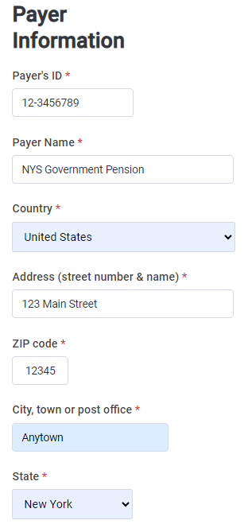
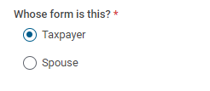
Enter Payer Information
On the Form 1099-R page, if preparing a married filing joint return, select whether this Form 1099-R is for the taxpayer or the spouse.
Next, enter the Payer Information as shown on Form 1099-R.

Slide 16
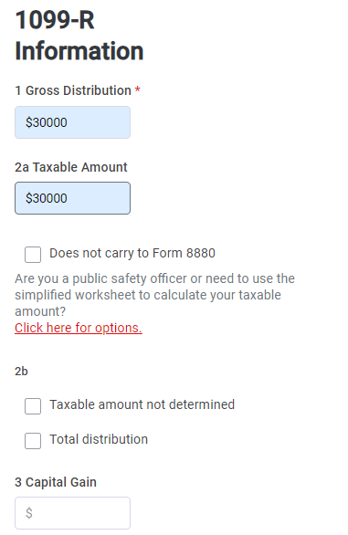
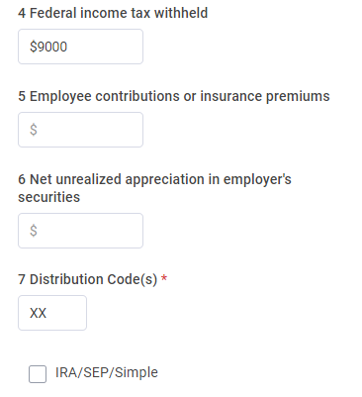
Enter 1099-R Information
Enter the information shown on Form 1099-R, including Gross Distribution and any federal withholdings.
Reminder: be sure to enter the correct distribution code in box 7

Slide 17
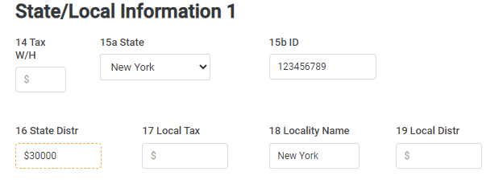
Enter State/Local Information
Next, enter the State/Local Information as shown on Form 1099-R, including any state distributions.

Slide 18
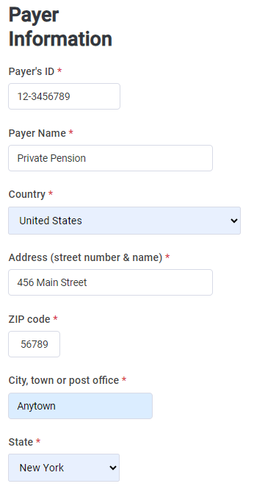
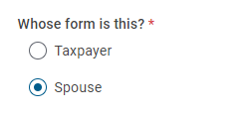
Enter Spouse Retirement Income
On the Form 1099-R page, select Spouse.
Next, enter the Spouse’s Payer Information as shown on Form 1099-R.

Slide 19
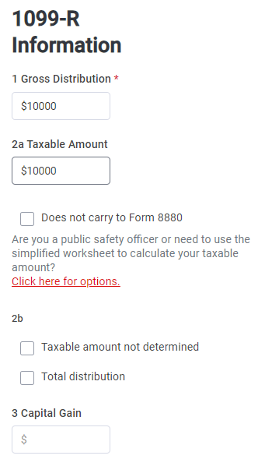
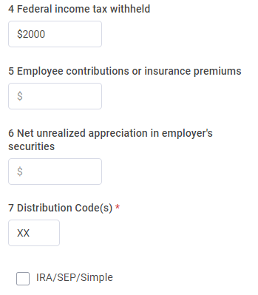
Enter Spouse Retirement Income
Enter the information shown on the Spouse’s Form 1099-R, including Gross Distribution and any federal withholdings.
Reminder: be sure to enter the correct distribution code in box 7

Slide 20
Enter Spouse Retirement Income
Next, enter the Spouse’s State/Local Information as shown on Form 1099-R, including any state distributions.

Slide 21
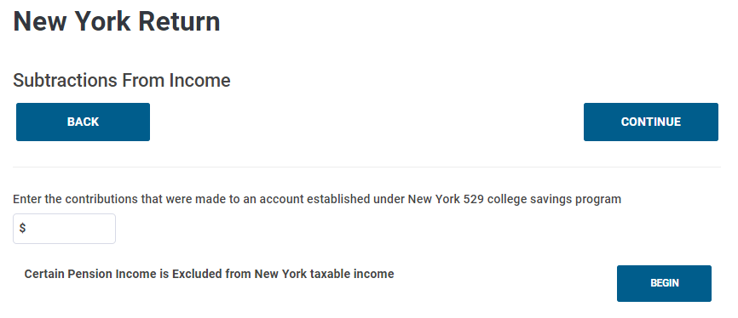
Enter Pension Income Exclusion
From the State section, New York Return landing page, click on Subtractions From Income, then select Certain Pension Income Is Excluded From New York Taxable Income.
Notes:
Note to Graphics Team: please highlight where is says: “Entry under the NYS, local and federal governments” and “Taxpayer: $30,000” entry
Speakers Note: Exclusion amount on 1099-R for taxpayer who qualify for exclusion. In this example, the taxpayer qualifies for $30,000 exclusion based on retirement income from government pension. In addition, Spouse qualify for $10,000 exclusion for “private” pension because they were 59 ½ at the time they received the payments. The total pension subtraction allowed for taxpayer and spouse= $40k

Slide 22
Enter Pension Income Exclusion
TaxSlayer has two questions for pension income:
Pensions received from New York State, Local, and Federal governments
2. Other taxable pensions (not included above) for private pension income

Slide 23
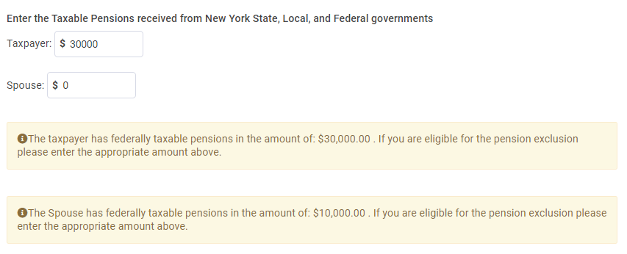
Enter Pension Income Exclusion
Example 1: the Taxpayer can enter a pension exclusion of $30,000 for their New York government pension.
Notes:
Speakers Note: Exclusion amount on 1099-R for taxpayer who qualifies for the exclusion. In this example, the taxpayer qualifies for $30,000 exclusion based on retirement income from government pension.

Slide 24
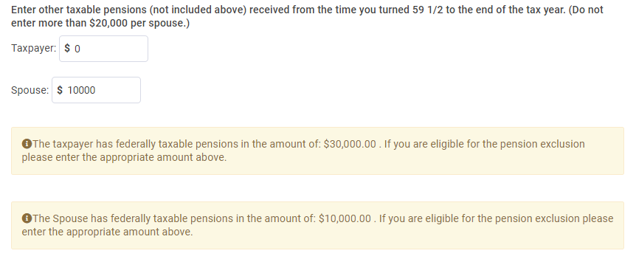
Enter Spouse’s Pension Income Exclusion
Example 1: the Spouse can enter a pension exclusion of $10,000 for their private pension as they were over 59 ½ at the time of the distribution.
Notes:
In addition, Spouse qualifies for $10,000 exclusion for “private” pension because they were 59 ½ at the time they received the payments. The total pension subtraction allowed for taxpayer and spouse= $40k

Slide 25
Subtraction On New York Return
The New York return will reflect the proper pension exclusions on Lines 26 and 29, respectively.

Slide 26
Pension Example 2
Married filing jointly
Taxpayer: age 52, received $35,000 from a government pension (NYS, local governments within NYS, and the federal government)
Spouse: age 52, received $15,000 from a private pension
Total pension subtraction allowed = $35,000
Spouse 2 does not qualify for the $20,000 pension and annuity income exclusion as they were not aged 59½ or older
Notes:
Married filing jointly
Spouse 1 - age 52. Received $35,000 in pension from public government job (federal, New York State, or New York State local government)
Spouse 2 - age 52. Received $15,000 from a private pension.
Total pension subtraction allowed = $35,000
Spouse 1 qualify for the full subtraction on the government plan
Spouse 2 doesn’t qualify for up to $20,000 since they were not ages 59½ or older.

Slide 27
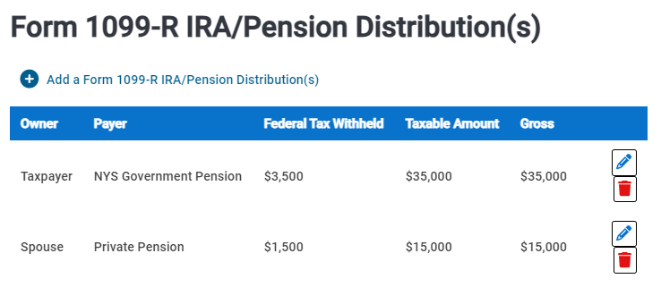
Entering Pension Exclusion Income
After entering Form 1099 information for the Taxpayer and Spouse, the summary page will display the following:
Notes:
Speakers note: On the New York State return: enter exclusion for taxpayer who qualifies for an exclusion.
In this example: New York Taxpayer-three qualifies for a $35,000 exclusion based on retirement income from government pension in the amount of $35,000.
New York Taxpayer-Four do not qualify for any exclusion. Although the total 1099 income was $50,000, the total pension subtraction allowed = $35,000

Slide 28
Enter Pension Income Exclusion
The Taxpayer can exclude the $35,000 of pension income received from their NYS government pension.
The Spouse cannot exclude the $15,000 of pension income received from their private pension as they were not 59 ½ at the time of the distribution.
Remember: it’s important to verify the age of the taxpayer when determining the pension exclusion

Slide 29
Subtraction On New York Return
Line 10 reflects the taxable amount of Pensions and Annuities entered in the Income section.
Line 26 reflects the subtraction for the NYS government pension.
Line 33 reflects the New York adjusted gross income of $15,000.
Notes:
Let’s look at another example.

Slide 30
Pension Example 3
Married filing jointly
Spouse 1: age 63, received $30,000 from a New Jersey (NJ) state pension
Spouse 2: age 58, received $10,000 from a private pension
Total pension subtraction allowed = $20,000
Pensions of states – other than New York State – are considered private plans. Spouse 1 does qualify for the $20,000 exclusion they were aged 59½ or older
Spouse 2 does not qualify as they were not aged 59½ or older

Slide 31
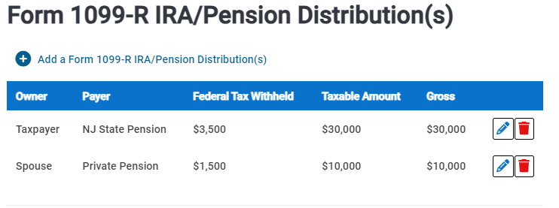
Return Summary Before Exclusion
After entering Form 1099 information for the Taxpayer and Spouse, the summary page will display the following:

Slide 32
Enter Pension Income Exclusion
The Taxpayer’s NJ State pension does not qualify for the NYS, Local, and Federal government exclusion.
The Taxpayer can exclude $20,000 of other taxable pensions.
The Spouse was not 59 ½ at the time of their distribution and does not qualify for an exclusion.

Slide 33
Subtraction On New York Return
Line 10 reflects the taxable amount of Pensions and Annuities entered in the Income section
Line 29 reflects the maximum amount of $20,000 “Private” pension subtractions
Line 33 reflects the New York adjusted gross income amount of $20,000 ($10,000 for the taxpayer and $10,000 for spouse who was under age 59 ½).
Notes:
Spouse 1 - age 63. Received $20,000 exclusion for the pension from New Jersey state job
Spouse 2 - age 58. do not receive any exclusion since they were not age 59 1/2 or older
Total pension subtraction allowed = $20, 000.
Let’s look at another example.

Slide 34
Pension Example 4
Head of household or single
Age 62, received $50,000 from a New York State pension
Received $30,000 from NYS Deferred Compensation Plan withdrawal
Total pension subtraction allowed = $70k
NYS Deferred Compensation Plan withdrawals qualify for the exclusion up to $20,000 as they were aged 59½ or older.
Notes:
Head of household or single
Age 62. Received $50k in pension from New York State job
Received $30,000 from New York State Deferred Compensation Plan withdrawal
Total pension subtraction allowed = $70k
New York State Deferred Compensation Plan is a private plan. The withdrawal qualify for up to $20,000 since they were ages 59½ or older.

Slide 35
Return Summary Before Exclusion
After entering Form 1099 information for the Taxpayer, the summary page will display the following:

Slide 36
Enter Pension Income Exclusion
The Taxpayer can exclude the $50,000 of NYS government pension income.
The Taxpayer can exclude the $20,000 of NYS Deferred Compensation income as other taxable pensions.
Remember: the maximum pension exclusion for other taxable pensions is $20,000

Slide 37
Subtraction On New York Return
Line 10 reflect the taxable amount of Pensions and Annuities you entered in the income section
Line 26 reflect the amount of “Private” pension subtractions for New York State and local governments and the federal government
Line 29 reflect the amount of “Private” pension subtractions
Line 33 reflect the New York adjusted gross income

Slide 38
Pension and Annuity Income Resources
Publication 36, General Information for Senior Citizens and Retired Persons.
Form CO-60, Common questions and answers about pension subtraction adjustments.
Notes:
Publication 36, General Information for Senior Citizens and Retired Persons, available on our website under Forms and Guidance
Form CO-60, Common questions and answers about pension subtraction adjustments.

Slide 39
Efficiency
● Integrity
● Fairness
Notes:
We covered a lot with this training, I hope it will help you to help others with filing their 2021 tax returns. Thank you again for all that you do to help the taxpayers of the state of New York.

