Slide 1
Income Tax Assistance Volunteer Training
Tax Year 2023
Notes:
Welcome to the Income Tax Assistance Volunteer Training for Tax Year 2023. I am (enter name), the (Title) for the (Division) at the New York State Department of Taxation and Finance. I am pleased to be presenting you this training. I would like to start by letting all of you know how valued you are to our Department. Your assistance to those taxpayers that need it most, through tax preparation and other financial literacy services, is essential to the communities you serve and to New York State as a whole. Our goal is to make sure you have the information you need to help others so let’s review our agenda.

Slide 2
Efficiency: Compliance Continuum
Our mission:
To efficiently collect tax revenues in support of state services and programs, while acting with integrity and fairness in the administration of the tax laws of New York State.
Notes:
Some of you may have seen this Compliance Continuum slide in the past. It shows how actions can be taken by both taxpayers and the Department which enable us to be more efficient. These actions on the left side of the continuum like proposing legislation, publishing clear guidance and instructions, and, for taxpayers, filing their returns and making payments timely, also cost both the taxpayers and Department less money. On the right side we have the more expensive and time-consuming things like audits, collections and litigation.
While the department will always have some activity on the right side of the continuum, the left is really where we have tried to focus on improvement opportunities.

Slide 3
Department Focus
Improving the taxpayer experience
Form Clarity and Translation Project
form instructions are moving to html pages
forms will be written clearer for easier translation
Tax Modernization
reduce manual processes and expand self-service options for taxpayers
enhance the use of analytics in our processing
Notes:
Department have three primary focus:
Improving the Taxpayer experience: As we look to be more efficient, we also have been very focused on improving the taxpayer experience. Throughout the Department, our operational units are engaged in ongoing evaluation of how we interact with the public and, based upon feedback from the public, we are improving continuously. A consumer focus is not only more effective for taxpayers, but it is more efficient for the department to strive for voluntary compliance.
Form Clarity and Translation Project: The Department has been working to make our official communications clearer and more concise. Forms are been written clearer for easier translation. Last year we hit some big ones, including the IT-201-I, and IT-203-I
Tax Modernization: Another focus of the Department is our Tax Modernization project. This multi-year project is on track to improve the technology we use to make the department, and our system of tax administration, more efficient.

Slide 4
Agenda
Volunteer Requirements and Confidentiality Reminder
Volunteer Resources
New York State Filing Requirements
New York State Income and Adjustments
New York State Modifications
New York State Standard and Itemized Deductions
New York State Credits
New York State Personal Income Tax Filing Reminders
Tax Department Programs and Initiatives
Notes:
Last year (2022), we reworked our volunteer training presentation to better match the flow of the New York State return.
You will notice we do not have a specific “what’s new” section. Instead, we added New icons to any pages that reflect brand new items and an updated icon to reflect sections that were updated for other items. As you can see from the agenda, we added more sections to explain the different areas of the New York return, so after we cover general volunteer resources we will then go to:
New York State Volunteer Requirements
Volunteer Resources
New York State Filing Requirements
New York State Income and Adjustments
New York State Modifications
New York State Standard and Itemized Deductions
New York State Credits
New York State Personal Income Tax Filing
Reminders
Tax Department Programs and Initiatives
We hope you like this new format, so let’s get started.

Slide 5
New York State Volunteer Requirements
Federal requirements must be met
No additional New York State testing
Review volunteer training
Volunteer website: www.tax.ny.gov/volunteer
Notes:
As a volunteer filing NYS tax returns you are required to meet all the federal requirements. However, there are no additional requirements to meet for NYS. New York State does not have an additional test. If you don’t meet the Federal requirements to complete federal returns, you can’t file NYS tax returns.
What you will want to do is to fully review this training presentation and familiarize yourself with our volunteer website which we will cover in a minute.

Slide 6
Confidentiality Reminder
Taxpayers using volunteer program services provide personal information to the volunteers, such as names, addresses, social security numbers, birth dates, and bank account information.
Volunteers must keep all information confidential, safeguard it from unauthorized individuals, and prevent its misuse.
Notes:
This is just a reminder of something that is covered in your federal trainings, but it is extremely important to NYS as well. You will be looking at and working with a lot of personal information. Volunteers must keep all information confidential, safeguard it from unauthorized individuals, and prevent its misuse. We know if you passed the federal training that you are familiar with this rule, however it is so important in the world we live in today – we just wanted to remind you one more time.

Slide 7
Volunteer Resources
Notes:
So now that you know what training is required, let’s get into where you can find the information you need.

Slide 8
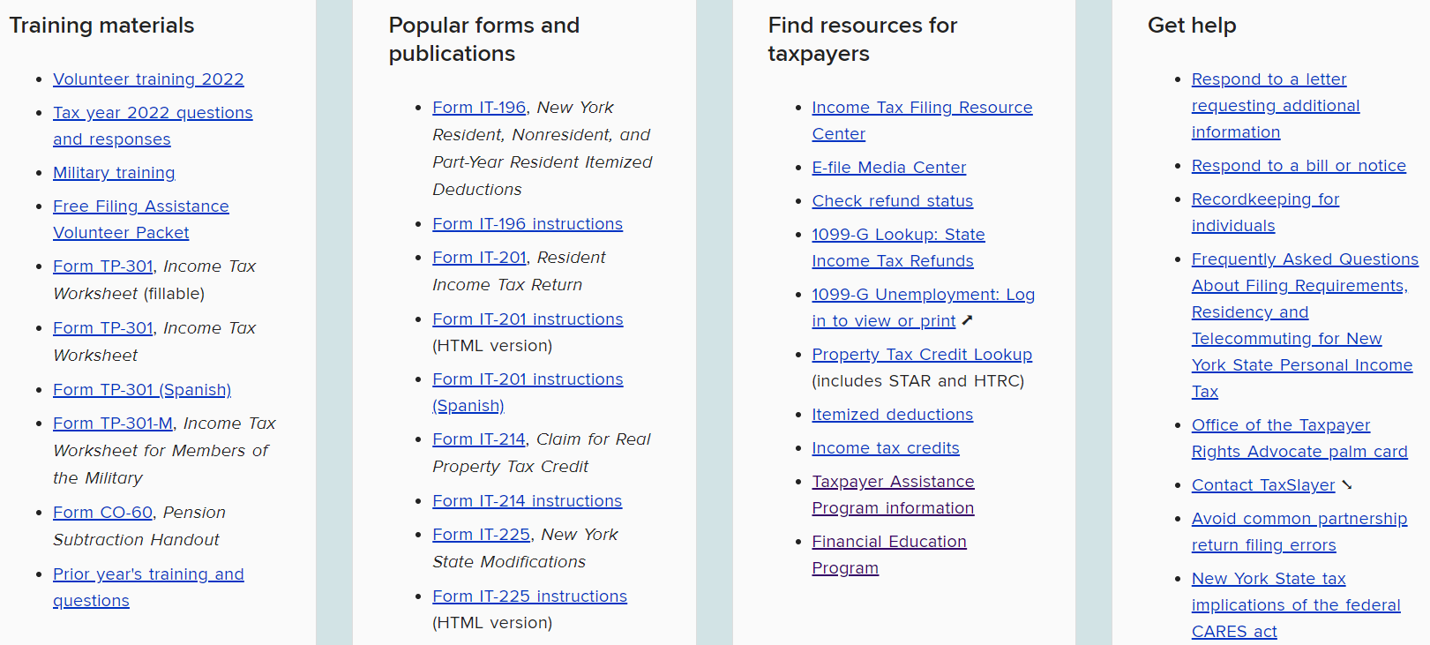
Volunteer Resource Center
www.tax.ny.gov/volunteer
Notes:
All of the information you need to be a volunteer working on a New York State tax return can be found in our Volunteer Resource Center at www.tax.ny.gov/volunteer. The page has an opening paragraph but the key information you need can be found in these topic lists of training materials, popular forms and publications, resources for taxpayers and get help.
Let’s go over what you will find in each section.
RS: Add new screen shot after page is updated

Slide 9
Training Materials
Volunteer training 2023
Military personnel training
2023 Free Filing Assistance Volunteer Packet
Form TP-301, Income Tax Worksheet (2023)
Pension subtraction handout
Prior year’s training
Notes:
The Training Materials section includes all the training items that will help you throughout the season. Obviously, it houses this training and the recorded version; a military personnel training which has specifics for those serving in the military; a link to the materials in the 2023 free file assistance volunteer packet, The TP-301 updated for 2023, the pension subtraction handout which helps answer questions on how taxation of pensions work and finally a link to a page which houses all of our older training presentations.

Slide 10
2023 Free Filing Assistance Volunteer Packet
IT-201, Full-Year Resident Income Tax Return packet for New York State, New York City, Yonkers and MCTMT*
Form IT-196, New York Resident, Nonresident, and Part-Year Resident Itemized Deductions*
IT-225, New York State Modifications*
IT-195, Allocation of Refund
* with instructions
Notes:
The Free Filing Assistance Packet has the main forms in it that are needed for filing. We include the IT 201 packet that has NYS, NYC and MCTMT in it, then the IT-196 for itemized deductions, the IT-225 for New York state modifications and the IT-195 which allows taxpayers to allocate any refund they having coming to them. I will discuss this later in the presentation.

Slide 11
2023 Free Filing Assistance Volunteer Packet
IT-227, New York State Voluntary Contributions
IT-214, Claim for Real Property Tax Credit for Homeowners and Renters
IT-229, Real Property Tax Relief Credit
NYC-210 and NYC-210-I, Claim for New York City School Tax Credit
DTF-215, The Earned Income Tax Credit - Recordkeeping Suggestions for Self-employed Persons
CO-309, How are you paid for your work and services?
Notes:
In addition to those forms, we have the IT-227 for voluntary contributions, the IT -214 Claim for real property tax credit for homeowners and renters, the new IT-229 real property tax relief credit and the NYC-210 Claim for the New York City School Tax Credit.
We also include some informational items, the DTF-215 Earned income tax credit- recordkeeping suggestions for self-employed persons and the CO-309 how are you paid for your work and services? These item are great to hand out to taxpayers who are not sure what they should keep for their tax records when they are self-employed.
While we mail out the packets these materials can be printed from the free filing assistance volunteer packet page as well.

Slide 12
Request Packets and Forms
Request packets and forms from: taxpartners@tax.ny.gov no later than December 22, 2023.
Your name, email, and address (physical addresses only, no PO boxes)
Number of 2023 Free Filing Assistance Volunteer Packets (5 maximum)
Form type and quantity (TP-301, NYC-208, and NYC-210 only)
Materials will ship no later than the week of January 15, 2024.
Notes:
If you are looking for these packets to be mailed, you should have sent those requests in already as we were looking for them by December 22, 2023. the Include
your name, email, and mailing address (no P.O. boxes!);
the number of packets you need (no more than 5); and
any other forms and how many.
Packets will ship no later than the week of January 15, 2024

Slide 13
TP-301, Income Tax Worksheet
Provides guidance on income, expenses, deductions and credits that do not automatically carry over from the federal return:
New York State additions and subtractions
New York State only credits
Pension exclusions
New York State, New York City, and Yonkers residency questions
Notes:
The TP-301 is the intake questionnaire that provides guidance on income, expenses, deductions and credits that do not automatically carry over from the federal return:
New York State additions and subtractions
New York State only credits
pension exclusions
New York State, New York City, and Yonkers residency questions
We had a few updates on the TP-301 for this year. We added School district back and added 529 saving to the qualify education.

Slide 14
TP-301, Income Tax Worksheet updates
The section to enter the Town information was updated to enter School District information. Taxpayers can enter the Town if the School District is unknown.
Q 9. Did you pay undergraduate college tuition expenses by cash, check, credit card, with borrowed funds, or funds from a qualified state tuition program (such as 529 College Savings Program), for yourself, your spouse, or your dependent(s)?
Notes:
The section to enter the Town information was updated to enter School District information. Taxpayers can enter the Town if the School District is unknown
Q 9. Did you pay undergraduate college tuition expenses by cash, check, credit card, with borrowed funds, or funds from a qualified state tuition program (such as 529 College Savings Program), for yourself, your spouse, or your dependent(s)?

Slide 15
Forms and Publications
You can download and print forms and publications from our website: www.tax.ny.gov/volunteer.
Select documents are available in languages other than English (search “language access”).
If necessary, limited additional quantities of some forms can be mailed to you during the filing season. Order by sending an email to NYStax.SpecReq@tax.ny.gov.
Notes:
Other resources available to you can be found on our website, like forms and publications. You can also get many documents in other languages. In addition, limited additional quantities of some forms can be mailed to you during the filing season. Order by sending an email to NYStax.SpecReq@tax.ny.gov.

Slide 16
Tax Practitioner Hotline
Available to professionals and volunteers, (you must confirm the name of your VITA or TCE site)
Limited or no wait time
Experienced staff to answer more technical questions
518-457-5451
Notes:
Finally, during the filing season the tax practitioner hotline is available as a resource for your questions. Just don’t forget to identify yourself as a volunteer or they will send you to the other line where the waits are much longer. This line has shorter wait times, extended hours during the peak filing season and experienced staff answering questions. Remember do not give this number out to any taxpayers.

Slide 17
2023 Filing and Payment Due Date
Monday, April 15, 2024
Notes:
Taxpayers will have until April 15, 2024 to file their 2023 and pay amounts owed. Taxpayers may request a 6 months extension by filing Form IT-370 and paying any tax due, on or before this due date.

Slide 18
Summary of NYS Income Tax Return
Federal Adjusted Gross Income
(FAGI)
Adjustments to income
Federal Adjusted Gross Income
New York additions and subtractions
New York Adjusted Gross Income (NYAGI)
Standard or New York Itemized Deductions
NY Taxable Income
Credits
Notes:
Once you know if a taxpayer is a resident or not and that they need to file here is the general flow of the New York State tax return. The New York Return is based off of the federal return with adjustments and modifications. The flow starts with the same income items from the Federal Return that you put in Federal Adjusted Gross Income, but we have adjustments to that income to give you the federal adjusted gross income. From there we have New York specific additions and subtractions to arrive at New York Adjusted Gross Income. We then deduct a New York standard deduction or New York itemized deduction to arrive at NY taxable income. Taxable income is used to compute the tax which is further reduced by tax credits.
We will now go through each section highlighting where we are unique.

Slide 19
New York State and New York City Filing Requirements
Notes:
Now that you know where to find resources, let’s get into the New York State return.

Slide 20
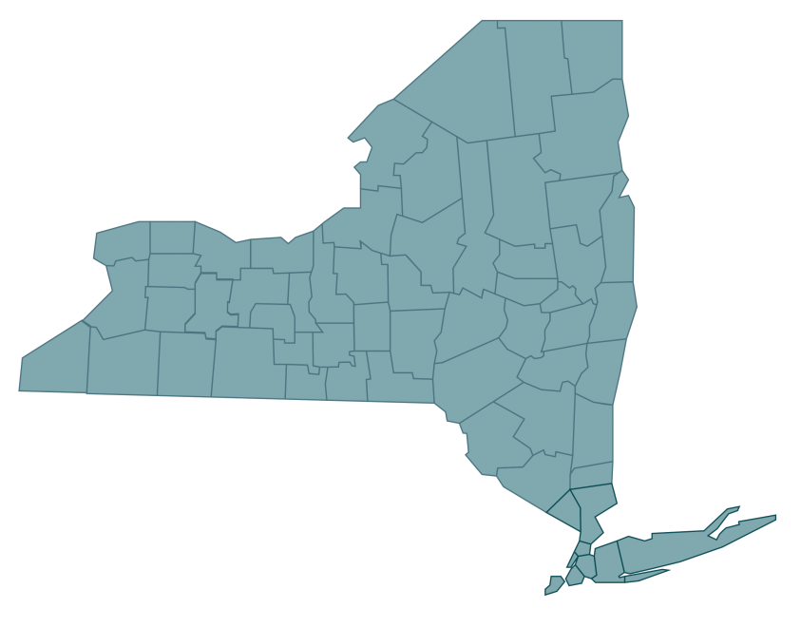
New York State Residency
When filing a personal income tax return, a taxpayer must determine which one of three New York State residency statuses applies:
Resident
Nonresident
Part-year resident
Notes:
When filing a New York state return the first thing you must determine is residency. You need to know if the taxpayer Is a resident, non-resident, or part-year resident.

Slide 21
New York State Resident or Nonresident
If the taxpayer is a resident for New York State income tax purposes and is required to file an income tax return, they will need to file Form IT-201, Resident Income Tax Return.
If the taxpayer is a part-year resident or nonresident for New York State income tax purposes and is required to file an income tax return, they will need to file Form IT-203, Nonresident and Part-Year Resident Income Tax Return.
Notes:
If the taxpayer is a resident for New York State income tax purposes and is required to file an income tax return, they will need to file Form IT-201, Resident Income Tax Return.
If the taxpayer is a part-year resident or nonresident for New York State income tax purposes and is required to file an income tax return, they will need to file Form IT-203, Nonresident and Part-Year Resident Income Tax Return.

Slide 22
New York Resident Filing Requirements
A taxpayer must file a New York State resident return if:
they’re required to file a federal return;
they’re not required to file a federal return but their federal adjusted gross income plus New York additions is more than $4,000 ($3,100 or more if the taxpayer is single and can be claimed as a dependent on another taxpayer’s federal tax return);
they want to claim a refund of any New York State, New York City, or Yonkers income taxes withheld from their pay, or from UI benefit payments; or,
they want to claim New York refundable or carryover credits.
Notes:
A taxpayer must file a New York State resident return if:
they’re required to file a federal return;
($3,100 or more if the taxpayer is single and can be claimed as a dependent on another taxpayer’s federal tax return);
they want to claim a refund from any New York State, New York City, or Yonkers income taxes withheld from their pay; or
they want to claim New York refundable or carryover credits.

Slide 23
New York State Residency
To be considered a resident of New York State for tax purposes, an individual must fall into one of two categories.
Domiciliary: the taxpayer's domicile is New York State.
Statutory Resident: whether or not the taxpayer's domicile is in New York State, but:
the taxpayer maintains a permanent place of abode in New York State for substantially all of the taxable year ; and
the taxpayer spends more than 183 days in New York State during the taxable year.
Notes:
To be considered a resident of New York State for tax purposes, an individual must fall into one of two categories.
Domiciliary: the taxpayer's domicile is New York State. Meaning their permanent home is located in New York.
Statutory Resident: the taxpayer's domicile is outside of New York State, but:
the taxpayer maintains a permanent place of abode in New York State; and
the taxpayer spends more than 183 days in New York State.

Slide 24
Permanent Place of Abode
A residence (a building or structure where a person can live) that:
you permanently maintain, whether you own it or not, and
is suitable for year-round use.
A permanent place of abode usually includes a residence that your spouse owns or leases.
Notes:
What is a permanent place of abode? It’s a residence (a building or structure where a person can live) that you permanently maintain, whether you own it or not, and is suitable for year-round use. A permanent place of abode usually includes a residence that your spouse owns or leases.

Slide 25
New York Nonresident
You may also have to file a New York State return if you're a nonresident of New York and you have income from New York State sources.
Notes:
You may also have to file a New York State return if you're a nonresident of New York and you have income from New York State sources. You need to determine if you're a resident, nonresident or part-year resident before you can decide if you need to file a return with New York State.

Slide 26
Telecommuting Rules
Impact nonresidents with a primary office in New York State.
Telecommuting days are considered days worked in New York State, unless your employer has established a bona fide employer office at your telecommuting location.
Notes:
Many taxpayers have been asking how New York is treating the fact that so many nonresidents are telecommuting. We have long standing rules in this area. If you are a nonresident whose primary office is in New York State, your days telecommuting during the pandemic are considered days worked in the state unless your employer has established a bona fide employer office at your telecommuting location.
There are a number of factors that determine whether your employer has established a bona fide employer office at your telecommuting location. In general, unless your employer specifically acted to establish a bona fide employer office at your telecommuting location, you will continue to owe New York State income tax on income earned while telecommuting.

Slide 27
Telecommuting Rules
See TSB-M-06(5)I, New York Tax Treatment of Nonresidents and Part-Year Residents Application of the Convenience of the Employer Test to Telecommuters and others; and
Frequently Asked Questions About Filing Requirements, Residency, and Telecommuting for New York State Personal Income Tax.
Notes:
For more information on telecommuting, See TSB-M-06(5)I New York Tax Treatment of Nonresidents and Part-Year Residents Application of the Convenience of the Employer Test to Telecommuters and others for all the details and the webpage Frequently asked questions about filing requirements, residency and telecommuting for new York state Personal income tax, which can be found on our website www.tax.ny.gov. Search, “telecommuting.”

Slide 28
New York City or Yonkers Residents
Taxpayers must report New York City* income tax or Yonkers resident income tax surcharge on their state return if they:
were a New York City* or Yonkers resident for the tax year, and
have to file a New York State return.
* New York City includes the counties of: Bronx, Kings (Brooklyn), New York (Manhattan),
Queens, and Richmond (Staten Island).
Notes:
Taxpayers must report New York City income tax or Yonkers resident income tax surcharge on their state return if they:
were a New York City or Yonkers resident for the tax year, and
have to file a New York State return.
New York City includes the counties of: Bronx, Kings (Brooklyn), New York (Manhattan), Queens, and Richmond (Staten Island).

Slide 29
Part-Year Residents and Nonresidents
Taxpayers who changed their New York City or Yonkers resident status during the year must complete Form IT-360.1, Change of City Resident Status.
Form IT-360.1 must be included with:
IT-201: to report full-year New York State tax and part-year New York City resident tax, or part-year Yonkers resident income tax surcharge (or both), or
Form IT-203: to report part-year New York State resident tax and part-year New York City resident tax or part-year Yonkers resident income tax surcharge.
Notes:
Taxpayers who changed their New York City or Yonkers resident status during the year must complete Form IT-360.1, Change of City Resident Status.
Form IT-360.1 must be included with:
Form IT-201: to report applicable New York State tax and part-year New York City resident tax, or part-year Yonkers resident income tax surcharge (or both), or
Form IT-203: to report part-year New York State resident tax and part-year New York City resident tax or part-year Yonkers resident income tax surcharge.

Slide 30
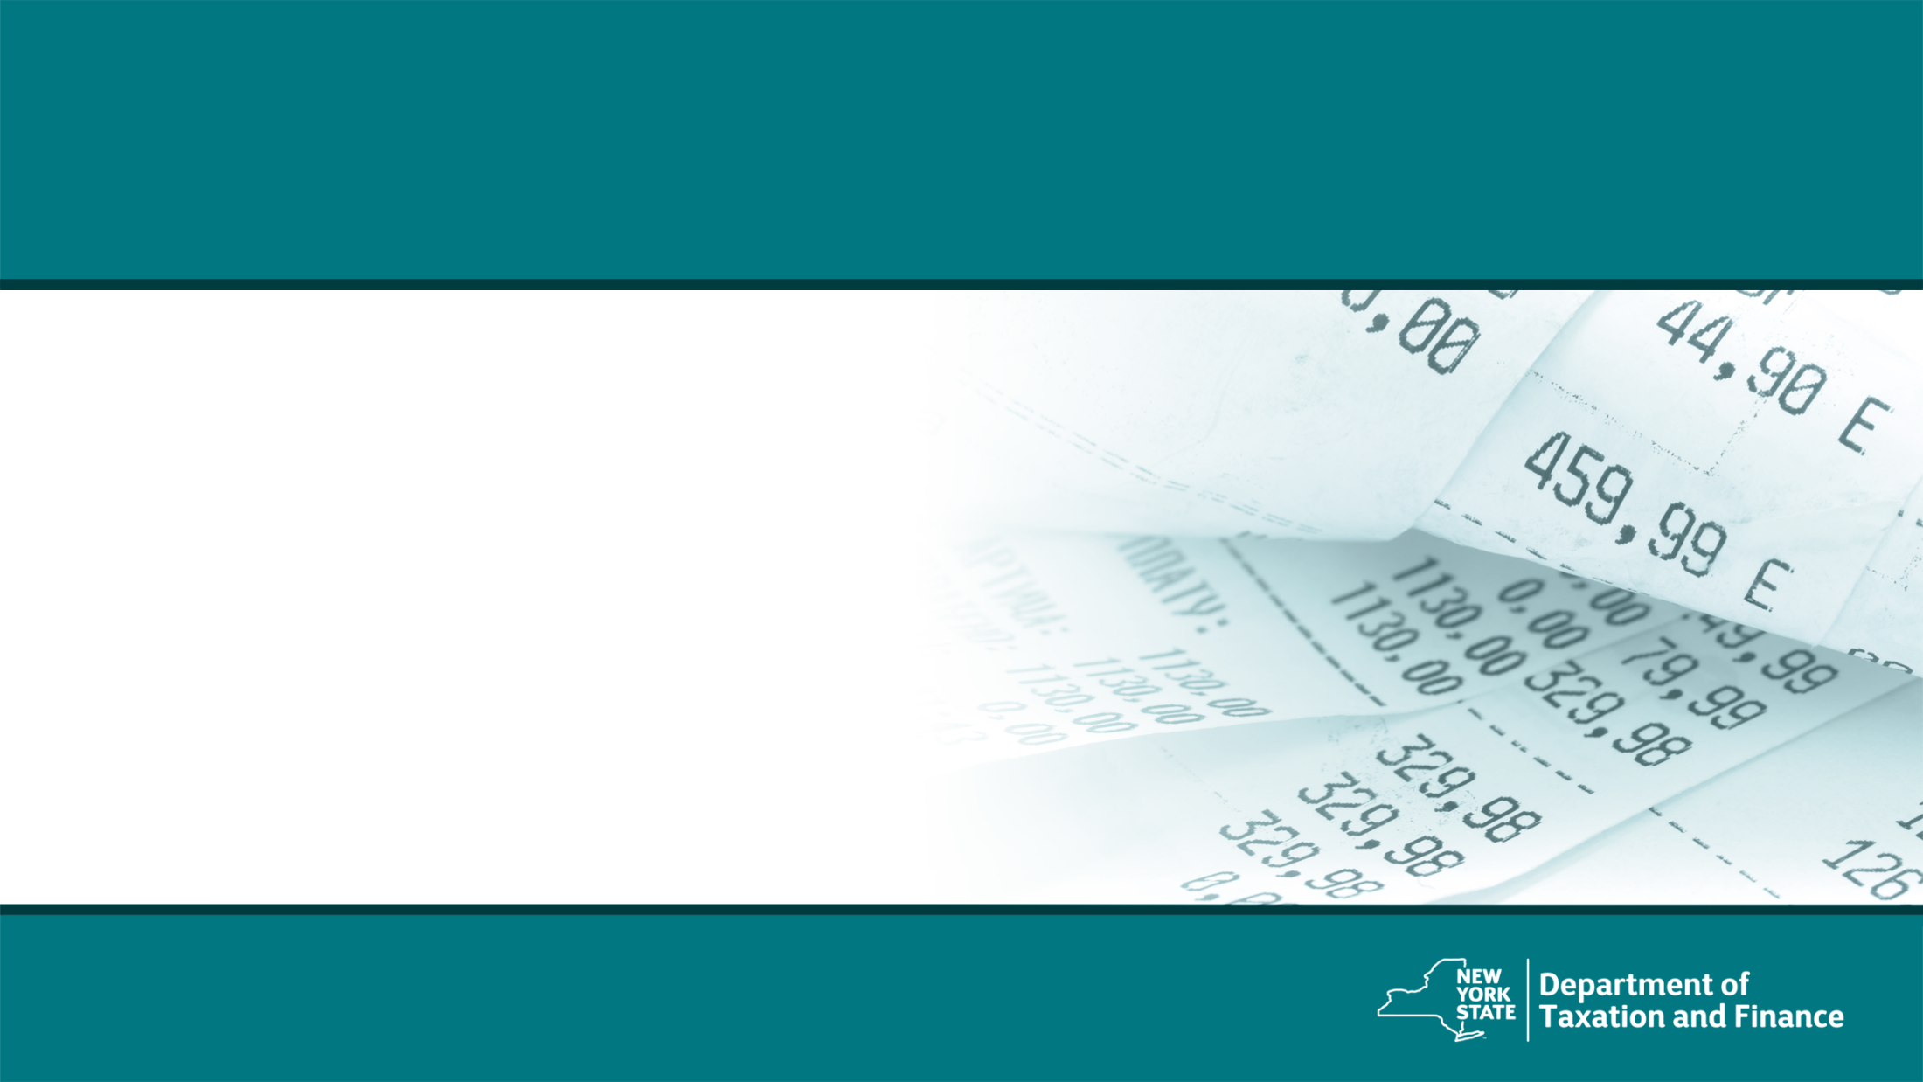
Income and Adjustments
Notes:
Let’s start with income and adjustments.

Slide 31
Federal Income
Most income items are carried over directly from the federal return.
There are some items where New York does not treat them the same way, however those are handled through adjustments to income
Notes:
Most income items are carried over directly from the federal return. There are some items where New York does not treat them the same way, however those are handled through adjustments to income.

Slide 32
Addition and Subtraction Modifications
Notes:
Next we will discuss addition and subtraction modifications, first let’s explain why we have these modifications.

Slide 33
New York State Modifications
Computation of New York State income tax is based on a taxpayer’s NYAGI, which is FAGI modified by certain New York adjustments.
New York State taxes certain items of income not taxed by the federal government. You must add these New York additions to FAGI.
New York State does not tax certain items of income taxed by the federal government. You must subtract these New York subtractions from FAGI.
Notes:
The Computation of New York State income tax is based on a taxpayer’s New York Adjusted Gross Income, which is the recomputed Federal Adjusted Gross Income (or FAGI) modified by certain New York adjustments. New York State taxes certain items of income not taxed by the federal government. You must add these New York additions to the recomputed FAGI.
New York State does not tax certain items of income taxed by the federal government. You must subtract these New York subtractions from the recomputed FAGI. For these additions and subtractions some items have their own line items on the return, but other items are included on the IT-225. The software will place them appropriately.

Slide 34
Common New York State Additions
Interest income on state and local bonds
Net gain from casualty and theft loss
Public employee 414(h) retirement contributions
New York City Flexible Benefits Program (IRC 125) amounts deducted or deferred from salary
New York’s 529 college savings program
Notes:
Some common new York state additions include:
Interest income on state and local bonds
Net gain from casualty and theft loss
Public employee 414(h) retirement contributions
New York City Flexible Benefits Program (IRC 125) amounts deducted or deferred from salary
New York’s 529 college savings program
Let’s go into these one at a time.

Slide 35
New York State Addition Modifications
Interest income on state and local bonds
If from other than New York State or it’s local governments, addition modification must be made.
Net gain from casualty and theft loss
New York itemized deduction for a casualty or theft that results in a net gain, addition modification must be made.
Notes:
For Interest income on State and local bonds
If the interest is from other than New York State or it’s local governments, an addition modification must be made.
For Net Gains from Casualty and Theft Loss
When there is a net gain on the New York itemized deduction for a casualty or theft, an addition modification must be made.

Slide 36
NY Addition 414(h) and IRC-125
Must report 414(h) retirement contributions as an addition modification to their Federal Adjusted Gross Income (FAGI) on the New York State return.
New York State and Local Retirement System
New York City Retirement System
New York City Police Pension Fund
New York City Teachers Retirement System
Same rules apply to New York City employees who participate in a New York City flexible benefits program, IRC-125.
Notes:
Regarding the 414H contributions and the IRC 125 flexible benefit programs:
Taxpayers Must report 414(h) retirement contributions as an addition modification to their Federal Adjusted Gross Income (FAGI) on the New York State return. These contributions are related to the New York State and Local Retirement System; New York City Retirement System; New York City Police Pension Fund, or New York City Teachers Retirement System. The same rules apply to New York City employees who participate in a New York City flexible benefits program, IRC-125.

Slide 37
414(h) and IRC-125 Reporting
Reported to the employee in box 14 on Form W-2.
414(h) pension contributions are added on line 21 of Form IT-201, Resident Income Tax Return and on line 21 of Form IT-203, Nonresident and Part-year Resident Income Tax Return.
New York City flexible benefits program are reported on Form IT-225, New York State Modifications, and then totaled with other additions and entered on line 23 of the IT-201 or line 22 of the IT-203.
Notes:
Reported to the employee in box 14 on Form W-2.
414(h) pension contributions are added on line 21 of Form IT-201, Resident Income Tax Return and on line 21 of Form IT-203, Nonresident and Part-year Resident Income Tax Return.
New York City flexible benefits program are reported on Form IT-225, New York State Modifications, and then totaled with other additions and entered on line 23 of the IT-201 or line 22 of the IT-203.
(Line numbers verified – 2023 2022)

Slide 38
College Savings Program Additions
New York’s 529 college savings program
transfer to another state’s program
nonqualified distributions
Note: If the withdrawal is not used for higher education, any subtraction modification taken in the current or previous years on the original contributions must be added back to income.
Notes:
For the New York’s 529 college savings program there are additions if a taxpayer transfers funds to another state’s program or if there are nonqualified distributions such as taking funds out for any 5-12 (professional certification) programs. If the withdrawal is not used for higher education, any subtraction modification taken in the current or previous years on the original contributions must be added back to income.

Slide 39
Use of 529 College Savings Accounts
Qualified apprenticeship expenses are now a qualified use of a 529 savings program.
Programs must be registered and certified with the Secretary of Labor.
DOL has a list of active apprenticeship programs in New York that would qualify.
Notes:
Since we are talking about non-qualified use of a 529 plan, you should know that the definition of eligible education institution under Subdivision 5 of Section 695-b of the education law was amended to include any apprenticeship program described in section 529 (c)(8) of the IRC.
So, it’s not just higher education, Qualified apprenticeship expenses are now a qualified use of a 529 savings program.
To qualify programs must be registered and certified with the Secretary of Labor. The Department of Labor has a list of active apprenticeship programs in New York that would qualify on their website.
We placed a link to that site in the Get Help section of our volunteer website.
Reference:
List of Active Sponsors | Department of Labor (ny.gov)

Slide 40
Common New York State Subtractions
Refunds, credits, or offsets of state and local income taxes
Qualified moving expense reimbursements or expenses
$20,000 pension/annuity exclusion for taxpayers 59½ or older
Interest on U.S. government bonds
New York 529 college savings program
Pensions of New York State, local, or federal government employees
Repayment of income reported in a prior year
Notes:
Now let’s talk about subtractions. Some of the common New York State subtractions you may have seen in the past:
refunds, credits, or offsets of state and local income taxes
qualified moving expense reimbursements or expenses
$20,000 pension/annuity exclusion for taxpayers 59½ or older
interest on U.S. government bonds
New York 529 college savings program
pensions of New York State, local, or federal government employees
deduction for student loans discharged due to death or disability
Repayment of income reported in a prior year

Slide 41
New York State Modifications
Refunds, credits, or offsets of state and local income taxes
Qualified moving expense reimbursements and moving expenses
If a taxpayer received any qualified moving expense reimbursements or paid any moving expenses, there is a subtraction modification.
Interest on U.S. government bonds
Notes:
For refunds, credits, or offsets of state and local income taxes
While these items are included in federal adjusted gross income (FAGI), New York allows a subtraction for them, so on our return they are in FAGI but then subtracted before determining New York adjusted gross income.
For qualified moving expense reimbursements and moving expenses
If a taxpayer received any qualified moving expense reimbursements or paid any moving expenses, there is a subtraction modification.
For Interest on U.S. government bonds
New York allows a subtraction for the interest.

Slide 42
NYS-529 College Savings Program
Contributions to a NYS-529 College Savings Program may be deducted from federal income as a New York subtraction
Contributions are the amount contributed to the program up to $5,000 ($10,000 for married filing a joint return)
Only payments made during the taxable year can be claimed.
Unclaimed amounts can not be carried forward to a future year.
Taxpayer must be the owner of the account. If taxpayer contributes to an account owned by someone else, taxpayer cannot claim the subtraction.
Notes:
While we explained the addition modification that could be needed regarding NYS 529 plans, there is also a subtraction allowed for contributions to a NYS-529 College Savings Program. Contributions are the amount contributed to the program up to $5,000 ($10,000 for married filing a joint return). Only payments made during the taxable year can be claimed. Unclaimed amounts can not be carried forward to a future year. The taxpayer must be the owner of the account. If the taxpayer contributes to an account owned by someone else, the taxpayer cannot claim the subtraction.

Slide 43
Pensions and Annuities
Some taxpayers incorrectly exclude pension income or take an excessive pension subtraction.
Two New York State subtractions for pension income:
pensions of New York State and local governments and the federal government
the pension and annuity income exclusion
Deferred compensation or supplemental pension income is not fully excludable government pension income.
A pension or annuity subtraction may only be claimed if pension income was included in total income.
Notes:
Some taxpayers incorrectly exclude pension income or take an excessive pension subtraction. There are two New York State subtractions for pension income:
100% of pensions of New York State and local governments and the federal government can be excluded, or
the 20,000 pension and annuity income exclusion.
Be aware that deferred compensation or supplemental pension income is not fully excludable government pension income.
A pension or annuity subtraction may only be claimed if pension income was included in total income. And you should be aware that pension and annuity income includes the TY2023 income getting recognized from a qualified COVID distribution that was taken in TY2020 where the income was spread over 3 years.

Slide 44
Pensions and Annuities
If a taxpayer received pension income as a beneficiary and the decedent would have been 59½ if they continued to live, the beneficiary is eligible for an exclusion with certain limitations.
The exclusion must be prorated amongst all beneficiaries in the same ratio as the distribution is shared, even if not all beneficiaries are New York residents.
Notes:
If a taxpayer received pension income as a beneficiary and the decedent would have been 59½ if they continued to live, the beneficiary is eligible for an exclusion with certain limitations. The exclusion must be prorated amongst all beneficiaries in the same ratio as the distribution is shared, even if not all beneficiaries are New York residents.
I want to remind you that there is a pension subtraction handout which goes over the ins and outs of pensions on the website under training. It’s CO-60.

Slide 45
New York State Income Modifications
Deduction for student loans discharged due to death or disability
For students or parent borrowers that had a student loan discharged in whole or in part due to death or disability, to the extent that the discharged amount was included in federal income, there is a subtraction modification.
Notes:
Deduction for Student Loans Discharged Due to Death or Disability
For students or parent borrowers that had a student loan discharged in whole or in part due to death or disability, to the extent that the discharged amount was included in federal income, there is a subtraction modification.
There are other student loan modifications for loan forgiveness that we will cover in a later section.

Slide 46
Repayments of Income Reported in Prior Year
Generally, if a taxpayer included an item of income in the computation of NYAGI in a prior year and is then required to repay any of that previously taxed income in the current year, the amounts repaid in the current year may be deducted from current year income.
For example: if overpaid unemployment income in 2021 and required to repay a portion of it in 2023, the amount repaid is allowed to be subtracted from income in 2023.
Notes:
A new provision was added to allow and adjustment for repayments of items of income reported in a prior year. Generally, if a taxpayer included an item of income in the computation of New York Adjusted Gross Income in a prior year and is then required to repay any of that previously taxed income in the current year, the amounts repaid in the current year may be deducted from current year income. For example: If a taxpayer was overpaid unemployment income in 2020, or 2021 and required to repay a portion of it in 2023, the amount repaid is allowed to be subtracted from income in 2023.
This adjustment would be made on the Form IT-225.

Slide 47
Repayments of Income Reported in Prior Year (cont.)
No subtraction will be allowed if:
The repayment amount is included in their New York itemized deduction (or any other deduction allowed under Article 22 of the Tax Law), or
They filed Form IT-257, New York State Claim of Right Credit, using the repayment amount as the basis of the credit.
Notes:
Note: For purposes of this modification, no subtraction will be allowed if:
the repayment amount is included in the taxpayer’s New York itemized deduction (or any other deduction allowed under Article 22 of the Tax Law), or
The taxpayer filed Form IT-257, New York State Claim of Right Credit, using the repayment amount as the basis of such credit

Slide 48
Exemption for Student Loan Forgiveness
Excludes from New York State income tax income attributable to loan forgiveness awards under programs administered by the Higher Education Service Corporation (HESC) under Article 14 of the education law to the extent included in federal adjusted gross income.
Effective for tax years beginning on or after January 1, 2022.
Notes:
The other new subtraction covers student loan forgiveness.
Typically loan forgiveness is considered taxable income.
If the loan forgiveness is due to a loan under a program administered by the Higher Education Service Corporation, that loan forgiveness will be excluded from income.
There will be a subtraction modification on the IT-225 to reflect this exclusion and it should be used only if the loan forgiveness was included in federal taxable income.
For Reference Purposes only:
Subtraction Modification code S-142

Slide 49
Student Loan Debt Forgiveness
American Rescue Plan has student loan forgiveness that will exclude it from federal adjusted gross income (FAGI).
Since it is not in FAGI, it will not carry over into New York adjusted gross income.
No New York modification will be added to include it.
Notes:
Since we just mentioned the specific loan forgiveness on Higher Education Service Corporation loans, I thought it would be worth mentioning the student loan forgiveness under the American Rescue Plan and how that is treated since we have gotten quite a few calls on it already.
We are conformed to the federal treatment for this debt forgiveness.
Since the loan forgiveness will not be in Federal adjusted Gross Income, it will not carry over into New York Adjusted gross income and
There will be no NY modification to include it.

Slide 50
Other NYS Subtractions You May See
Taxable amount of social security and Tier 1 railroad retirement benefits
Military combat pay
Military pay (Form IT-203 filers only)
Disability income exclusion
Native American income exclusion
Notes:
As you can see there are a lot of New York subtractions. Here are a few more you may run into:
taxable amount of social security and Tier 1 railroad retirement benefits
military combat pay
military pay (Form IT-203 filers only)
disability income exclusion
Native American income exclusion
These are reported on the IT-225 and the instructions to the IT-225 explain them very well.

Slide 51
New York State Standard or Itemized Deductions
Notes:
Once all the modifications to income are done, you have your New York adjusted gross income and we can now cover deductions

Slide 52
Standard and Itemized Deductions
If the New York standard deduction is greater than the New York itemized deduction, you would use the New York standard deduction.
However, if the taxpayer is married and filing a separate return and itemizes deductions, the spouse must also claim the itemized deduction, even if it is less than the standard deduction.
If the taxpayer is itemizing New York deductions, they must submit Form IT-196, New York Resident, Nonresident, and Part-Year Itemized Deductions.
Notes:
If the New York standard deduction is greater than the New York itemized deduction, you would use the New York standard deduction. However, if the taxpayer is married and filing a separate return and itemizes deductions, the spouse must also claim the itemized deduction, even if it is less than the standard deduction. If the taxpayer is itemizing New York deductions, they must submit Form IT-196, New York Resident, Nonresident, and Part-Year Itemized Deductions.

Slide 53
2023 Standard Deduction Table
Filing Status | Standard Deduction
Single (item C Yes) Single (item C No) | $3,100 $8,000
Married Filing Jointly | $16,050
Married Filing Separately | $8,000
Head of Household | $11,200
Qualifying surviving spouse | $16,050
Notes:
The 2023 standard deduction table is the same as last year.

Slide 54
Itemized Deductions
In general, New York itemized deductions are computed using the federal rules as they existed prior to the changes made by the Tax Cuts and Jobs Act.
Taxpayers can not use total federal itemized deduction as a starting point.
Taxpayers may itemize for the state, even if they use the standard deduction for their federal return.
Notes:
In general, New York itemized deductions are computed using the federal rules as they existed prior to the changes made by the Tax Cuts and Jobs Act. Taxpayers can not use total federal itemized deduction as a starting point. Taxpayers may itemize for the state, even if they use the standard deduction for their federal return.

Slide 55
Form for Itemized Deductions
IT-196, New York Resident, Nonresident, and Part-Year Resident Itemized Deductions:
Walks you through the computation of New York itemized deductions.
For additional guidance, visit the itemized deductions page on our website.
Notes:
Itemized deductions are handled on Form IT-196, New York Resident, Nonresident, and Part-Year Resident Itemized Deductions:
This form Walks you through the computation of New York itemized deductions. And the software guides you though them as well, so we won’t go through these items in the training. For additional guidance, visit the Itemized deductions page on our website.

Slide 56
Form 1099-G Information
You may view and print Form 1099-G, Statement for Recipients of State Income Tax Refunds, directly from our website. We do not mail Form 1099-G.
The 1099-G amount reflects the amount of state and local taxes a taxpayer overpaid through withholding or estimated tax payments.
For most people, the amount shown on their 2023 Form 1099-G is the same as the 2022 New York State income tax refund they actually received.
Notes:
If taxpayers include taxes paid for itemizing, they may need their 1099-G information from New York State. You may view and print Form 1099-G, Statement for Recipients of State Income Tax Refunds, directly from our website. We do not mail Form 1099-G. The 1099-G amount reflects the amount of state and local taxes a taxpayer overpaid through withholding or estimated tax payments. For most people, the amount shown on their 2023 Form 1099-G is the same as the 2022 New York State income tax refund they actually received.

Slide 57
2023 Exemptions
Dependent exemption $1,000 per qualified dependent
No New York State personal exemption for the taxpayer and spouse allowed
Notes:
After determining the standard or federal exemption, the New York return also reflects the dependent exemption of 1,000 per qualified dependent. New York does not have a personal exemption for the taxpayer and spouse.

Slide 58
New York State Tax Credits
Notes:
Now that all the adjustments and deductions are complete, the taxpayer will have their New York taxable income and compute their tax due. However, they can reduce this tax due amount further with Tax Credits. While there are many New York State tax credits, we tried to concentrate on the ones you are most likely to see. If you do come across a credit that is not listed in this presentation, our website has designated web pages for each credit that can offer you clear explanations to assist you. First let’s discuss a new credit this year.

Slide 59
Empire State Child Tax Credit Expansion
The definition of qualifying child was amended to include those under the age of 4.
The state credit is allowed for qualifying children under the age of 17.
See Form IT-213-I for more information.
Notes:
The definition of qualifying child - for purposes of the Empire State Child Tax Credit - was amended to include those under the age of 17.
The State credit was previously limited to children ages 4 through 16.
You can see Form IT-213-I for more information.

Slide 60
IT-213, Empire State Child Credit
Full-year resident taxpayers who have at least one qualifying child and meet certain income limitations may claim a credit equal to the greater of:
$100 times the number of children who qualify for the federal child tax credit, or
33% of the taxpayer’s allowed federal child tax credit and additional child tax credit calculated using the federal credit amounts and income thresholds that were in effect for tax year 2017.
Notes:
The Empire State Child credit Is Refundable for qualifying children from infant to age 16. Full-year resident taxpayers who have at least one qualifying child and meet certain income limitations may claim a credit equal to the greater of :
$100 times the number of children who qualify for the federal child tax credit, or
(b) 33% of the taxpayer’s allowed federal child tax credit and additional child tax credit calculated using the New York recomputed federal adjusted gross income as well as the federal credit amounts and income thresholds that were in effect for tax year 2017.
For reference: for tax year 2018 and after, the federal amount is no longer used in calculating the Empire State child credit. The calculation uses the 2017 credit amounts and income thresholds.

Slide 61
Real Property Tax Relief Credit
For tax years beginning on or after January 1, 2021 and before January 1, 2024
To be eligible for the refundable credit, taxpayers must be a New York State resident for the entire tax year, and have:
qualified gross income of $250,000 or less,
owned and resided in New York State real property for more than six months,
received either the STAR exemption or school tax relief credit on that property, and
paid real property taxes on that property.
Article 22
Notes:
For tax years beginning on or after January 1, 2021 and before January 1, 2024, taxpayers may be able to claim a refundable real property tax relief credit for qualifying real properties on their personal income tax returns.
To be eligible for the credit, New York State residents must have:
qualified gross income of $250,000 or less,
owned and resided in New York State real property for more than six months,
received either the STAR exemption or school tax relief credit, and
paid real property taxes.
Note: Any rent you may have received from nonresidential use of your residence may not exceed 20% of total rental income.

Slide 62
Real Property Tax Relief Credit
The credit is computed using the amount of real property tax which exceeds 6% of the taxpayer’s income, and a specified rate based on the taxpayer’s income.
To claim the credit, the computed amount must exceed $250.
The credit cannot exceed $350, regardless of the amount computed.
Form IT-229, Real Property Tax Relief Credit
Note: If a taxpayer itemizes deductions on their New York State return, they must reduce the amount of property tax claimed by the amount of the credit.
Article 22
Notes:
The credit is computed using the amount of real property tax which exceeds 6% of the taxpayer’s income, and a specified rate based on the taxpayer’s income. In order to claim the credit, the computed amount must exceed $250. The credit cannot exceed $350, no matter the amount of the computation. For more information, see Form IT-229, Real Property Tax Relief Credit, and its instructions. It should be noted: if a taxpayer itemizes deductions on their New York State return, they must reduce the amount of property tax claimed by the amount of the credit.
You will note this year we took a good look at the instructions for this credit and ran them through clarity review. We also put the instructions on our web site. Hopefully it will be much easier to take taxpayers through this credit this year.

Slide 63
IT-215, Earned Income Tax Credit (EIC)
Investment income can not be greater than $11,000.
Generally, 30% of the federal credit reduced by the amount of any household credit (additional 10% to 30% for New York City residents, based on their NYAGI).
The taxpayer must have claimed the federal earned income credit (EIC) for tax year 2023.
Notes:
The NY earned income credit has some updates this year. The investment income threshold increased so that Investment income can not be greater than $11,000.
The credit is generally 30% of the allowable federal credit reduced by the amount of any household credit allowed.
Remember, The taxpayer must have claimed the federal earned income credit (EIC) for tax year 2023.

Slide 64
IT-215, Earned Income Tax Credit (EIC)
Refundability:
full-year residents = fully refundable
part-year residents = partially refundable
nonresidents = non-refundable
Note: Due to the different methods for computing, New York City taxpayers may have an amount of New York City EIC and not New York State EIC – make sure to complete Worksheet C, New York City earned income credit!
Notes:
New York State EIC refundable status depends on your residency status:
full-year residents = fully refundable
part-year residents = partially refundable
nonresidents = non-refundable
Note: Due to the different methods for computing, NYC taxpayers may have an amount of NYC EIC and not NYS EIC – make sure to complete Worksheet C, NYC Earned income credit!

Slide 65
IT-209, Noncustodial Parent Earned Income Credit
Filers may claim the noncustodial EIC only if they meet all of the following conditions for tax year 2023:
must be a full-year New York State resident and at least 18 years of age;
earned income is less than $46,560 in 2023;
must be a parent of a minor child with whom they do not reside;
must have an order in effect for at least one-half of the tax year requiring the taxpayer to make child support payments payable through a New York State Support Collection Unit (SCU); and
have paid an amount in child support in 2023 at least equal to the amount of current child support the taxpayer was required to pay by all court orders.
Notes:
We’ve updated this credit for the 2023 earned income amount, otherwise this is still the same. Filers may claim the noncustodial EIC only if they meet all of the following conditions for tax year 2023:
must be a full-year New York State resident and at least 18 years of age;
earned less than $46,560 in 2023;
must be a parent of a minor child with whom they do not reside;
must have an order in effect for at least one-half of the tax year requiring the taxpayer to make child support payments payable through a New York State Support Collection Unit (SCU); and
have paid an amount in child support in 2023 at least equal to the amount of current child support the taxpayer was required to pay by all court orders.

Slide 66
IT-214, Claim for Real Property Tax Credit for Homeowners and Renters
No changes in eligibility for 2023:
Household gross income was $18,000 or less
Average rent was $450 or less
Must have paid real property taxes or rent on their residence
Market value of all real property owned was $85,000 or less
Must be a New York State resident for the entire year
Can’t be claimed as a dependent
Notes:
There are no changes in eligibility for 2023 for the Claim for Real Property Tax Credit for Home owners or renters. To qualify, a taxpayer must:
Household gross income was $18,000 or less
Average rent was $450 or less
Must have paid real property taxes or rent on their residence
Market value of all real property owned was $85,000 or less
Must be a New York State resident for the entire year
Can’t be claimed as a dependent

Slide 67
IT-214 Definitions
Members of household
All who share your residence and its furnishings, facilities, and accommodations, whether they are related to you or not.
Household gross income
Income from all sources that you and members of your household receive. It does not include food stamps, Medicare, Medicaid, scholarships, grants, surplus food, or other relief.
Notes:
Some key definitions for this credit:
Members of household
All who share your residence and its furnishings, facilities, and accommodations, whether they are related to you or not.
Household gross income
Income from all sources that you and members of your household receive. It does not include food stamps, Medicare, Medicaid, scholarships, grants, surplus food, or other relief.

Slide 68
IT-214 Definitions
Adjusted rent
The rent paid after subtracting any charges for heat, gas, electricity, furnishings, or board. Don’t include any subsidized part of your rental charges in adjusted rent.
Property taxes paid
In computing the amount of real property taxes paid, include those actually paid to a county, city, town, village or school district. You must reduce the amount of taxes by any school tax relief credit received.
Notes:
Adjusted rent
The rent paid after subtracting any charges for heat, gas, electricity, furnishings, or board. Don’t include any subsidized part of your rental charges in adjusted rent.
Property taxes paid
In computing the amount of real property taxes paid, include those actually paid to a county, city, town, village or school district. You must reduce the amount of taxes by any school tax relief credit received.

Slide 69
IT- 272, College Tuition Credit or Deduction
Only qualified tuition expenses paid for undergraduate enrollment or attendance at an institution of higher education qualify for the credit.
Up to $10,000 of tuition expenses per eligible student can be used to calculate the credit
Can claim a 4% refundable credit or use the tuition expense amount as an added itemized deduction
For tuition expense under $5,000, the credit is the lesser of $200 or the tuition expense
Notes:
The claim for college tuition credit.
Only qualified tuition expenses paid for undergraduate enrollment or attendance at an institution of higher education qualify for the credit. Up to $10,000 of tuition expenses per eligible student can be used to calculate the credit. Taxpayers can claim a 4% refundable credit or use the tuition expense amount as an added itemized deduction. For tuition expense under $5,000, the credit is the lesser of $200 or the tuition expense.

Slide 70
IT- 272, College Tuition Credit or Deduction
Expenses may be paid by cash, check, credit card, or with borrowed funds.
The eligible student doesn’t need to be enrolled in a degree program or to attend full time for the expenses to qualify.
If the student is claimed as a dependent, these payments are treated as paid by the taxpayer.
Notes:
Expenses may be paid by cash, check, credit card, or with borrowed funds. The eligible student doesn’t need to be enrolled in a degree program or to attend full time for the expenses to qualify. If the student is claimed as a dependent, these payments are treated as paid by the taxpayer.

Slide 71
IT- 272, College Tuition Credit or Deduction
Do not claim as qualified expenses:
Graduate level tuition expenses
Tuition expenses that were paid by scholarships, grants and/or an employer
Expenses for:
room/board, insurance, medical expenses, and transportation;
course related books, supplies, or equipment; and
fees paid as a condition of enrollment, attendance, or non-academic activities
Notes:
Let’s review the college tuition credit or deduction. The qualified expenses for this credit and the itemized deduction are listed on the on the IT-272. However, a taxpayer can not take both the credit and the deduction. There is a worksheet included to help determine which is more beneficial. Do not claim the following as qualified expenses:
graduate-level tuition expenses
tuition expenses that were paid by scholarships, grants and/or an employer
expenses for:
room/board, insurance, medical expenses, and transportation;
course related books, supplies, or equipment; and
fees paid as a condition of enrollment, attendance, or non-academic activities

Slide 72
IT- 272, College Tuition Credit or Deduction
Do not claim:
Tuition expenses in a different tax year than they were paid
College tuition credit for someone who is not the taxpayer or a dependent
Be sure to provide:
Correct student SSN on Form IT-272
Correct college EIN on Form IT-272
Notes:
Additionally, do not claim tuition expenses in a different tax year than they were paid or a college tuition credit for someone who is not the taxpayer or a dependent. Remember, be sure to provide the correct student SSN and correct college EIN on Form IT-272.

Slide 73
IT-245, Claim For Volunteer Firefighter and Ambulance Worker Credit
$200 refundable credit or $400 if married filing jointly and both spouses qualify:
full-year resident; and
active volunteer firefighters or ambulance workers for the entire year for which the credit is claimed.
Use IT-201-ATT - Code 354 on line 12
A taxpayer cannot claim the volunteer firefighter and ambulance worker credit if the taxpayer receives a real property tax exemption that relates to their volunteer service.
Notes:
The claim for volunteer firefighter and Ambulance worker credit is a $200 refundable credit or $400 if married filing jointly and both spouses qualify. The taxpayer must be a full-year resident and active volunteer firefighters or ambulance workers for the entire year for which the credit is claimed. Use IT-201-ATT - Code 354 on line 12. A taxpayer cannot claim the volunteer firefighter and ambulance worker credit if the taxpayer receives a real property tax exemption that relates to their volunteer service.

Slide 74
IT-249, Claim for Long-Term Care Insurance Credit
The credit is for premiums paid for qualified long-term care insurance.
The credit is equal to 20% of the premiums paid during the tax year for the purchase of or for continuing coverage under a qualifying long-term care insurance policy.
Notes:
The claim for long term care insurance credit is for premiums paid for qualified long-term care insurance. The credit is equal to 20% of the premiums paid during the tax year for the purchase of or for continuing coverage under a qualifying long-term care insurance policy.

Slide 75
IT-249, Claim for Long-Term Care Insurance Credit
Health and life insurance don’t qualify.
Credit is only available to taxpayers with a NYAGI of less than $250,000.
Limits the credit amount to $1,500 per return.
Notes:
Remember, health and life insurance premiums do not qualify for the credit. The credit is only available to taxpayers with NYAGI of less than $250,000 and is capped at $1,500 per return for taxable years beginning on or after January 1, 2020

Slide 76
IT-258, Refundable Nursing Home Credit
Available for amount of assessment imposed on a residential health care facility.
The assessment must be separately stated and must be paid directly by the individual taxpayer claiming the credit.
Credit equals the assessment amount (not expenses) separately stated and accounted for on the billing statement.
Use IT-201-ATT - Code 258 on line 12 or IT-203-ATT - Code 258 on line 12.
Notes:
The refundable nursing home credit is available for the amount of assessment imposed on a residential health care facility.
The assessment must be separately stated and must be paid directly by the individual taxpayer claiming the credit. The credit equals the assessment amount (not expenses) separately stated and accounted for on the billing statement. Use IT-201-ATT - Code 258 on line 12 or IT-203-ATT - Code 258 on line 12.

Slide 77
IT-216, Child and Dependent Care Credit
Can be claimed if qualified to claim the federal child and dependent credit (whether it was claimed it or not).
The credit is computed based on the amount of the New York State adjusted gross income, the number of qualifying persons, and the amount of qualified expenses paid
The credit is fully refundable for resident, nonrefundable for nonresidents, and partially refundable for part year residents.
The New York City credit can be as much as 75% of the New York State credit.
Notes:
The child and dependent care credit can be claimed if qualified to claim the federal child and dependent credit (whether it was claimed it or not).
The credit is computed based on the amount of the New York State adjusted gross income, the number of qualifying persons, and the amount of qualified expenses paid
The credit is fully refundable for resident, nonrefundable for nonresidents, and partially refundable for part year residents. The New York City credit can be as much as 75% of the New York State credit.

Slide 78
IT-216, Child and Dependent Care Credit
Qualified expense limits for taxpayers with more than two qualifying persons as follows:
$7,500 for three,
$8,500 for four, and
$9,000 for five or more qualified persons.
Notes:
Qualified expense limit increased for taxpayers with more than two qualifying persons as follows:
$7,500 for three,
$8,500 for four, and
$9,000 for five or more qualified persons.

Slide 79
Geothermal Energy Systems Credit
For qualified geothermal energy system equipment and expenditures installed at residential property located in New York state and placed in service after January 1, 2022.
To qualify, the property where the geothermal system is installed must be the taxpayer's residence at the time the system is originally placed in service.
The credit is equal to 25% of the qualified geothermal energy system expenditures and is limited to $5,000.
Notes:
We have one new credit that you might see this year. The Geothermal energy systems credit.
This new credit is for qualified geothermal energy system equipment and expenditures installed at residential property located in New York state and placed in service after January 1, 2022.
To qualify for the credit, the property where the geothermal system is installed must be the taxpayer's residence at the time the system is originally placed in service.
The credit is equal to 25% of the qualified geothermal energy system expenditures and is limited to $5,000.

Slide 80
Geothermal Energy Systems Credit (cont.)
Taxpayers can not claim the credit if the residential property is rented at any time during the year in which the credit is claimed.
Credit is allowed for leased systems but only for the first 15 years.
For cooperative housing corporation or a condominiums, a percentage of the qualified geothermal energy system equipment expenditures may be attributed to each unit within the building.
See Form IT-267, Geothermal Energy System Credit.
Notes:
If the residential property is rented at any time during the year in which the credit is claimed, you may not claim this credit
Taxpayers may only claim the credit for one geothermal energy system in a tax year. (Note: credit is allowed for leased systems but only for the first 15 years.)

Slide 81
Filing Personal Income Tax
Notes:
Now that we have gone over the basics of the return and some of the common credits, it is time to finish it up so the return can be e-filed.

Slide 82
PIT E-file Mandate
All forms should be e-filed, either directly through software or by PDF attachment to the filing.
Volunteer preparers are not subject to e-file mandate.
New York State supports both linked and unlinked returns.
even if the IRS will not accept a return, the state return can be filed as an unlinked return
most software allows unlinked returns
Notes:
New York State has a Personal income tax e-file mandate. We support both linked and unlinked returns. Even if the IRS will not accept a return, the state return can be filed as an unlinked return. Most software allows unlinked returns. All forms can be e-filed, either directly through software or by PDF attachment to the filing.

Slide 83
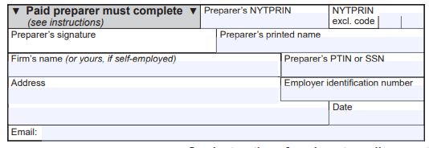
Volunteer Tax Preparer Signature
Tax returns will include the site name and exclusion code 09 (volunteer tax preparer)
Notes:
While tax return preparers that filed returns for more than 10 different taxpayers during the year fall under the E-file mandate, volunteer preparers are not subject to the e-filing mandate. You should make sure to use the 09 - volunteer tax preparer code in your program.

Slide 84
Driver License Information Required
ID information is used to protect taxpayers from fraud and identity theft.
The document number for the primary taxpayer and spouse are required.
Only the first three characters of the document number (Doc #) are required.
If the taxpayer won’t disclose their ID information:
You may check the box to indicate the taxpayer does not have an ID.
You must document you used due diligence to obtain the information and the taxpayer refused.
Notes:
Drivers license ID information is used to protect taxpayers from fraud and identity theft. The document number for the primary taxpayer and spouse are required. Only the first three characters of the document number are required. If the taxpayer won’t disclose their ID information, you may check the box to indicate the taxpayer does not have an ID; and you must document you used due diligence to obtain the information and the taxpayer refused.

Slide 85
New York State and Local Sales Tax
New York State sales tax is owed if the taxpayer purchased property or a service delivered to them in New York State without payment of sales and use tax.
This includes purchases through the internet, by catalog, or from shopping channels on the television.
Most tangible personal property is subject to tax.
Do not leave the line blank.
Do not set software to auto fill with zero amount.
Notes:
You must ask taxpayers if they have any sales tax owed. New York State sales tax is owed if the taxpayer purchased property or a service delivered to them in New York State without payment of sales and use tax. This includes purchases through the internet, by catalog, or from shopping channels on the television. Most tangible personal property is subject to tax. Do not leave the line blank. Do not set software to auto fill with zero amount.

Slide 86
Refund Allocation to NY- 529 Accounts
Form IT-195, Allocation of Refund
Allows taxpayers to allocate all or a portion of their refund into up to three New York State 529 College Savings Plan accounts.
If refund claim is reduced or denied, the disbursements to the NYS-529 will not be processed.
Notes:
Towards the end of the return filing there will be questions to see if taxpayers want to allocate all or a portion of their refund into up to three New York State 529 College Savings Plan accounts. This is for Form IT-195, Allocation of Refund. Please note that if a refund claim is reduced or denied, the disbursements to the NYS-529 will not be processed.

Slide 87
Other Reminders
Notes:
Now we want to cover a few other reminders for return filings.

Slide 88
Enter Date of Birth
Enter the date of birth if the form requires this information.
If not provided, taxpayers may not receive credit amounts they are entitled to based on age.
This can lead to adjusted refunds and refund denials.
Notes:
You should always enter the date of birth if a form requires the information. If not provided, taxpayers may not receive credit amounts they are entitled to based on age. This can lead to adjusted refunds and refund denials.

Slide 89
EITC Dependent Relationships
Relationship information added back to forms:
IT-215, Claim for Earned Income Credit, and
IT-209, Claim for Noncustodial Parent New York State Earned Income Credit.
Notes:
In addition, make sure to include relationship information. This information is included on forms IT-215, Claim for Earned Income Credit and IT-209, Claim for Noncustodial Parent New York State Earned Income Credit.

Slide 90
Amended Returns and Attachments
We treat an amended return as if it is an original return. All schedules and credit forms must be attached to the amended return.
All attachments for original or amended returns must be in PDF format.
Software should provide assistance.
Don’t password protect, encrypt, or in any way document-protect PDF attachments.
Notes:
With regard to attachments to returns:
They must be in PDF format.
Your Software should provide assistance on how to attach.
Don’t password protect, encrypt, or in any way document-protect PDF attachments.

Slide 91
Print All Worksheets
For both the federal and New York State returns, worksheets must be completed to support the information on a return.
A copy of the return should be printed and maintained for at least three years. It’s important that all worksheets be printed and kept with a copy of the return.
Taxpayers must maintain all documents that substantiate entries on a return. Worksheets are part of their supporting documentation.
Notes:
For both the federal and New York State returns, worksheets must be completed to support the information on a return. A copy of the return should be printed and maintained for at least three years. It’s important that all worksheets be printed and kept with a copy of the return. Taxpayers must maintain all documents that substantiate entries on a return. Worksheets are part of their supporting documentation.

Slide 92
Unreported Federal Changes
Taxpayers must file an amended New York State return to report any changes made to their federal return within 90 days of the federal change.
Even if the item of omission is not taxable to New York State, it should be included on an amended return since it could result in reductions to itemized deductions and credits.
If New York State issues a bill for unreported federal changes, an amended return should not be filed. Follow the instructions on the billing notice.
Notes:
It’s important to mention to your clients that Taxpayers must file an amended New York State return to report any changes made to their federal return within 90 days of the federal change. Even if the item of omission is not taxable to New York State, it should be included on an amended return since it could result in reductions to itemized deductions and credits. If New York State issues a bill for unreported federal changes, an amended return should not be filed. Follow the instructions on the billing notice instead.

Slide 93
Tax Department Programs and Initiatives
Notes:
Finally, let’s go over some key information on department programs and initiatives.

Slide 94
What Happens After You File?
95% of returns are accepted and processed with no issues.
Some filings require additional information.
Taxpayers have the right to dispute any Tax Department bill or notice they disagree with.
We encourage taxpayers to respond as soon as possible by following the printed instructions on the document, including the deadline for filing.

Slide 95
Common Notices Issued by the Tax Dpt:
DTF-948, Request for Information (RFI)
AU-346, Statement of Proposed Audit Change (SOPAC)
DTF-160, Account Adjustment Notice
DTF-170, Notice of Disallowance
DTF-962, Notice of Deficiency
DTF-963, Notice of Determination
DTF-966, Notice and Demand

Slide 96
Wage and Withholding Notices
Notices may be sent if wage and withholding information on the tax return is not consistent with the information the department received from an employer:
Employer may not have filed the wage and withholding form timely.
Taxpayers may have multiple jobs and the Tax Department may not have received information from all employers.
An error may have been made on the withholding information and/or on the tax return.
Fraud related activity may have occurred.
Notes:
Clients may have received notices related to wage and withholding information. The reason taxpayers may receive one of these notices are:
the wage and withholding information on the tax return may not be consistent with the information the department received from their employer;
the employer may not have filed the wage and withholding form timely;
the client has multiple jobs, and we didn’t receive information from all employers;
there is an error on the withholding information and/or on the tax return; or
its fraud related.

Slide 97
Disagree With A Bill Or Action
Taxpayers have the right to dispute any Tax Department bill or notice they disagree with.
It is important to follow the printed instructions on the document, including the deadline to respond.
Taxpayers can respond online through their Online Services account and use the Respond to Department Notice application
Common notices used to request additional information or support what was claimed on the return are:
Form DTF-948 or DTF-948-O, Request for Information (RFI)
Form DTF-160 or Form DTF-161, Account Adjustment Notice
Notes:
Taxpayers have the right to dispute any Tax Department bill or notice they disagree with.
It is important to follow the printed instructions on the document, including the deadline to respond.
Taxpayers can respond online through their Online Services account and use the Respond to Department Notice application
Common notices to request additional information or support what was claimed on the return are:
Form DTF-948 or DTF-948-O, Request for Information (RFI), which is used to request additional information.
Form DTF-160 or Form DTF-161, Account Adjustment Notice, which is used to explain a refund adjustment or denial.

Slide 98
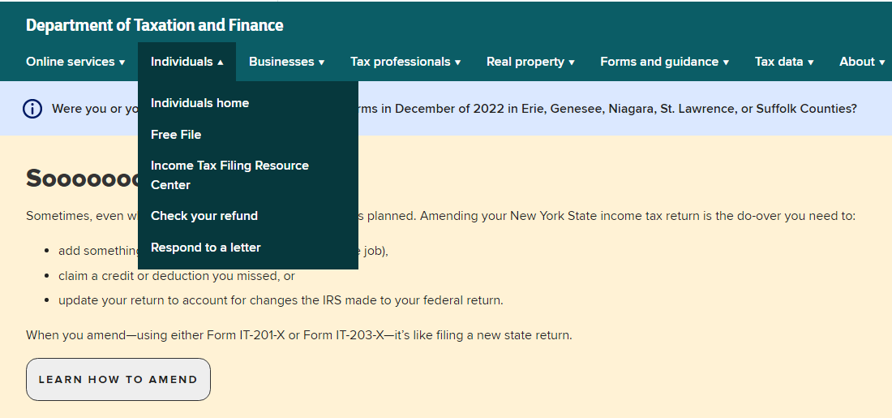
Respond To A Letter Requesting Additional Information
Notes:
Always advise taxpayers to respond to the department notices. The Tax Department has a webpage dedicated to assist taxpayers in responding to their notice. This page includes a list of the various notices that we send and checklist of the documentation and records that we need in a response.

Slide 99
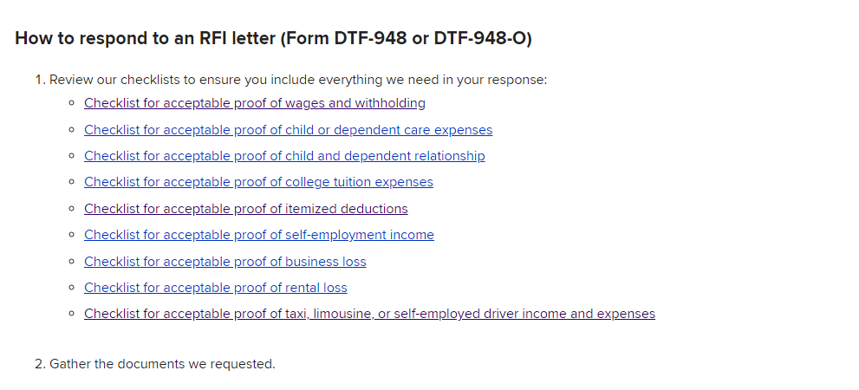
Respond To A Letter Requesting Additional Information
Notes:
This slide shows the various check lists for additional information that we request.

Slide 100
Protest A Department Notice
Certain Tax Department notices have protest rights where the taxpayer can challenge the notice in either of the following ways:
file a request for a conciliation conference (Form CMS-1), or
file a petition for a Tax Appeals hearing (Form TA-100).
A conciliation conference through the Bureau of Conciliation and Mediation Services (BCMS) is more timely and less expensive than a Division of Tax Appeals hearing.
Taxpayers initially file more than 98% of all protests as a request for a conciliation conference. Over 90% of these protests are resolved through this process.
Notes:
Certain Tax Department notices have protest rights where the taxpayer can challenge the notice in either of the following ways:
file a request for a conciliation conference (Form CMS-1), or
file a petition for a Tax Appeals hearing (Form TA-100).
A conciliation conference through the Bureau of Conciliation and Mediation Services (BCMS) is more timely and less expensive than a Division of Tax Appeals hearing. Tax Appeals is a more formal process before an administrative law judge who will make a determination in the case.
Taxpayers initially file more than 98% of all protests as a request for a conciliation conference. Over 90% of these protests are resolved through this process.

Slide 101
Protest Rights
The most common types of notices with protest rights are:
Notice of Determination (additional tax due)
Notice of Deficiency (additional tax due)
Notices are sent via certified mail to the last known address.
The protest date is 90 days from the mail date of the letter.
For more information, visit www.tax.ny.gov (search: protest).
Notes:
The most common types of notices with protest rights are:
Notice of Determination (additional tax due)
Notice of Deficiency (additional tax due)
Notices are sent via certified mail to the last known address, which is why it is important to verify the taxpayer’s address.
The protest date is 90 days from the mail date of the letter. This date cannot be extended.
For more information, visit www.tax.ny.gov (search: protest).

Slide 102
Identity Theft
Visit our website www.tax.ny.gov (search: Identity Theft)
Complete Form DTF-275, Identity Theft Declaration
Fax documents to: 518-435-2990 Attention: Identity Theft
Mail to: NYS Assessment Receivables
Attn: Identity Theft PO Box 4128 Binghamton, NY 13902-4128
Call 518-457-5181 for more information.
Notes:
Identity theft is a serious issue. If a taxpayer thinks their identity may have been compromised, they should:
Visit our website www.tax.ny.gov and search, “Identity Theft.” Complete Form DTF-275, Identity Theft Declaration.
Fax documents to: 518-435-2990 Attention: Identity Theft
Mail to: NYS Assessment Receivables
Attn: Identity Theft PO Box 4128 Binghamton, NY 13902-4128
Or Call 518-457-5181 for more information.

Slide 103
Identity Theft
Submit IRS Form 14039, Identity Theft Affidavit
Report to the Federal Trade Commission at www.identitytheft.gov
Contact credit bureau to place “fraud alert” on credit record
Equifax: 800-685-1111
Experian: 888-397-3742
TransUnion: 888-909-8872
Notes:
Some other recommendations for taxpayers are to:
Submit IRS Form 14039, Identity Theft Affidavit
Contact the Federal Trade Commission at www.identitytheft.gov
Contact credit bureau to place “fraud alert” on credit record
Equifax: 800-685-1111
Experian: 888-397-3742
TransUnion: 888-909-8872

Slide 104
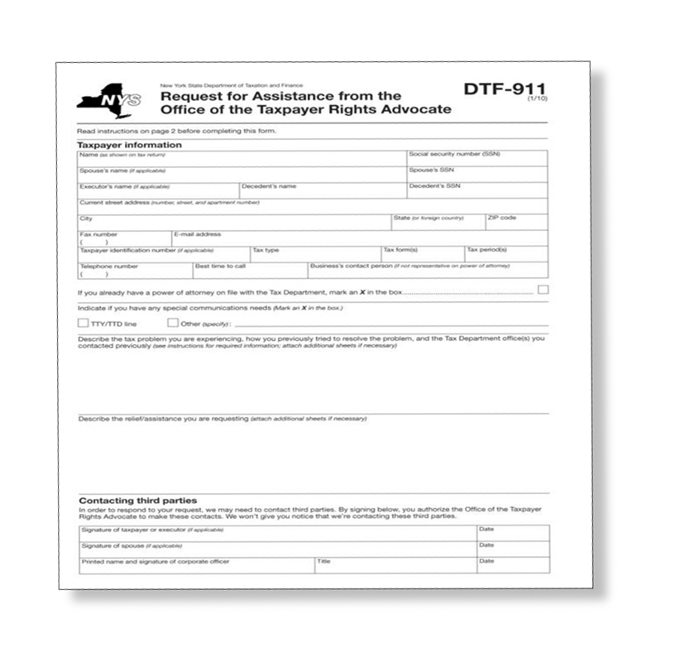
Office of the Taxpayer Rights Advocate
Provides free and independent tax problem assistance
Ensures that the taxpayer’s case is reviewed in a timely manner
Helps the taxpayer understand important notices and deadlines
Explains taxpayer rights and responsibilities under the law
Helps resolve long standing tax issues
Notes:
If a taxpayer has an issue that they have tried to resolve without success and feels they are not getting the help they need, the taxpayer can contact the Office of the Taxpayer Rights Advocate. The taxpayer can visit our website and search “Advocate.” They will need to complete form DTF-911 and an advocate will review the issue.
provides free and independent tax problem assistance;
ensures that the taxpayer’s case is reviewed in a timely manner;
helps the taxpayer understand important notices and deadlines;
explains taxpayer rights and responsibilities under the law; and
helps resolve long standing tax issues.

Slide 105
Individual Online Services Account
View filing and payment history
Manage estimated income tax payments.
Choose to receive bills, notices, and refund notifications electronically.
Pay bills and respond to notices, and
Eliminate phone calls and hold time.
Notes:
Please remind taxpayers that they can Get access to their tax information whenever they need it by using an individual online services account. Here they can:
View filing and payment history
Manage estimated income tax payments.
Choose to receive bills, notices, and refund notifications electronically.
Pay bills and respond to notices, and.
Eliminate phone calls and hold time.

Slide 106
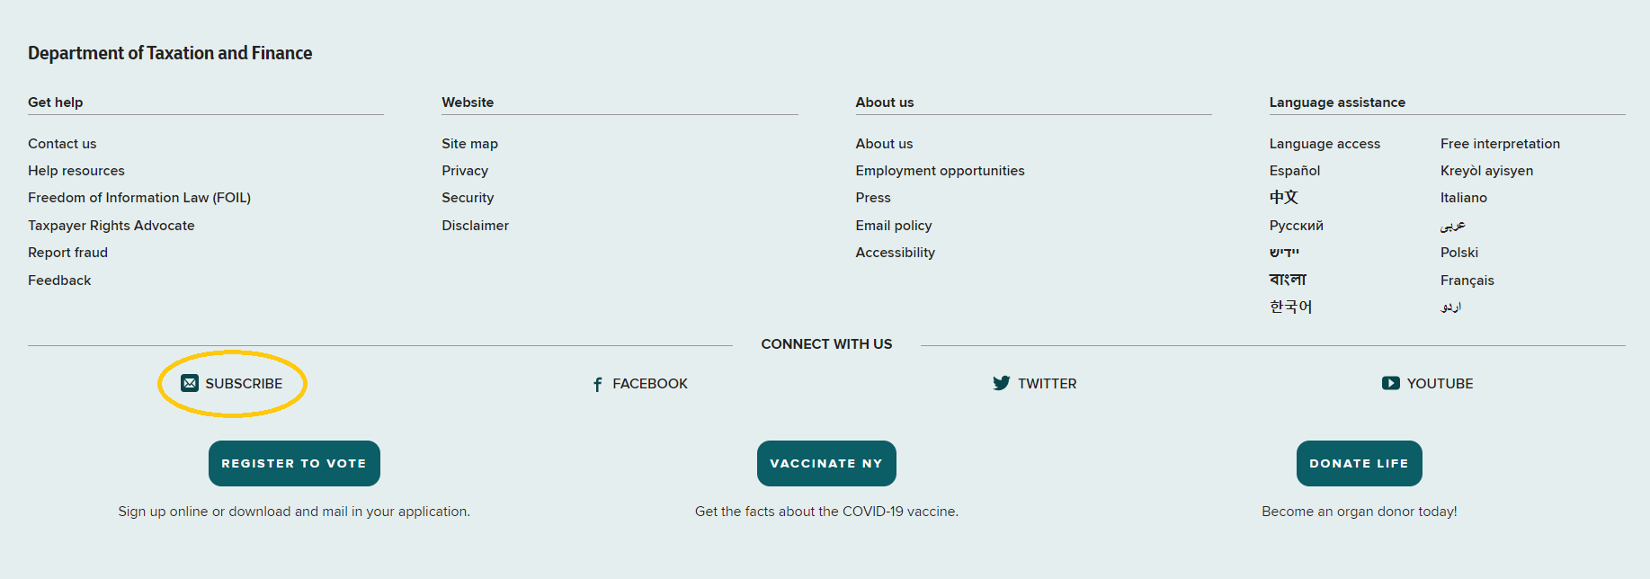
Tax Department Website (www.tax.ny.gov)
Notes:
We also want to remind you about our subscribe function at the bottom section of all our web pages.

Slide 107
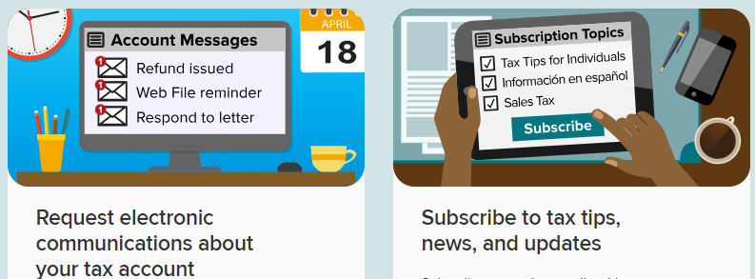
Subscription Services - Signing Up
Notes:
Can't get enough of Tax? Subscribe to receive emails with tax tips, news, and the latest guidance. Our subscription services allow you to sign up to automatically get notified when there is information you need to know. We have two main subscription services. One to sign up for email alerts and one to subscribe to tax news and updates.
This second option is the one that allows you to have notices, memorandums and other information sent to you as soon as it goes out!

Slide 108
Financial Education Program
The training is broken into seven modules to help taxpayers have a better understanding of taxes, credits and more.
One section focuses on self-employment resources, including a mileage log and tax deduction tracker!
A link is available on the volunteer page under the Find Resources for Taxpayers section.
Share it with the taxpayers you assist!
Notes:
Speaking of financial literacy, remember to tell your clients about our financial education program which can be found on our website. This program is broken into seven modules to help taxpayers have a better understanding of taxes, credits and much more. There is a whole section on self-employment resources including a mileage log and tax deduction tracker! We provided a Link for you on the Volunteer page under the Find Resources for Taxpayers section. Share it with the taxpayers you assist!

Slide 109
Efficiency
● Integrity
● Fairness
Notes:
We covered a lot with this training, I hope it will help you to help others with filing their 2021 tax returns. Thank you again for all that you do to help the taxpayers of the state of New York.

